Slide 1
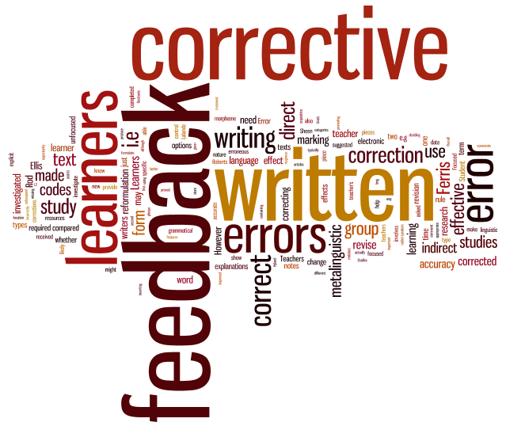
From Reflexivity to Learner Action Plans:
Strategies for Students to Get More out of Feedback
Dr Sandra López-Rocha
School of Modern Languages, University of Bristol

Slide 2
Giving feedback and acting on it
    1. Closing the gap
    2. Considerations
    3. How can we do it?

Slide 3
1. Closing the gap
Gap: Perceptions on the role of feedback
MacLellan, 2001
Minimal monitoring: Reception and use of feedback
Askew and Lodge, 2000;
Walker, 2009

Slide 4


Perceptions of feedback
Teachers
Students
Feedback = successful aiding student learning
Students will know what to do
Feedback does not...
  Promote discussion
  Help understanding assessment
  Improve learning
Burke, 2009; MacLellan 2001; Lillis and Turner, 2001

Slide 5
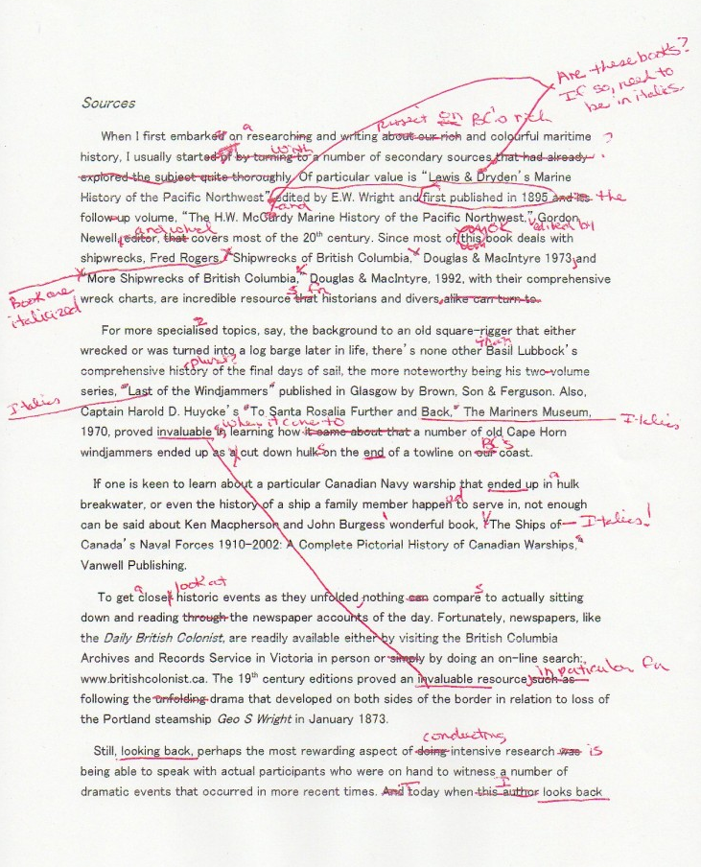
Feedback not satisfactory?
Too brief
Too detailed
Assumptions
Terminology
Limited range of lexis
Unconsolidated argument
!
Considerable backtracking
Inappropriate use of lexis still a major source of irritation
?
Red ink!

Slide 6
2. Considerations
Teachers
Students
“Pedagogic practice that needs to be restored”
Hounsell, 2007
Students – passive recipients of feedback
Act on feedback
Prepare, discuss
An objective academic assessment – FOR learning

Slide 7
What students want…
Right amount of information
Accessibility
Consistency
Prompt feedback
Constructive feedback
Non-judgemental
Exemplars
Burke 2007, 2009; Chanock, 2000
NUS – Feedback should be:
  For learning
  A continuous process
  Timely
  Related to clear criteria
  Constructive
  Legible and clear
  Provided on exams
  Self-assessment/PtoP
  Accessible to all students
  Flexible
Porter, 2009

Slide 8



Challenges
Time/class size
    Organise a feedback session during class time
    Peer-to-peer
    Combine FTF - WF
Form
    Oral
    Handouts
    Email
    Blog

Slide 9
3. How can we do it?
Situation:
You’ve just handed back a written assignment or your feedback comments on oral presentations.
Assume:
  Assess achievement of learning outcomes, explain basis for our comments and highlight key areas
  Balanced combination of marginal and end comments
  More facilitative (suggestions/questions) and less directive (commands)

Slide 10
a. Unpacking the comments
Feedback Effectively Form
University of Wolverhampton
What has your tutor written? | What do you understand this to mean?
Break feedback down into
Good points (note these down so you can do them again) | Areas for improvement (draw out the two main areas from feedback)

Slide 11
a. Unpacking the comments
What has your tutor written? | What do you understand this to mean?
You should incorporate more transitional words in order to create more cohesion | I understand this to mean that when I develop the argument I need to include more words like similarly, however, consequently, and therefore, so that the ideas are better connected and related to each other.

Slide 12
a. Unpacking the comments
Break feedback down into
Good points (note these down so you can do them again) | Areas for improvement (draw out the two main areas from feedback)
No mistakes in subjunctive clauses (yay!) Supporting information is relevant to the topic Very good incorporating field-specific/technical vocabulary | Sentence construction often follows an English structure Referencing style

Slide 13
a. Unpacking the comments
Competences
Conscious uncompetence
(what they know they cannot do)
Unconscious uncompetence
(what they don’t know yet they cannot do)
Conscious competence
(awareness of how well they completed the task)
Unconscious competence
(success in areas they didn’t know they could do well)
Race, 2001

Slide 14
b. Feedback tutorial
Synchronous
Face-to-face
Video conference
Asynchronous
Handout
Email
Screen capture and recording software
What do we focus on?
  Feedback they do/don’t understand
  Identify competences
  Develop an Action Plan
    Stage 1: Classify issues
      Major issues: e.g., further analysis
      Minor errors: e.g., punctuation
    Stage 2: Actions to take
      Review, explain, work with a peer
      Link to resources
      Follow up exercises
      Exemplars

Slide 15
c. Action Plan
Stage 1
Major issue |  | Minor errors
1. Referencing style 2. 3. |  | 1. Some accents missing 2. 3.
Stage 2
Issue | Tutor advice |  | Action to be taken
Referencing style | To correctly incorporate citations following the Harvard Style |  | Review guidelines in style manual; see examples in http://www.ntu.ac.uk/llr/document_uploads/66061.pdf

Slide 16
Other ways to engage students with feedback
Reflexivity
eTutoring
  Synchronic
    Live stream – Skype
    Discuss and act
  Asynchronic
    Dialogic feedback
Oral production Feedback
    Recording
    Mixed media feedback

Slide 17
Conclusion
In order for students to get more out of feedback
Change the way feedback is perceived
Provide effective feedback
Incorporate strategies and forms of delivery
Create the conditions for students to act on it
Positive impact on learning and teaching

Slide 18
References
Askew, S. & Lodge, C. (2000). Gifts, ping-pongs and loops – linking feedback and learning, in S. Askew (ed.) Feedback for learning. London: Routledge.
Brannon, L., & Knoblauch, C. H. (1982). On students’ rights to their own texts: A model of teacher response. College Composition and Communication, 33(2): 157-66.
Burke, D. (2007). Engaging students in personal development planning: Profiles, skills development and acting on feedback. Discourse: Learning and Teaching in Philosophical and Religious Studies, 6(2): 107-42.
Burke, D. (2009). Strategies for using feedback that students bring to their degree course: An analysis of first year perceptions at the start of a course in Humanities. Assessment and Evaluation in Higher Education, 34(1): 41-50.
Burke, D., & Pietrick, J. (2010). Giving students effective written feedback. London: McGraw-Hill.
Chanock, K. (2000). Comments on essays: Do students understand what tutors write? Teaching in Higher Education, 5(1): 95-105.
Haines, C. (2004). Assessing students’ written work: Marking essays and reports. London: Routledge.
Hounsell, D. (2007). Towards more sustainable feedback to students, in D. Boud & N. Falichov (eds.) Rethinking assessment in higher education. Abingdon: Routledge.
Lillis, T., & Turner, J. (2001). Student writing in higher education: Contemporary confusion traditional concerns. Teaching in Higher Education, 6(1): 57-68.
MacLellan, E. (2001). Assessment for learning: The differing perceptions of tutors and students. Assessment and Evaluation in Higher Education, 26(4): 307-18.
Nicolson, M., Murphy L., & Southgate, M. (eds) (2011). Language teaching in blended contexts. Edinburgh: Dunedin.
Porter, A. (2009). NUS – Working to improve assessment feedback. HE Focus: The Great NUS Feedback Amnesty, 1(1): 1. London: National Union of Students.
Race, P. (2001). Using feedback to help students learn. York: Higher Education Academy.
Sprinkle, R. S. (2004). Written commentary: A systematic, theory-based approach to response. Teaching English in the Two-Year College, 31(2): 273-86.
Walker, M. (2009). An investigation into written comments on assignments: Do students find them usable? Assessment and Evaluation in Higher Education, 31(3): 370-94.

