Slide 1
TEACHING WRITTEN FRENCH: REFLECTIONS ON COURSE DESIGN AND FEEDBACK
Isabelle Baron, Lancaster University

Slide 2
Formative feedback is assessment for learning
Summative assessment is assessment of learning
^{1]}

Slide 3
linguistic components
methodological requirements
textual analysis

Slide 4
[
Linguistic components
Writing as a transferable study skill
Goals and outcomes
Surface approach vs deep approach
^{[1]}.

Slide 5
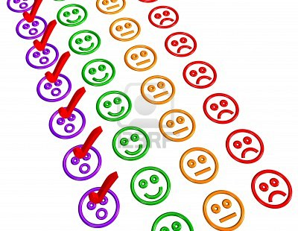
Selected activities

Slide 6
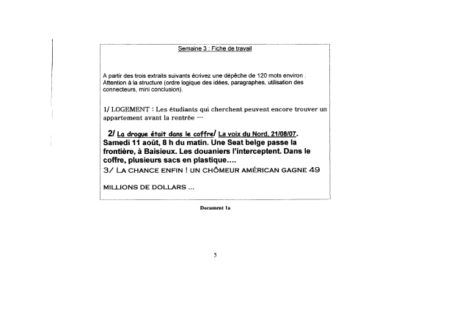

Slide 7
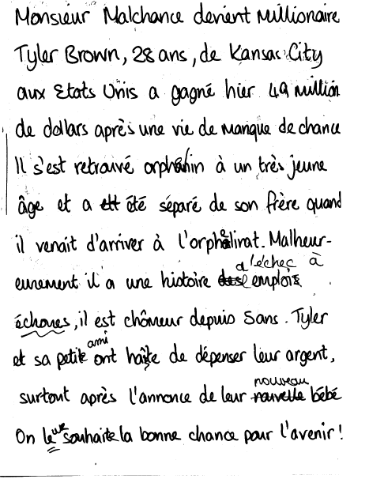

Slide 8
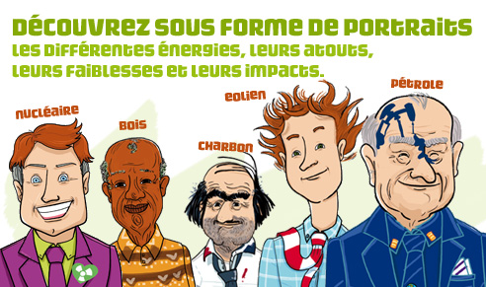

Slide 9
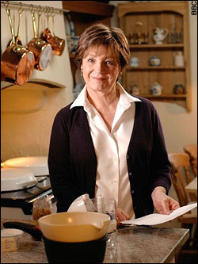
Delia's tins and tubs divide and conquer
Delia Smith is said to have expected a backlash to her new BBC cooking show
By Harry Wallop, Consumer Affairs Correspondent 12:01AM GMT 12 Mar 2008

Slide 10
 | FiFirst, take your frozen mash... Accompanied by accusations of hypocrisy, betrayal and cynicism, Delia Smith's latest bestseller, How to Cheat at Cooking, has caused quite a stir. But can tinned mince, frozen aubergine and canned onions ever be a good idea? Jon Henley invites sceptical but curious chef Aldo Zilli to rustle up five of Delia's new dishes, while our panel of six food experts addresses the all-important question: what do they taste like? guardian.co.uk, Friday 14 March 2008 10.45 GMT

Slide 11
Concrete experience
Students’ reactions, issues of classroom management group dynamics and timing with regards to feedback

Slide 12
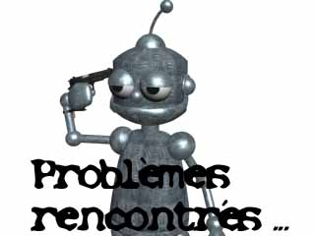

Slide 13
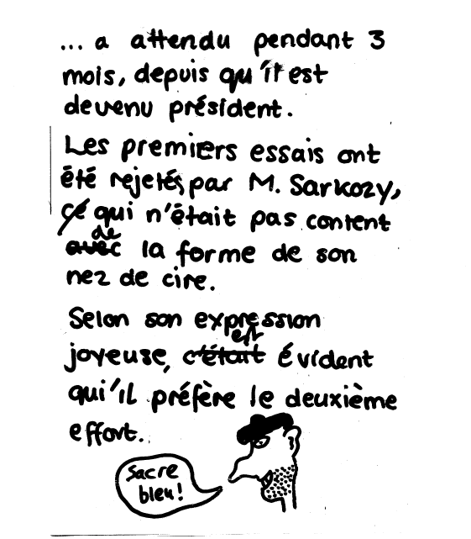

Slide 14
Ecrivez une réaction ou un avis sur les objectifs de la foundation Nicholas Hulot en exprimant les sentiments / situations données
incertitude peur
nécessité condition
restriction but
temps doute
souhait
sentiment (tristesse, déception, etc…)

Slide 15
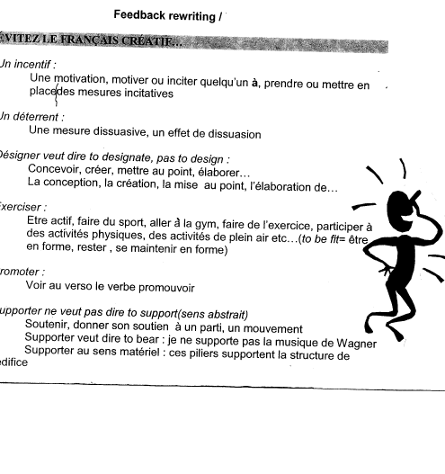

Slide 16
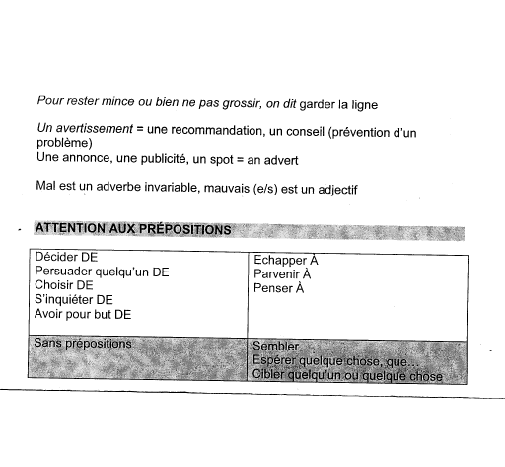

Slide 17
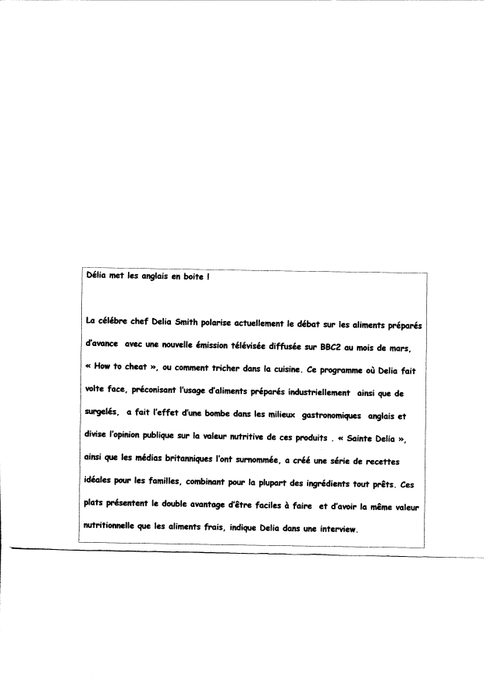

Slide 18
Goals
interaction
motivation

Slide 20
there must be a task at the heart of the activity […] defined in such way as to specify the topic, the purpose and the audience. Furthermore, the teacher needs to be aware of the language that the students need to have at their command in order to perform the task
TOMLINSON & TOWELL, 84-85 (2002)

Slide 21
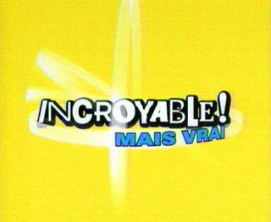
time spent on corrections is harmful to students writers .
J.Truscott (1996)

Slide 22
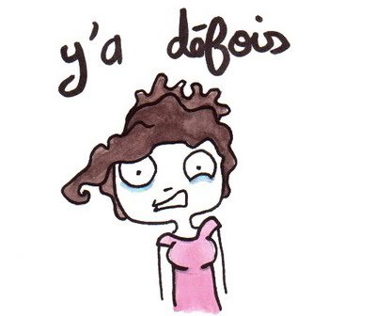
when students feel that they no longer need to learn…. | treatable and untreatable errors FERRIS (2006)

Slide 24
This questionnaire is designed to assess if and how feedback / corrections influence your subsequent assessable work, marked and unmarked.
Please tick the boxes by level of usefulness / probability of you taking action in relation to your future work following that feedback

Slide 25
This questionnaire is designed to assess if and how feedback / corrections influence students’ subsequent assessable work. Please tick the boxes according to the probability of students taking action in relation to their future work following that feedback1 = not particularly likely to 5 = extremely likely

Slide 26
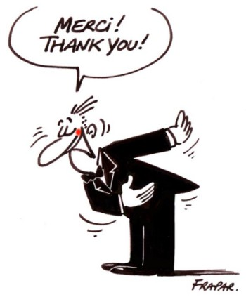
Isabelle Baron, Lancaster, 2012

