Slide 1


Is Japan more equal than the UK?
IPSS, Tokyo, 6/1/2012
Danny Dorling
Department of Geography
University of Sheffield
E-mail: danny.dorling@sheffield.ac.uk

Slide 2
Acknowledgements
The research presented here is based on joint work with Dimitris Ballas (University of Sheffield), Helena Tunstall (University of York), Tomoki, Nakaya, Kazumasa Hanaoka and Tomoya Hanibuchi (Ritsumeikan University) which was supported by a Daiwa Anglo-Japanese Foundation small grant (8006/8599).
The Family Resources Survey and Household Below Average Income microdata were made available through the UK Data Archive.
The National Survey of Family Income and Expenditure microdata were made available through the Japanese Statistics Bureau.
The Japanese General Social Surveys (JGSS) are designed and carried out at the Institute of Regional Studies at Osaka University of Commerce in collaboration with the Institute of Social Science at the University of Tokyo under the direction of Ichiro TANIOKA, Michio NITTA, Hiroki SATO and Noriko IWAI with Project Manager, Minae OSAWA. The project is financially assisted by Gakujutsu Frontier Grant from the Japanese Ministry of Education, Culture, Sports, Science and Technology for 1999-2003 academic years, and the datasets are compiled and distributed by SSJ Data Archive, Information Center for Social Science Research on Japan, Institute of Social Science, University of Tokyo.

Slide 3
Outline
The Spirit Level hypothesis
Why compare Britain and Japan?
Social cohesion, income inequalities and well-being in Britain and Japan
Income inequality and poverty in Britain and Japan 1989 – 2009

Slide 4

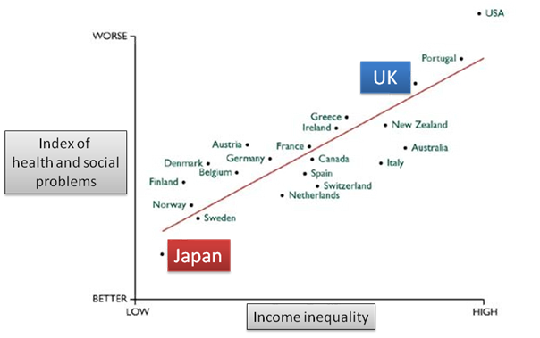
‘The Spirit Level’
by Richard Wilkinson and Kate Pickett
http://www.equalitytrust.org.uk
Notes:
“The Spirit Level” hypothesis suggests that the relationship between income distribution and well-being is mediated through psychosocial pathways by the impacts of economic structure upon social relationships. In this model lower income inequality is seen to result in societies with more cohesion, greater trust and cooperation and lower social stress

Slide 5
‘The Spirit Level’
by Richard Wilkinson and Kate Pickett
“Politics was once seen as a way of improving people’s social and emotional well-being by changing their economic circumstances. But over the last few decades the bigger picture has been lost. People are now more likely to see psychosocial well-being as dependent on what can be done at the individual level, using cognitive behavioural therapy – one person at a time – or on providing support in early childhood, or on the reassertion of religious or family values. However, it is now clear that income distribution provides policy makers with a way of improving the psychosocial wellbeing of whole populations. Politicians have an opportunity to do genuine good.”
(Wilkinson and Pickett, 2009: 233; my emphasis)
(p.s. Thanks to Dimitris Ballas for these early slides!)

Slide 6
Why compare Britain and Japan?
Japan is a world leader in health with currently the highest life expectancy of any country (United Nations, 2011). Life expectancy in Japan first overtook that in other countries in the 1970s and has retained this ranking ever since. In addition, according to a recent study comparing self-rated health and socio-economic status in East Asia, Japan has relatively low levels of health inequality (Hannibuchi et al., 2010).
Britain, in contrast, has a place near the bottom of the life expectancy rankings in comparison to other industrialised countries (Marmot & Davey Smith, 1989).

Slide 7
Why compare Britain and Japan?
Japan and Britain have, in different ways, been at the centre of recent international academic and political debate regarding health and social equality and wellbeing in industrialised countries.
Comparisons of Japan and Britain are pertinent to these recent debates because of their marked differences in death rates and (apparently) social inequality.
These differences are of particular interest because of the characteristics that these countries have in common: both are high income, island nations, dominated by world cities whose populations benefit from (different types of) universal health care.

Slide 8
However, there is a catch
According to the OECD, (2011a), Japan ranks 22nd out of 31 OECD member states (in ascending order) in terms of income inequality (Gini coefficient), whereas the UK ranks 26th. ranks Japan 24th and the UK 28th in ascending order in terms of income inequality out of 34 OECD member states (OECD, 2011b: page 67). The most recent OECD report (OECD, 2011c) ranks Japan 21st and UK 25th out of 29 OECD member states.

Slide 9
The Catch is based on one source
OECD, 2011a, Social Justice in the OECD–How Do the Member States Compare? Sustainable Governance Indicators 2011, Bertelsmann Stiftung, Gütersloh, Germany
OECD, 2011b, Society at a Glance 2011 - OECD Social Indicators (www.oecd.org/els/social/indicators/SAG)
OECD, 2011c, Divided We Stand: Why Inequality Keeps Rising, OECD Publishing. http://dx.doi.org/10.1787/9789
OECD, 2011d, Metadata on OECD database on income distribution and poverty, http://www.oecd.org/dataoecd/52/30/49147697.pdf
The Japanese Comprehensive Survey of Living Conditions
Is the underlying source (6773 households in 2009). It is apparently not available as micro-data for replication.

Slide 10
Research agenda
revisiting the “Spirit Level” evidence according to which Japan is a more equitable and hence harmonious society than any other industrialised country, focusing on contrasts with a country such as Britain.
comparing social and spatial inequalities, social cohesion and well-being between Britain and Japan at different geographical levels.

Slide 11
Social cohesion, income inequalities, health and well-being in Britain and Japan
The distribution of income in Japan has often been discussed as a possible explanation for high life expectancy since the 1980s (Marmot and Davey Smith, 1989) and has formed the centre of much recent debate following the publication of “The Spirit Level”.
Before World War Two Japan had a highly unequal income distribution but the differences between rich and poor declined in the post war period (Tachibanki, 2005).
Income inequality was lower in Japan than in other industrialised countries in the 1970s and 1980s (Buss et al, 1989; Baur and Mason, 1992).

Slide 12
Social cohesion, income inequalities, health and well-being in Britain and Japan
But, social relationships and culture are often seen as direct causes of good health rather than mediating factors linking income distribution to health outcomes.
Cultural tradition of strong ‘group-orientation’ (it is often claimed) promotes social cohesion and ‘cultural equality’, supporting psychological well being and good health among Japanese people (Marmot and Davey Smith, 1989; Horiuchi, 2011).
It has not been explained however why the suggested health benefits of these Japanese cultural traditions should have only have become evident in the post war period.

Slide 13
Social cohesion, income inequalities, health and well-being in Britain and Japan
“Britain is an unequal country, more so than many other industrial countries and more so than a generation ago. This is manifest in many ways – most obviously in the gap between those who are well off and those who are less well off. But inequalities in people’s economic positions are also related to their characteristics – whether they are men or women, their ages, ethnic backgrounds, and so on”
(Hills et al., 2010)

Slide 14
Data
The Family Resources Survey and Household Below Average Income (made available through the UK Data Archive).
The National Survey of Family Income and Expenditure microdata (made available through the Japanese Statistics Bureau).

Slide 15
Key terms (1)
The median quintile ratio: this is the median income of the richest 20 percent of the population divided by the median income of the poorest 20 percent. This ratio is also known as the ratio of top to bottom quintile medians and is widely used in the analyses of HBAI datasets conducted by the DWP.
The mean quintile ratio: this is the mean income of the richest 20 percent of the population divided by the mean income of the poorest 20 percent. This is also known as the ratio of top quintile share to bottom quintile share and it was the key measure used in the Spirit Level work (Wilkinson and Pickett, 2009)

Slide 16
Key terms (2)
People on incomes less than 50% of the median gross household income: the number of individuals living on household incomes less than 50% the median gross household income as a proportion of the total population.
People on incomes less than 60% of the median gross household income: the number of individuals living on household incomes less than 60% the median gross household income as a proportion of the total population.

Slide 17
Comparing gross household income quintile ratios between Britain and Japan.
Inequality measure/ Year | 1994 | 1999 | 2004
Median quintile ratio in Japan | 3.85 | 4.08 | 3.99
Median quintile ratio in the UK | 5.09 | 5.23 | 4.99
Difference | 1.24 | 1.15 | 1.00
Mean quintile ratio in Japan | 4.56 | 4.74 | 4.67
Mean quintile ratio in the UK | 6.65 | 7.13 | 6.93
Difference | 2.09 | 2.39 | 2.26

Slide 18
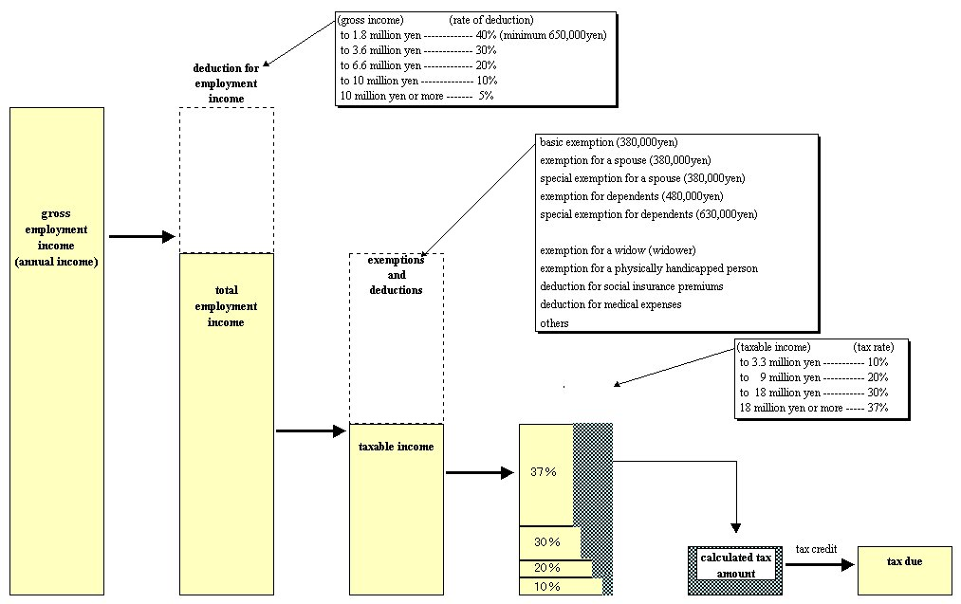
Calculating disposable income for Japan

Slide 19
Estimated quintile group annual disposable income in Japan (in 10,000s Japanese Yen; Source: calculated by applying tax bands on National Survey of Family Income and Expenditure )
 | Quintile group medians |  |  |  |  |  | Median quintile ratio
Year | 1 | 2 | 3 | 4 | 5* | Population mean*
2004 | 191 | 287 | 365 | 463 | 655 | 401 | 3.42
 | Quintile group means |  |  |  |  |  | Mean quintile ratio
Year | 1 | 2 | 3 | 4 | 5* | Population mean*
2004 | 179 | 286 | 365 | 465 | 712 | 401 | 3.97
* incomes over 2,500 were top-coded

Slide 20
Quintile group annual disposable income in Britain
(GBP; source: Family Resources Survey/HBAI)
 | Quintile group medians |  |  |  |  |  |  | Median quintile ratio
Year | 1 | 2 | 3 (median) | 4 | 5 |  | Population mean
Income Before Housing Costs
2008/09 | 201 | 304 | 407 | 545 | 844 | 507 |  | 4.20
2004/05 | 177 | 262 | 350 | 465 | 704 | 426 |  | 3.98
Income After Housing Costs
2008/09 | 139 | 243 | 343 | 474 | 745 | 433 |  | 5.4
2004/05 | 132 | 217 | 300 | 405 | 630 | 370 |  | 4.8
 | Quintile group means |  |  |  |  |  | Median quintile ratio
Year | 1 | 2 | 3 | 4 | 5 | Population mean
Income Before Housing Costs
2008/09 | 180 | 304 | 409 | 550 | 1090 | 507 | 6.05
2004/05 | 161 | 262 | 350 | 468 | 890 | 426 | 5.53
Income After Housing Costs
2008/09 | 110 | 243 | 344 | 478 | 988 | 433 | 9.0
2004/05 | 110 | 217 | 301 | 409 | 811 | 370 | 7.3

Slide 21
Estimated poverty rates in Japan using two measures which ignore the rich (based on gross income data from the Japanese National Survey of Family Income and Expenditure)
 | 50% below median | 60% below median
2004 | 10.3 | 16.4
1999 | 10.8 | 17.0
1994 | 10.2 | 16.3
1989 | 6.4 | 10.1
Estimated poverty rates in Britain using two measures which ignore the rich (based on gross income data from the UK Family Resources Survey)
 | 50% below median | 60% below median
2008/09 | 14.2 | 21.8
2004/05 | 14.0 | 22.2
1999/00 | 16.2 | 24.7
1994/95 | 15.5 | 24.9

Slide 22
Income distributions in UK and Japan, 2004

Slide 23
Why might this matter? Happiness, respect and social comparisons
“A house may be large or small; as long as the surrounding houses are equally small it satisfies all social demands for a dwelling. But if a palace arises beside the little house, the little house shrinks to a hovel… [and]… the dweller will feel more and more uncomfortable, dissatisfied and cramped within its four walls.”
(Marx, 1847)

Slide 24
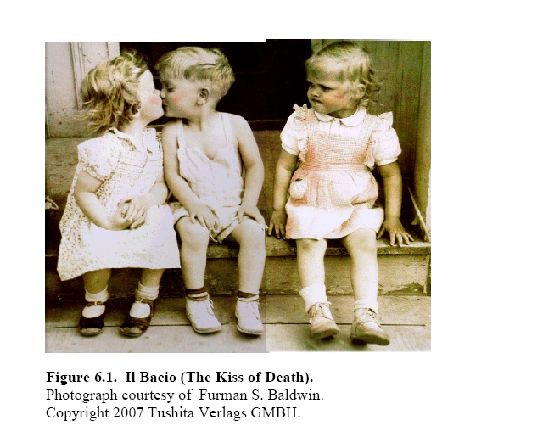
(source: Frank, 2005)

Slide 25
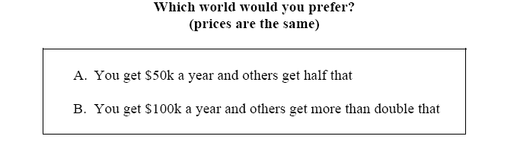
Positional and non positional goods

Slide 26
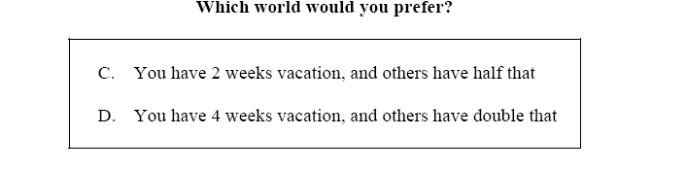
Positional and non positional goods

Slide 27
Positional and non-positional goods (Hirsch, 1976)
Positional goods: goods for which the link between context and evaluation is strongest.
Non-positional goods: goods for which the link between social (and spatial) context is weakest.

Slide 28
Relative consumption and “positional arms races” (Frank, 2005)
People care about relative consumption, more in some domains than in others.
2. Concerns about relative consumption lead to “positional arms races,” or expenditure arms races focused on positional goods.
3. Positional arms races divert resources from non-positional goods, causing large welfare losses.
4. In Britain recently housing costs were taking up to half of incomer and were half of ‘wealth’.

Slide 29
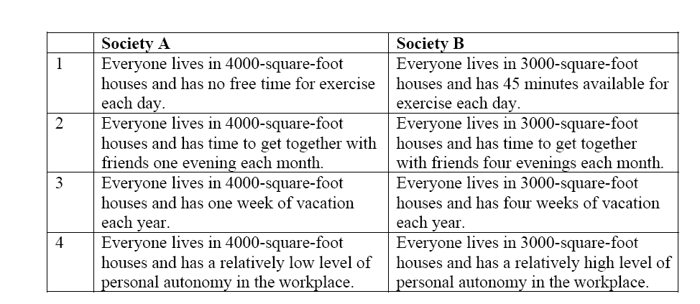
Choosing between different forms of consumption
(Frank, 2005)

Slide 30
Smart for one, dumb for all
“The list of consumption items that get short shrift could be extended considerably. Thus we could ask whether living in slightly smaller houses would be a reasonable price to pay for higher air quality, for more urban parkland, for cleaner drinking water, for a reduction in violent crime, or for medical research that would reduce premature death. And in each case the answer would be the same as in the cases we have considered thus far.”
(Frank, 2005: 100 Dimitris’ emphasis)

