Slide 1



Co-production - detecting opportunities and realising them with people in all strands
Bernd Sass / Disability Rights UK

Slide 2
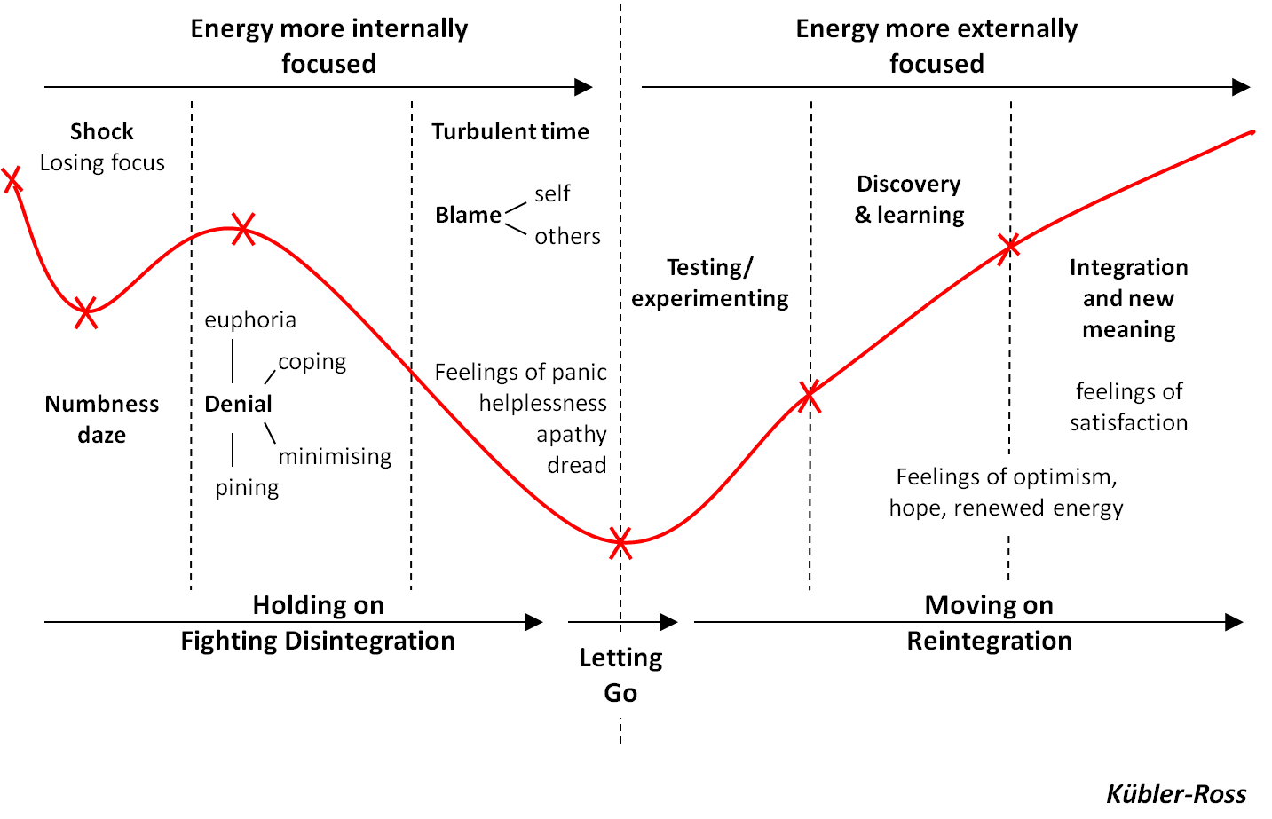
The ‘Change Curve’

Slide 3
Picking up from change curve
Why did disabled people or disability largely not feature in presentations or whole workshop on change management??
Disabled people are experts in mastering crisis (eg diagnosis point, fluctuating conditions) and managing change (everyday)
Most people would be very happy to pass on insights from what they have been through to peers or even to whole systems
Peer support is popular in some areas but largely used as a cheap means to promote and ‘showcase’ self-management (to discharge individual people) (wave 1) = change targets
Little understanding of peer support as a key rights-based element of co-production to improve whole systems (wave 2) = change agents/sponsors
So how to invest in a true co-production journey?

Slide 4
It’s all been done: what matters to patients and disabled people
Why not simply translate those global findings into metrics?
  Staying well (prevention, health promotion, self-care)
  Getting better, feeling better (outcomes of care)
  Right care from the right people (clinical quality, safety)
  Treated as a human being (humanity of care)
  Information, communication and having a say (involvement)
  Being supported (incl. support for carers and relatives)
  Safe, clean, comfortable place to be (environment of care)
  Right treatment at the right time (timely access)
  Right treatment in the right place (physical access)
  Not being passed from pillar to post (continuity of care)
  Continuous care (after-care)
  Support for independence (self-care) Life stock – not jargon!

Slide 5
Setting the scene: co-producing but not scratching at the surface
Ask people directly ‘What makes you feel better?’ and ‘what role can I (as professional or peer) play in this?’ ‘And how can we make sure that this happens?’ But this is not enough!
‘PAM’ - people need to drive care, support and treatment so resources can be tied in with improved community support
Co-production does NOT require new resources but different ways of working and releasing time

Slide 6
Some arguments...
People follow their own pathways but these are complex!
Commissioning plans need to encourage and pick up on whole life context rather than setting it - holistic pathways
If empowered, people will tap more into their own support networks (and those of their peers) while opting for less intensive care, support and treatment
Such collective spaces plug the gap between choice and ‘wider determinants’ (of health inequalities)
Win-win situations: gains in Quality of Life / Independent Living, service coordination, productivity, inclusive communities

Slide 7
Co-producing new landscape of services and support (1)
ESRC funded research with University of Bristol: ‘Tackling Disabling Practices: co-production and change’
- how do social practices get stuck? (tipping points?)
- what ideas about social practices will be useful in under-standing how to change things (swapping roles – ‘time credits’, Wellness Recovery Action Plan - applied to frontline teams)
User-driven commissioning in strand 5:
tried and tested approach to gather and translate lived experience of people’s own pathways into experience and outcome measures for contracting

Slide 8
Co-producing new landscape of services and support (2)
Starting strand 5 –
Finding partner sites: which projects and initiatives (in whatever care area) can we build on to ensure patients and disabled people have the most reasonable chance for a significant impact on systems and processes?
Example: co-procurement of 5-year CAMHS contract –
upfront commitment to pass on 20% stake!

Slide 9
User-driven commissioning – based on previous example
Co-facilitated group of children & YP with mental health problems (and carers) over 14 sessions in 8 months
Shared life stories, mapping out risk and protective factors in feeling good - also taking into account peers as (peer) advocates
Setting out vision for landscape of ideal services and paid (peer) support delivered at crucial ‘pathway’ points – step up/down
Next, the group would take specific focus, for example on:
a) experience and outcome measures – eg borrowing £5
b) procurement within commissioning cycle

Slide 10
Final remarks and questions
What opportunities for co-production in your own strand spring to mind?
What tips, tricks and pitfalls but also win-wins do you see?
How can you overcome threats and create real opportunities?
How can you make sure to follow through true co-production:
Listening – valuing – investing in people’s lived experience
to improve whole systems?
contact: bernd.sass@disabilityrightsuk.org

