Slide 1
Addressing Sexual Violence Against Refugee Women
A Project funded by the Rights, Equality and Citizenship (REC) Programme of the European Union
[European Commission DG Justice JUST/2015/RDAP/AG/VICT/9328]
and implemented by:
Fondazione di Ricerca Istituto Carlo Cattaneo – Bologna, Italy
Associazione Mondo Donna – Bologna, Italy
Centro Antigona, Universitat Autonoma de Barcelona – Barcelona, Spain
Centre for Gender and Violence Research, University of Bristol – Bristol, United Kingdom
Symbiosis – Thessaloniki, Greece
Bristol, 14 December 2017

Slide 2
2016
65.6 million individuals forcibly displaced worldwide (+ 300,000). 51% are children below 18 years.
22.5 million refugees
UN – 2016

Slide 3
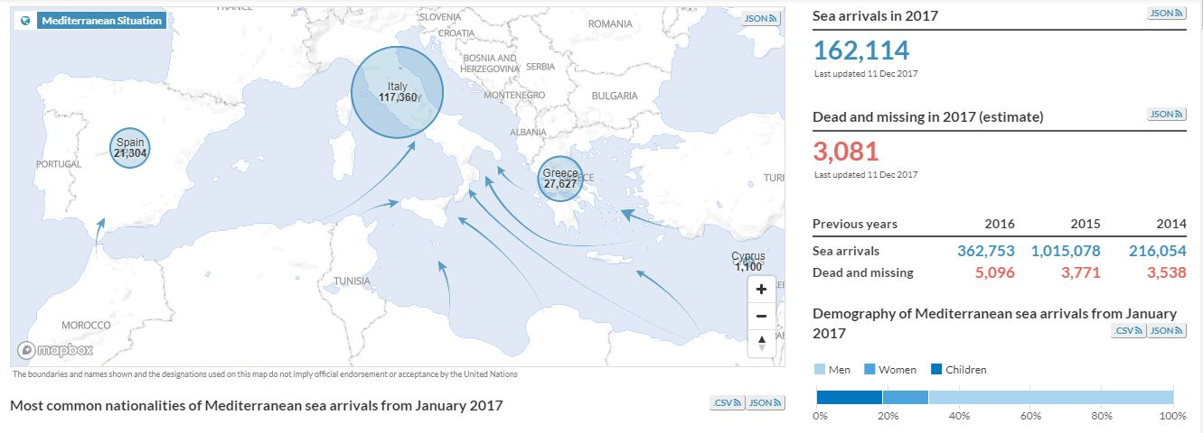
2016
1.2 million asylum seekers in Europe
According to Frontex, some 500,000 people irregularly entered EU territory
UNHCR, Operational portal. Mediterranean situation, http://data2.unhcr.org/
Women 12.8 % Children 18.6 % Men 68.6 %

Slide 4
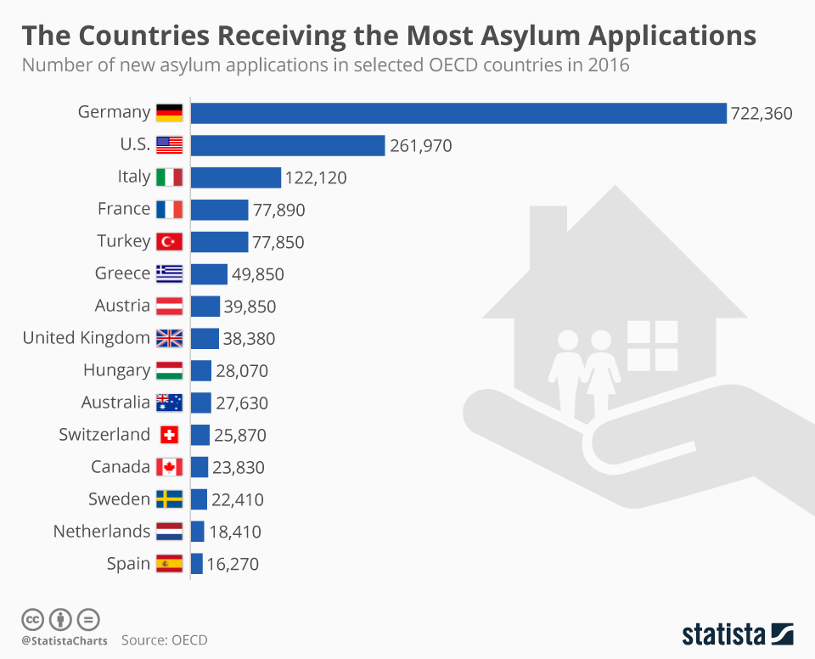

Slide 5
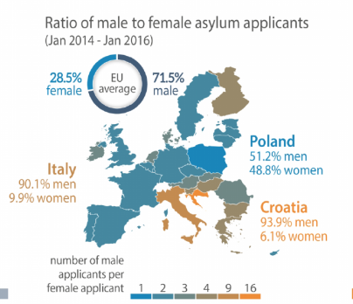
Refugee women
Most of them have suffered extreme and multiple violence such as sexual abuse, rapes, tortures, incarceration.
SGBV is both a reason for leaving the countries of origin and first asylum and a reality along the refugee and migration route, at first arrival, during the stay in the host country.
Concerns about high rates of women that may have been trafficked for sexual exploitation or that are in danger to be recruited in Europe by criminal organizations.
IOM : about 80% of Nigerian women arrived in Europe are potential victims of trafficking or forced prostitution.
European Parliamentary Research Service Blog

Slide 6
UNHCR, UNFPA e WRC “Initial Assessment Report: Protection Risks for Women and Girls in the European Refugee and Migrant Crisis” - 2016
  Establish a coordinated response system within and across borders that protects women and girls;
  Acknowledge the protection risks and put personnel and procedures in place specifically to prevent, identify, and respond to SGBV;
  Ensure response to SGBV that recognizes women will not stop to report SGBV or access services;
  Provide legal pathways to protection, especially for women, children and SGBV survivors, including effective family reunification and prioritization of these refugees with specific needs in relocation and resettlement opportunities.

Slide 7
ASVARW objectives
Building the capacity of the professional staff that works in reception centres / services / facilities to detect, treat, prevent violence against refugee and asylum seeker women
Empowering the victims of violence, coherently with the approach which relies on women themselves to overcome violence and its consequences on life, self-esteem and health.
Raising awareness at community level
Impact
The skills gained by the professionals have a direct influence on women themselves, when – and if – they are willing to be helped in overcoming violent relationships, sexual threats and abuses.
The overall net of reception and care services is more adequate to face SGBV against RAS women

Slide 8
ASVARW activities
Training modules for key professionals who are the first contacts for the victims of violence.
  Target groups: social workers, psychologists and legal counsellors at reception and assistance centres; medical staff; police staff.
  Topics: institutional and legal aspects; social, anthropological and cultural issues; how to interact and manage individual talks so as to recognise and bring out evidence of sexual-violence offences; how to direct identified victims of sexual violence, whether to medical treatment, social treatment or psychological treatment.
Pilot action “Multi-disciplinary teams within the reception and assistance centres” (IT, UK)
  Setting-up teams that bring together different expertise and competencies and working jointly on the identification, recognition and treatment of violence.
Pilot action “Community Antennas” (IT)
  Refugee and asylum seeker women who have succeeded in overcoming violence are involved in the fight against sexual violence, on a voluntary basis and after a short training.
Awareness raising at the community level.
  Networking actions targeting policy makers, professionals and service providers not directly in contact with RAS women but actively involved in violence against women and managing migrants’ inflows.

