Slide 1

Susan Carter & Richard Sutch
University of California
Riverside and Berkeley
HSUS Millennial Edition Overview
Economic History Society
University of Durham

Slide 2
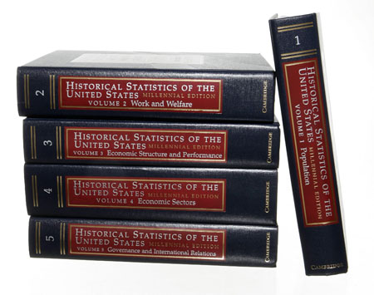
Lars Klove for the New York Times

Slide 3
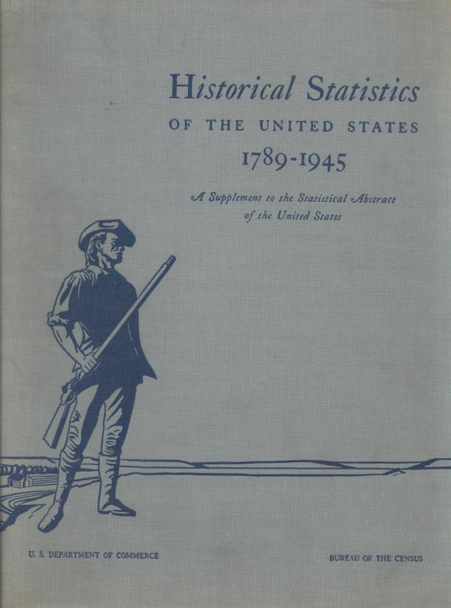
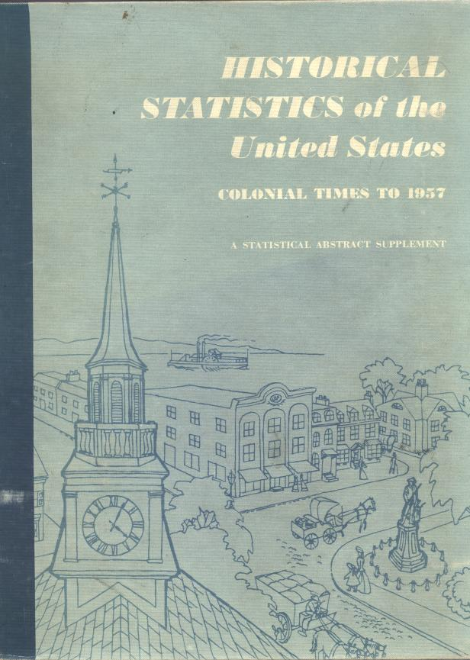
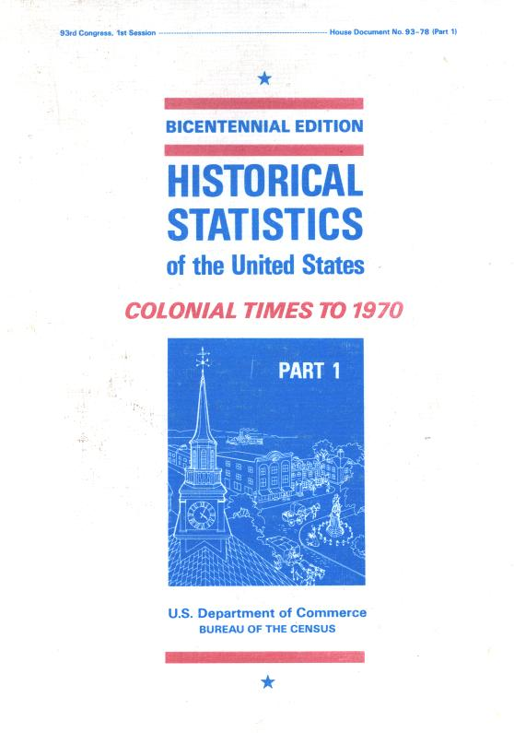
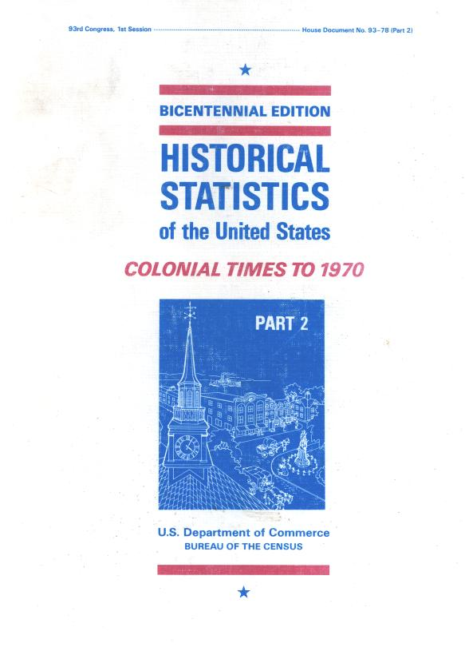


1949
1957
1975
2006

Slide 4
Electronic Edition

Slide 5
Millennial Edition
Editors in Chief
Susan Carter
Scott Gartner
Michael Haines
Alan Olmstead
Richard Sutch
Gavin Wright

Slide 6
Millennial Edition
Five Volumes
A. Population (777pages)
B. Work and Welfare (934 pages)
C. Economic Structure and Performance (831 pages)
D. Economic Sectors (1123 pages)
E. Governance and International Relations (826 pages)

Slide 7
Millennial Edition
Volume A: Population
Aa. Population characteristics
Ab. Vital statistics
Ac. Internal migration
Ad. International migration
Ae. Family and household composition
Af. Cohorts
Ag. American Indians

Slide 8
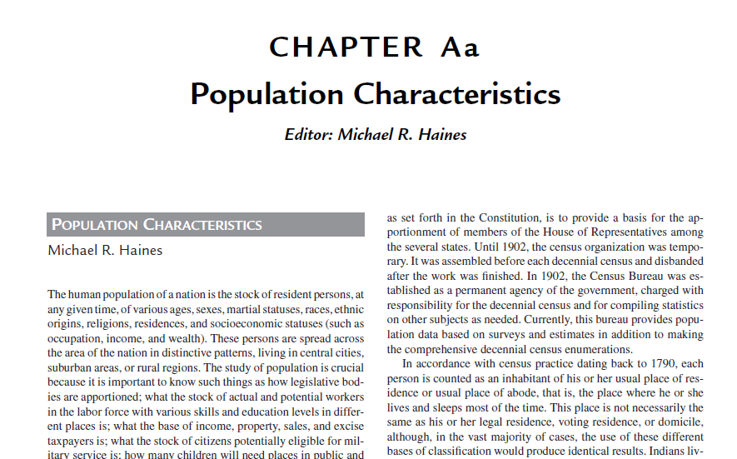

Slide 9
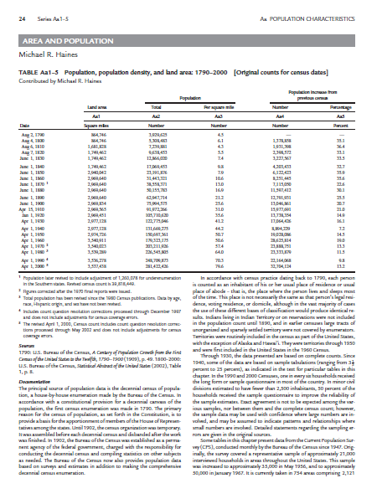
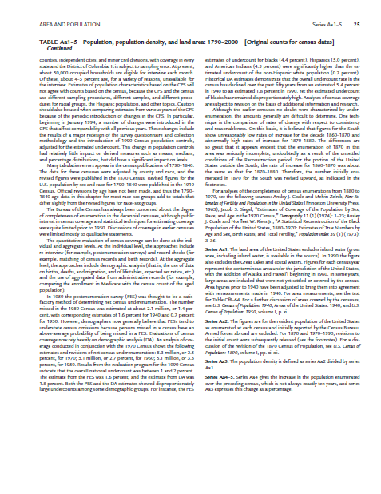

Slide 10
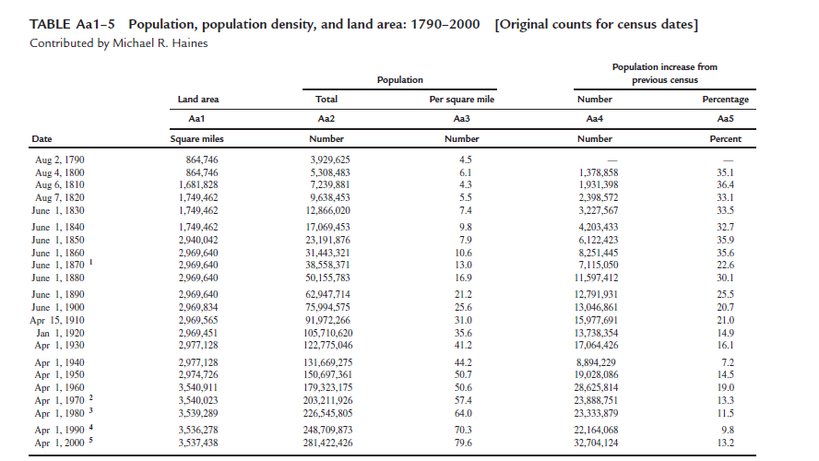

Slide 11
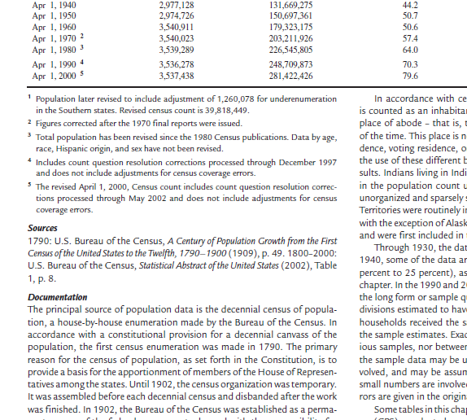
Footnotes
Sources
Documentation

Slide 12
Millennial Edition
Volume B: Work and Welfare
Ba. Labor
Bb. Slavery
Bc. Education
Bd. Health
Be. Economic inequality and poverty
Bf. Social insurance and public assistance
Bg. Nonprofit, voluntary, and religious entities

Slide 13
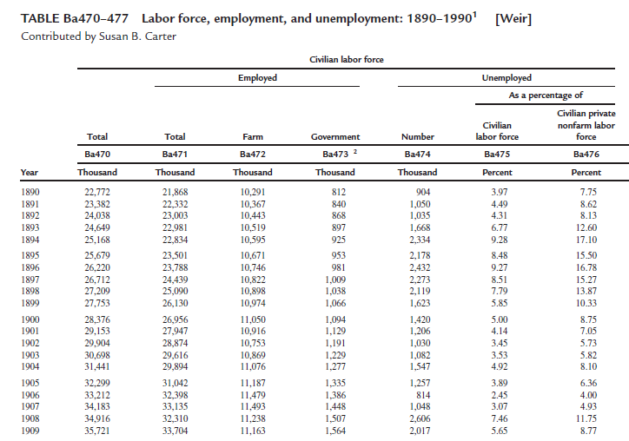


Slide 14
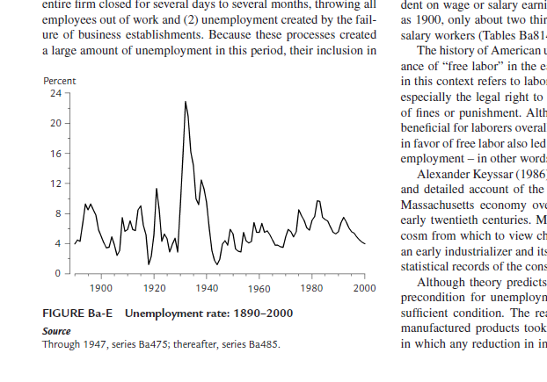


Slide 15
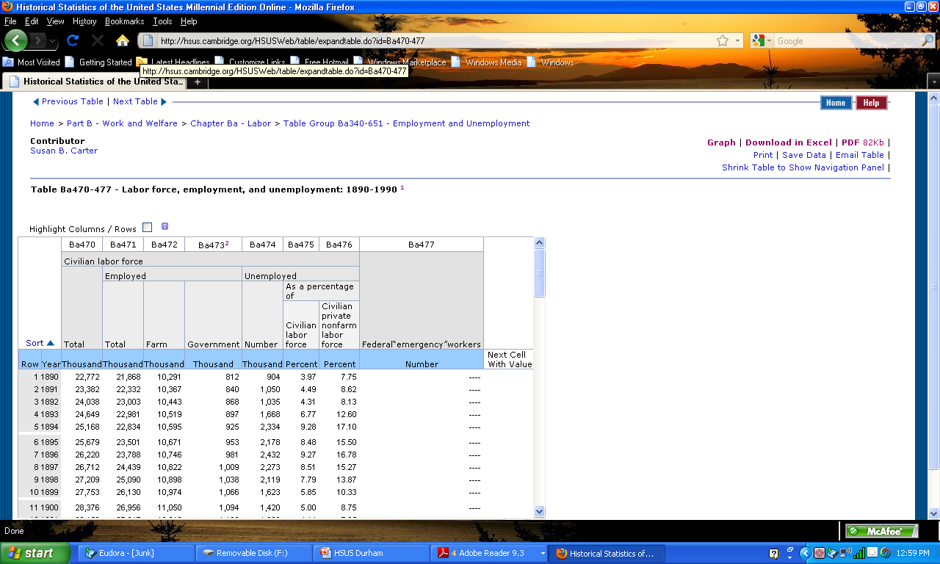

Slide 16
Millennial Edition
Volume C: Economic Structure and Performance
Ca. National income and product
Cb. Business fluctuations and cycles
Cc. Prices
Cd. Consumer expenditures
Ce. Saving, capital, and wealth
Cf. Geography and the environment
Cg. Science, technology, and productivity
Ch. Business organization
Cj. Financial markets and institutions

Slide 17
Millennial Edition
Volume D: Economic Sectors
Da. Agriculture
Db. Natural resource industries
Dc. Construction, housing, and mortgages
Dd. Manufacturing
De. Distribution
Df. Transportation
Dg. Communications
Dh. Services and utilities

Slide 18
Millennial Edition
Volume E: Governance and International Relations
Ea. Government finance and employment
Eb. Elections and politics
Ec. Crime, law enforcement, and justice
Ed. National defense, wars, armed forces, and veterans
Ee. International trade and exchange rates
Ef. Outlying areas
Eg. Colonial statistics
Eh. Confederate States of America

Slide 19
Five Volumes
4,491 pages
39 Chapters
User’s Guide
3 Appendixes
1,900 Tables
37,339 Time Series
1,066,139 Observations
70 Introductory Essays
83 Contributors
299 Consultants
65 Research Assistants

Slide 20
Millennial Edition
Thanks to Our Sponsors

Slide 21
With the Initial Support of:
University of California -- Berkeley, Davis, and Riverside
University of California, Office of the President
Cambridge University Press
Colgate University
Alfred P. Sloan Foundation
Stanford University and Stanford Libraries
With Continuing Support from:
U.S. National Science Foundation
University of California, All-UC Group in Economic History
University of California, Riverside, Center for Social and Economic Policy
And Over 50 Others
The Scholarly Community

Slide 22
Millennial Edition
John Simon Guggenheim Memorial Foundation
Harvard University, Hauser Center for Nonprofit Organizations
International Centre for Economic Research, Turin, Italy
University of Iowa, Department of Political Science
Robert Wood Johnson Foundation
University of Kansas, Department of Economics
Lilly Endowment, Incorporated
University of Minnesota, Minnesota Population Center
National Endowment for the Humanities
National Institute of Aging
National Institute of Child Health and Human Development
National Institutes of Health
North Carolina State University:
College of Agriculture and Life Sciences
College of Management
University of North Carolina, Greensboro, Joseph M. Bryan School of Business and Economics
Northwestern University:
University Research Grants Committee
Weinberg College of Arts and Sciences
University of Pennsylvania, Wharton School:
Huntsman Emerging Technologies Management Research Program
Jones Center for Management Policy, Strategy, and Organization
Mack Center for Technological Innovation
Russell Sage Foundation
Rutgers University, Department of Economics
Saint Mary's College of California
Santa Clara University, Leavey School of Business
The Spencer Foundation
Stanford University, Office of Technology Licensing
Wellesley College
Winthrop University
Yale University:
Institution for Social and Policy Studies
Program on Non-Profit Organizations
U.S. Department of Agriculture
American Association of Fundraising Counsel Trust for Philanthropy
American Council of Learned Societies
University of Arizona:
College of Business and Public Administration
Department of Economics
Aspen Institute, Nonprofit Sector Research Fund
Bowling Green State University, Office of Sponsored Programs
University of California, Berkeley:
Center for Real Estate and Urban Economics
Institute for Business and Economic Research
University of California, Davis:
Agricultural Issues Center
Department of Agricultural and Resource Economics
Division of Social Science
Institute of Governmental Affairs
University of California, Riverside:
Center for Social and Behavioral Science Research
College of Humanities, Arts, and Sciences
University of California, San Diego, Institute for Global Conflict and Cooperation
University of California, Washington D.C. Center
California Institute of Technology, Division of Humanities and Social Sciences
University of Canterbury, New Zealand, Department of Political Science
Farm Foundation
Federal Reserve Bank of St. Louis
The Ford Foundation

Slide 23
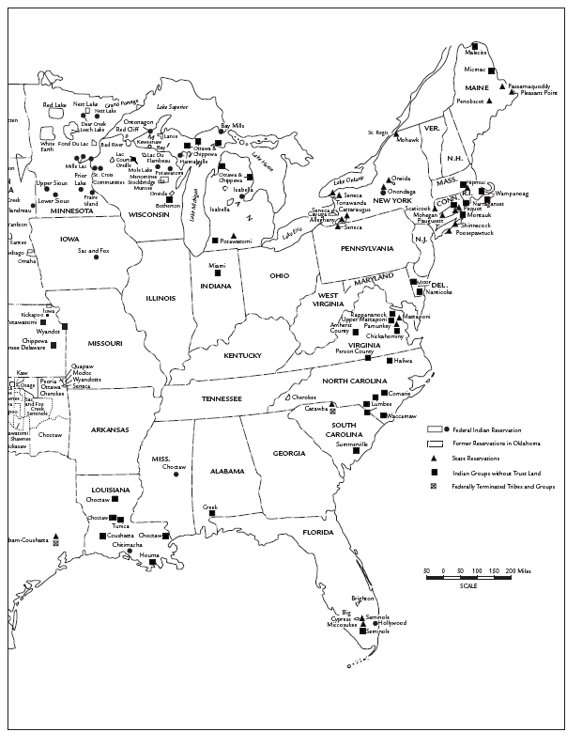

Slide 24
Total Fertility Rate, 1800-2003
8
Number of
Children Born
Per Woman
6
Black
Women
4
White
Women
2
0
1800
1820
1840
1860
1880
1900
1920
1940
1960
1980
2000
Source for updating: National Center for Health Statistics, National Vital Statistics Reports, 54(2) September 8, 2005, Table 4.
Series Ab63, Ab85

Slide 25
Rate of Net Population Change, 1790-2000
Percent
Irish
Series Aa9-10

Slide 26
Rate of Net Population Change, 1790-2000
Percent
1918 Influenza Epidemic
Series Aa9-10

Slide 27
Rate of Net Population Change, 1790-2000
Percent
New
Series Aa9-10

Slide 28
Overweight Americans
Percent
Total, 20-74 years,
age-adjusted
Men 20-34 years
Women 20-34 years
Update from National Health and Nutrition Examination Surveys (NHANES) 1999-2000, 2001-2002, and 2003-2004 as presented in the National Center for Health Statistics, Heath, United States, 2004, Table 69.
Series Bd653-687

Slide 29
Daily Per Capita Calorie Consumption
1909-2004
Kilocalories
per Day
Source for updating: USDA, Center for Nutrition Policy and Promotion, Nutrient Availability, U.S. Food Supply, March 3, 2006.
Series Bd562, Bd598

Slide 30
Per Capita Consumption of Sugar
1960-2004
Pounds
per Year
180
Including Non-Caloric Sweeteners
160
140
Including Corn Sweeteners
120
100
80
Cane and Beet Sugar
60
40
0
1960
1965
1970
1975
1980
1985
1990
1995
2000
2005
Source for updating: USDA, Center for Nutrition Policy and Promotion, Food Availability, U.S. Food Supply, December 21, 2005.
Series Bd593-596

Slide 31
Daily Per Capita Consumption of Fat
1909-2004
Grams
per Day
Source for updating: USDA, Center for Nutrition Policy and Promotion, Nutrient Availability, U.S. Food Supply, March 3, 2006.
Series Bd564, Bd601

Slide 32
Female Labor Force Participation Rate
Civilian, Noninstitutional Population 16 Years and Older
Percent
60
Bureau of Labor Statistics
50
40
30
Weiss
Sobek
20
10
1800
1840
1880
1920
1960
2000
Series Ba52, 345, 543

Slide 33
Number of Immigrants to the United States
Number
1986 Immigration Reform and Control Act
Series Ad1

Slide 35
Homicides
Per 100,000 Population
Rate
12
10
Eckberg
8
6
Official
4
2
0
1900
1920
1940
1960
1980
2000
Series Ec190, 191

Slide 36
Series Cc1 and Eg247

Slide 38
Series Eh118 and Eh128

Slide 39
Thank You
Questions
Welcome

