Slide 1

Laboratory Efficiency Assessment Framework
(LEAF)
LEAF helps make our lab more sustainable, and achieve Green Lab Accreditation by completing a guided workbook.

Slide 2
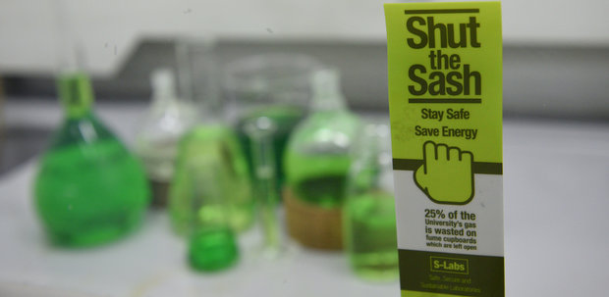
Why we need LEAF:
Labs typically use 3 – 10 time more energy than office spaces
40 % of environmental impact and costs but only 6% of space
University pledges to be carbon neutral by 2030
Benefits of LEAF:
Reduce utility costs and environmental footprint
Opportunity for direct savings through our financial incentive schemes
Ensures health and safety compliance within labs
Increases research efficiency
Provides recognition for individual labs and the University on a national stage
Aligns your research with the University strategy and Bristol Futures
Inter-lab and inter-departmental benchmarking
Notes:
Benefits of signing up to LEAF
Reduce utility costs and environmental footprint
Opportunity for direct savings through our financial incentive schemes
Ensures health and safety compliance within labs
Increases research efficiency
Provides recognition for individual labs and the University on a national stage
Enables a bottom-up sustainability movement
Integrates different labs and departments
Practice-based learning experiences that improve professional skills and employability
Strengthens relationships between Estates, lab users and other stakeholders.
Aligns your research with the University strategy and Bristol Futures
Provides chances of gaining additional research funding
Improves student experience via volunteering opportunities as LEAF Project Assistants
Inter-lab and inter-departmental benchmarking
Creates a better understanding within our community of our science buildings and operations

Slide 3








How LEAF Works
Teams are given a list of environmental activities in the form of an online workbook broken down into Bronze, Silver, Gold, Platinum and Bonus categories to complete. Each activity is a clear, easy to implement action.
Equipment
Waste
People
IT
Research Quality
Procurement
Ventilation
Sample & Chemical management
Notes:
The LEAF teams are given a list of environmental activities in the form of an online workbook broken down into Bronze, Silver and Bonus categories to complete. Each activity is a clear, easy to implement action. Every activity in 'Bronze' or 'Silver' must be completed in order to achieve that accreditation level. Each activity is scored, and depending on the number of activities that are completed and the number of points scored teams can achieve either the 'Gold' or 'Platinum' awards.
Special Awards: In addition to the above we also have special awards, Labs Environmental Hero, Labs Community Action, Labs Innovation for Engagement Award Labs Community Action Award.

Slide 4
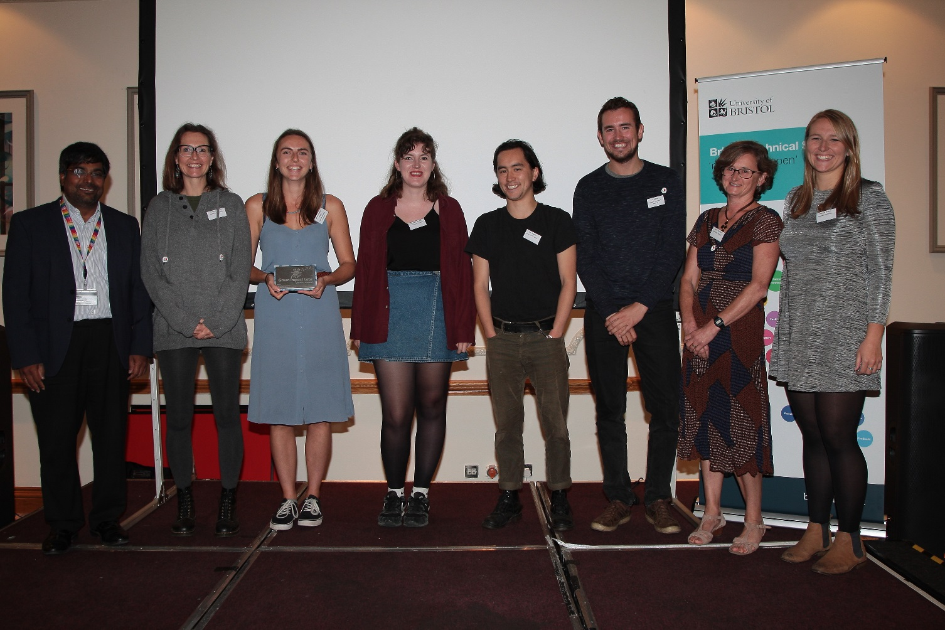
GIL - 2017/18
1 Platinum
8 Gold
2 Silver
22 Bronze
Platinum Winners, Southmead, at the Lab Tech Conference.
Notes:
LEAF is new for 2018/2019. The previous framework was known as Green Impact Labs. Last year 32 teams participated in total. Bristol Biomedical Sciences is a leader in the Higher Education sector by becoming the largest STEM building in the UK that can boast Green Lab Accreditation in 100% of its laboratories.

Slide 5
LEAF – Your Lab Name
Gold
Silver
Bronze
Sustainable Lab Leader:
  Name
  Email
Notes:
Bronze 4 - At least one person has been nominated to lead on efficient and sustainable practices (e.g. green champion). Completion of this criteria requires continuity of the role to be established.
[Place the star at the level your team is hoping to achieve]

Slide 6
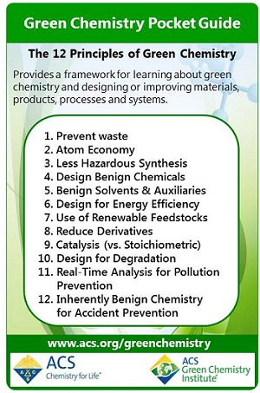
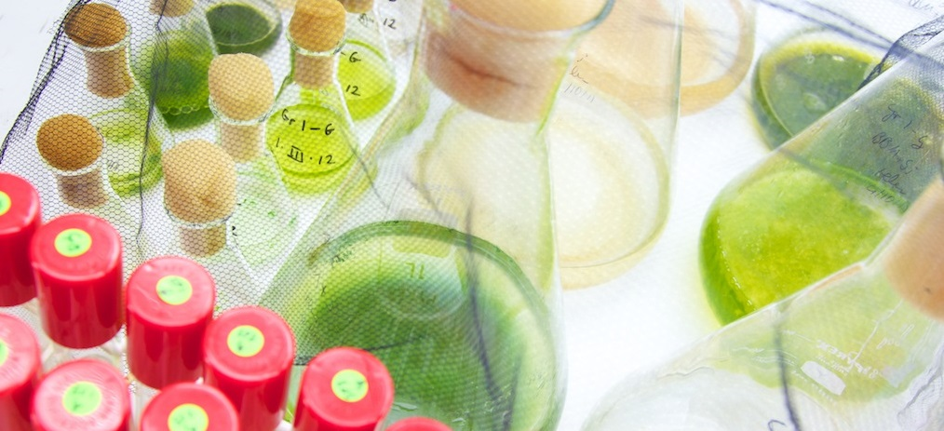
Sample and Chemical Management
Notes:
Bronze 11-All samples and chemical containers have legible labels or there is a system in place to ensure that, in future, all samples will be consistently labelled.
Bronze 12-The lab has a system in place for sharing chemicals between users within the lab group.
Silver 27 –The 12 Principles of Green Chemistry have been considered and if feasible, implemented for current lab members and communicated to the new members.

Slide 7


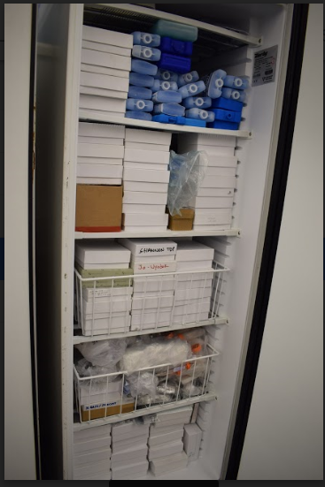
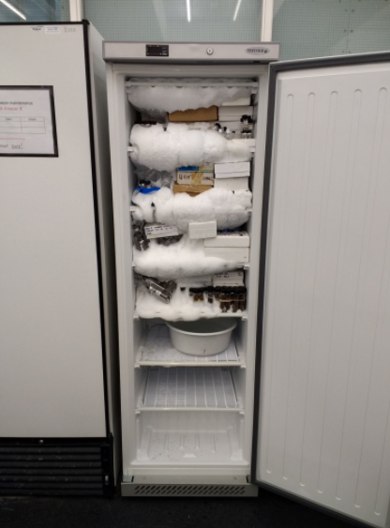
Equipment 1-
Cold Storage
Freezer Manager:
  Name
  Email
General freezer maintenance guide is posted on the freezer.
Freezers will be checked for proper storing techniques, general maintenance, and de-iced once a term.
Notes:
Bronze 7-Heat sources on cold storage equipment are not blocked and any filters are cleaned regularly.
Bronze 8- Cold storage, ovens, or incubators operate only when as full as possible.
Silver 21- Freezers, fridges and LN2 dewars are maintained or there is a plan in place going forward to achieve this. This includes defrosted units, functioning seals and clean filters for ULT freezers.
Silver 24-Where feasible, freezers and fridges have temperatures raised and ovens have had temperatures lowered.

Slide 8
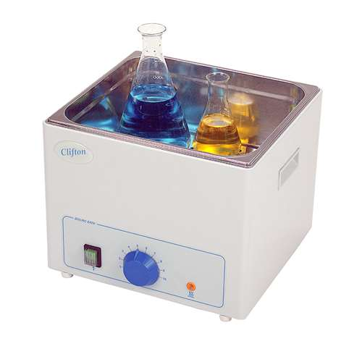
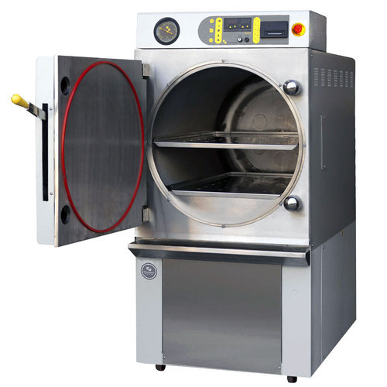
Equipment 2
Auto-claves Ovens Incubators
Notes:
Equipment is only run when full. Ovens have temperatures decreased.

Slide 9

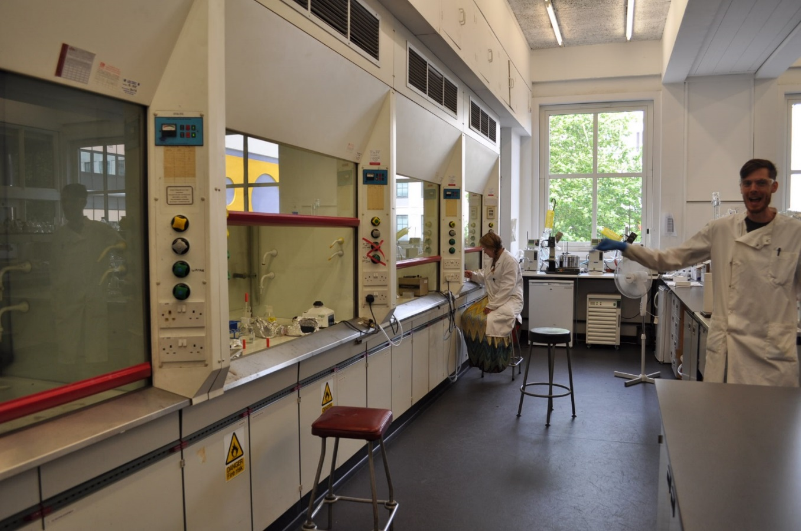


Ventilation 1-Fume Cupboards/ BSC
Be sure to:
Shut lab/hallway doors
Shut fume cupboard and BSC sashes
Turn off fume cupboards/BSC when not used for extended period
Notes:
Silver 31- Fume cupboards and Local Exhaust Ventilation (LEV) equipment is not being utilised for extended storage and nothing impedes internal airflow.
Silver 32- Users have have improved sash lowering of fume cupboards and/or turn safety cabinets off when finished (80% effective).
Gold 44- The lab has engaged and implemented actions via Estates on lowering fume cupboard flow rates and laboratory air change rates and/or removing unnecessary ducted extracts from safety cabinets and fume cupboards to become recirculating.

Slide 10
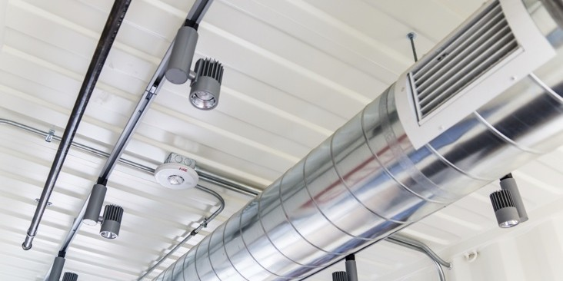
Ventilation 2- HVAC
Possible signs of a faulty HVAC:
• Frequent alarms on fume cupboard use
• Known problems with ventilation equipment
• Unpleasant working conditions for many users due to draughts and excessive cold or heat
• Fume cupboards not functioning properly
• Difficulty opening/closing doors because of pressure differentials.
Notes:
Bronze 15-The lab is aware of any negative (or positive) pressure required and these are correctly maintained. Users have reported any issues with pressures, excess heating or cooling, or any other relevant issue to Estates.

Slide 11


Lighting
Notes:
Bronze 9-There is a system in place to ensure equipment and lighting are turned off when they are not needed.

Slide 12

IT
Be sure to:
Losses of data can be devastating
Reducing the screen brightness and optimising code can be effective ways to reduce energy consumption.
Notes:
Bronze 10- Ensure brightness settings and computer time-to-sleep have both been minimised.
Silver 25- Critical data has been backed up, or there is a plan moving forward to ensure it is.
Gold 39-Computing code has been optimised and the number of storage clusters has been optimised to the tasks or schedule of tasks.

Slide 13
Waste and Recycling
Laboratory Contaminated Waste
Respective items here
Respective items here
Sharps Boxes
Mixed Glass
Respective items here
Respective items here
Clean Labs Plastics
Notes:
Go over the bins that are in your lab and the common items that can be recycled/thrown away in them. A waste audit template can be found on the sustainability website.
Bronze 1-The lab possesses required waste bins (possibly clinical, glass/sharps, hazardous etc.), as well as recycling/general waste bins with appropriate and clear signage.
Silver 18-There is a minimum of mixing of waste streams in bins (no more than 10%), and lab members are aware of best practice.

