Slide 1
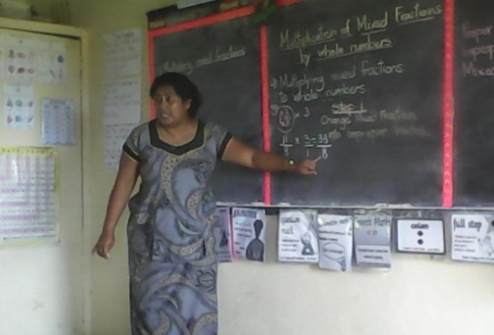
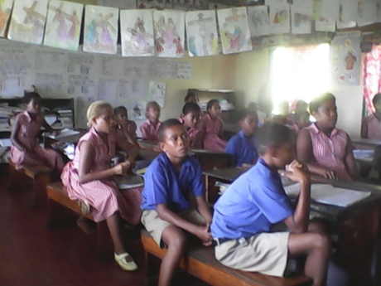
Teachers and Teacher Education in Fiji Identities, Capabilities and Quality
Research carried out through a partnership between The University of the South Pacific, the University of Bristol and the University of Nottingham
Photographs taken during USP Student Practicum Assessment, © 2015.

Slide 2
Overview
International post-2015 education & development discourse emphasis on ‘quality’ education
Implicit & explicit implications for teacher education, policy & practice
This collaborative exploratory study to investigate the context of teachers and teaching in Fiji
Potential starting point for wider regional investigation

Slide 3
Purpose
To generate insights into the process of international research collaboration to help understand potential, challenges & realities of cross-cultural research partnerships in education
To determine stakeholder perspectives of:
the nature & quality of teaching in Fijian schools, and of teacher education;
their understanding of the challenges being faced in practice; and,
The priorities for attention if the quality of education is to be improved.

Slide 4
Methodology & Methods
Qualitative methodological approach
Mixing western and Pacific techniques
Methods:
Questionnaires (consensus building through structured stakeholder consultation/focus groups)
Talanoa (dialogic informant- research conversations)
Talanga
Research Ethics – MOE (2014), USP (2015)

Slide 5
Changing Policy Context
1978 Education Act
Post-2000 policy initiatives incl.
Ed Commission report (2000)
Systems-based curriculum mapping exercise (2003 – ongoing)
Suva Declaration (2005)
NCF 1st Edition (2007), 2nd Edition (2013)
Primary concern post-2000 was content overload, repetition/ overlapping and poor-sequencing/gaps
Also, labor market needs & cultural relevance

Slide 6
Disconnections
Education Act (EA) review 2013 (IP)
NCF (2013) contrasts EA (1978) with strong philosophical standpoint:
To provide a holistic, inclusive, responsive and empowering education system that enables all children to realize their full potential, appreciate fully their inheritance, take pride in their national and cultural identity and contribute fully to sustainable national development (Fiji Ministry of Education, Heritage and Arts, 2013a, p. 1).
Emphasis on social constructivism, Delors’ Pillars of Education and Cultural Influences
Some progress towards development of new curricula under broad banner of ESD
Post-2014 elections shift in priority confusion

Slide 7
Post-2015 Fijian Education
Alignment of priorities and NCF unclear
Policy statement release in Oct, 2015 identifies 3 pillars of change:
Content review & development
Delivery by our teachers
Infrastructure
No mention of NCF
Identified need for comprehensive curriculum review “to bring it to par with the curriculum of schools in Australia, New Zealand and India” in 2016
Potential for deferment post-TC Winston

Slide 8
Cont…
MoE encouragement/expectation that trs upgrade qualifications
Basic English Proficiency Test for all teachers from 2016
Student Assessment of teachers’ performance from 2015
Teacher upskilling with counselling skills by MOE
Temporary appointment of roving HT and P’s for under-performing schools
Absence of teacher standards, but Teacher code of ethics, 2013 to be used alongside the PSC Code of Conduct

Slide 9
Findings & Analysis: Practitioner Stakeholders
Nature & Quality of Teaching & Teacher Ed/ preparedness
Topical issue given MOE shift in focus during fieldwork
Emergent themes:
Ideal teacher
Current state of teaching and teaching profession
Quality of teacher ed

Slide 10
The ideal teacher …
Is guided by national policies, standards & curricula
Has a strong sense of teacher identity & professional ethics and moral standards
Has a passion for teaching & facilitating student learning
Possess cultural/multicultural/emotional intelligence
Is well-versed with subject content knowledge
Keeps up-to-date with pedagogical developments, is innovative and applies a wide range of teaching strategies to enhance student learning
Prioritizes student welfare: learning needs & safety
Values life-long learning

Slide 11
Why teach?
Majority ‘called to teach’
Active decision to take up teaching
Parental direction
Limited employment opportunities

Slide 12
General perception of teachers & teaching in Fiji
Teacher belief in the ‘profession’ vs. overworked, underpaid civil-servants
Current struggle with pace of reform & lack of capacity to cope
Some concern about teacher quality decline reflected in examination results
Overall quality of teaching and learning considered ‘average’
Poor status of teachers attributed to MOE – overloads, rate of change, and salary
Teacher-centered classrooms widely practiced blamed on MOE demands
Sincere concern about future direction of teachers’ work an teaching in Fiji and lack of clarity of ‘vision’ within a broader philosophy of teaching and learning

Slide 13
Quality of teacher education
Low entry requirements
Over-theoretical approach
Need to strengthen Practicum

Slide 14
Teacher Challenges
Six-levels:
Ministry of Education
School
Teacher
Curriculum
Student
Community

Slide 15
MOE
Rapid pace of reform including regulations and procedures
Significant teacher stress & reform lethargy
Lack of teacher consultation
Confusion regarding NCF principles vs. reform directives
Shift from AfL back to AoL
Examination pressure
Belief that reform is driven by international policy vs. contextualization

Slide 16
The School
Ruralness & remoteness
Resources & facilities
Poor quality ‘new’ textbooks
Limited access to technology
Low level support from school admin & boards
School leadership
Retirement age ‘crisis’

Slide 17
The teacher
Heavy workload
Student- teacher ratio
Composite classes
Paperwork
Extra-curricular responsibilities
Need for Teachers’ rights dialogue/policy
Implications of Teacher review questionnaire
Competency & capability of teachers
Teacher preparedness & quality of Teacher Ed

Slide 18
The curriculum
Reverting to content-driven curriculum
Quality of new textbooks
Curriculum pacing
Teaching content for examinations

Slide 19
The students
Diverse learning needs
Student attendance
Attitudes towards learning and behavior
Academic ability
Leverage of student assessment of their teachers

Slide 20
Community
Culture & language gap
Parental support
Value & respect for teachers declining
Teachers’ held accountable for low literacy and numeracy rates and poor examination results

Slide 21
Emergent Priorities
Consultation and collaboration btw. the MOE, teacher education providers & teaching profession.
Realistically paced, consistent and coordinated reform processes.
Clarification of the place of the NCF in ongoing reform.
Critical reflection on the implications of intensification of examination pressures for the national philosophy of education, for pedagogy, the nature and quality of teaching and learning, the teaching profession and teacher education.
Strengthened levels of support for rural and isolated schools.

Slide 22
Cont…
6. Improved access to/provision of school leadership training.
7. Realistic appreciation of teacher workloads.
8. Improved opportunities for continuing professional development (CPD) esp. rel. to counselling skills, ICT competencies, subject content knowledge, and training for English as a Second Language & students with special and diverse learning needs.
9. Commitment to improve societal recognition and respect for the teaching profession & the role of the teacher.
10. Detailed consideration of time constraints relating to the coverage of curriculum content within the school year.

Slide 23
Cont…
11. Resolution of tensions btw. content and examinations driven curriculum & benefits of active learning and learner centred pedagogy.
12. Systematic evaluation of the quality of new text books and curriculum mapping & pacing
13. Improvement of student attitudes towards learning, behaviour and performance in tests and examinations.
14. Ongoing adaptation of the curriculum to better fit the needs of the labour market & cultural appropriateness.
15. Revision of teacher education curriculum to strengthen teacher competencies, assessment & leadership skills, improve practicum experience & increase engagement wt. the contextual realities of classroom teaching and learning.

Slide 24
Reflections for the future
Need for clarification of teacher standards & rights
Awareness re – Fiji Teacher Code of Ethics
Strengthen partnership with teachers, teacher unions and FTRB, teacher ed providers and FHEC
Clarification of new MOE philosophy for ed in Fiji
Education Act Review is critical
Targeted research incl. MA/PhD studies
Committment to Fijian ed but confusion re: perceived policy direction

Slide 25
Acknowledgements
British Academy & USP FALE Research
Respondents
Research Team
Professor Konai Helu Thaman, Professor in Teacher Education, USP
Dr Cresantia Frances Koya Vaka’uta, Senior Lecturer in Education, USP
Dr Ledua Waqailiti, Lecturer in Education, USP
Dr Rosiana Lagi, Lecturer in Education, USP, Labasa Campus
Mr Asish Kumar, Secondary School Teacher & USP Tutor in Education, Labasa Campus
Mr Satish Chand, Lecturer in Education, Fiji National University, Lautoka Campus
Mrs Atelini Bai, Lecturer in Education, University of Fiji, Lautoka Campus
Professor Michael Crossley, Professor of Comparative and International Education, University of Bristol, UK
Professor Simon McGrath, Professor International Education and Development, University of Nottingham, UK

