Slide 1
Classics Colloquium: University of Bristol – Why Classics?
Classics Colloquium
Graduate School of Education
22nd June
Hannah Walsh

Slide 2
Classics Colloquium: University of Bristol – Why Classics?
Session overview
Why Classics?
Latin for beginners
Embedding Latin into other curriculum areas

Slide 3
Classics Colloquium: University of Bristol – Why Classics?
Why Classics?
“[The study of Classics provides what] Jefferson argued in Notes on the State of Virginia (1782) was the main goal of education in a democracy: to enable us to defend our liberty. History, he proposed, is the subject that equips citizens for this. To stay free also requires comparison of constitutions, utopian thinking, fearlessness about innovation, critical, lateral and relativist thinking, advanced epistemological skills in source criticism and the ability to argue cogently. All these skills can be learned from their succinct, entertaining, original formulations and applications in the works of [the Romans] and Greeks.”
Professor Edith Hall, “Classics for the People” in The Guardian, 20 June 2015

Slide 4
Classics Colloquium: University of Bristol – Why Classics?
Why Classics?
Grammar and vocabulary
Critical thinking
Culture

Slide 5
Classics Colloquium: University of Bristol – Why Classics?
Grammar
Encourages the accurate use of language.
Helpful for other inflected languages (e.g. German)
Close attention to grammar necessary for understanding meaning (can’t rely on word order)

Slide 6
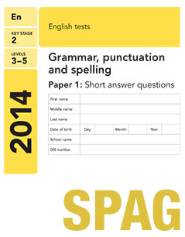
Classics Colloquium: University of Bristol – Why Classics?
KS2 SPAG requirements
Nouns
Verbs
Adjectives
Connectives
Pronouns
Adverbs
Prepositions
Articles
Complex sentences
Clauses (main and subordinate)
Subordinating connectives
Tense agreement
Subject–verb agreement
Double negatives
Active and passive voices

Slide 7
Classics Colloquium: University of Bristol – Why Classics?
Vocabulary
More than 65% of English words come from Latin (and more than 90% of those over two syllables).
Latin is the basis of 75–80% of all Spanish, French, Italian and Portuguese words.
73% of students in Year 7 at CHS believe that Latin has helped them with learning other languages

Slide 8
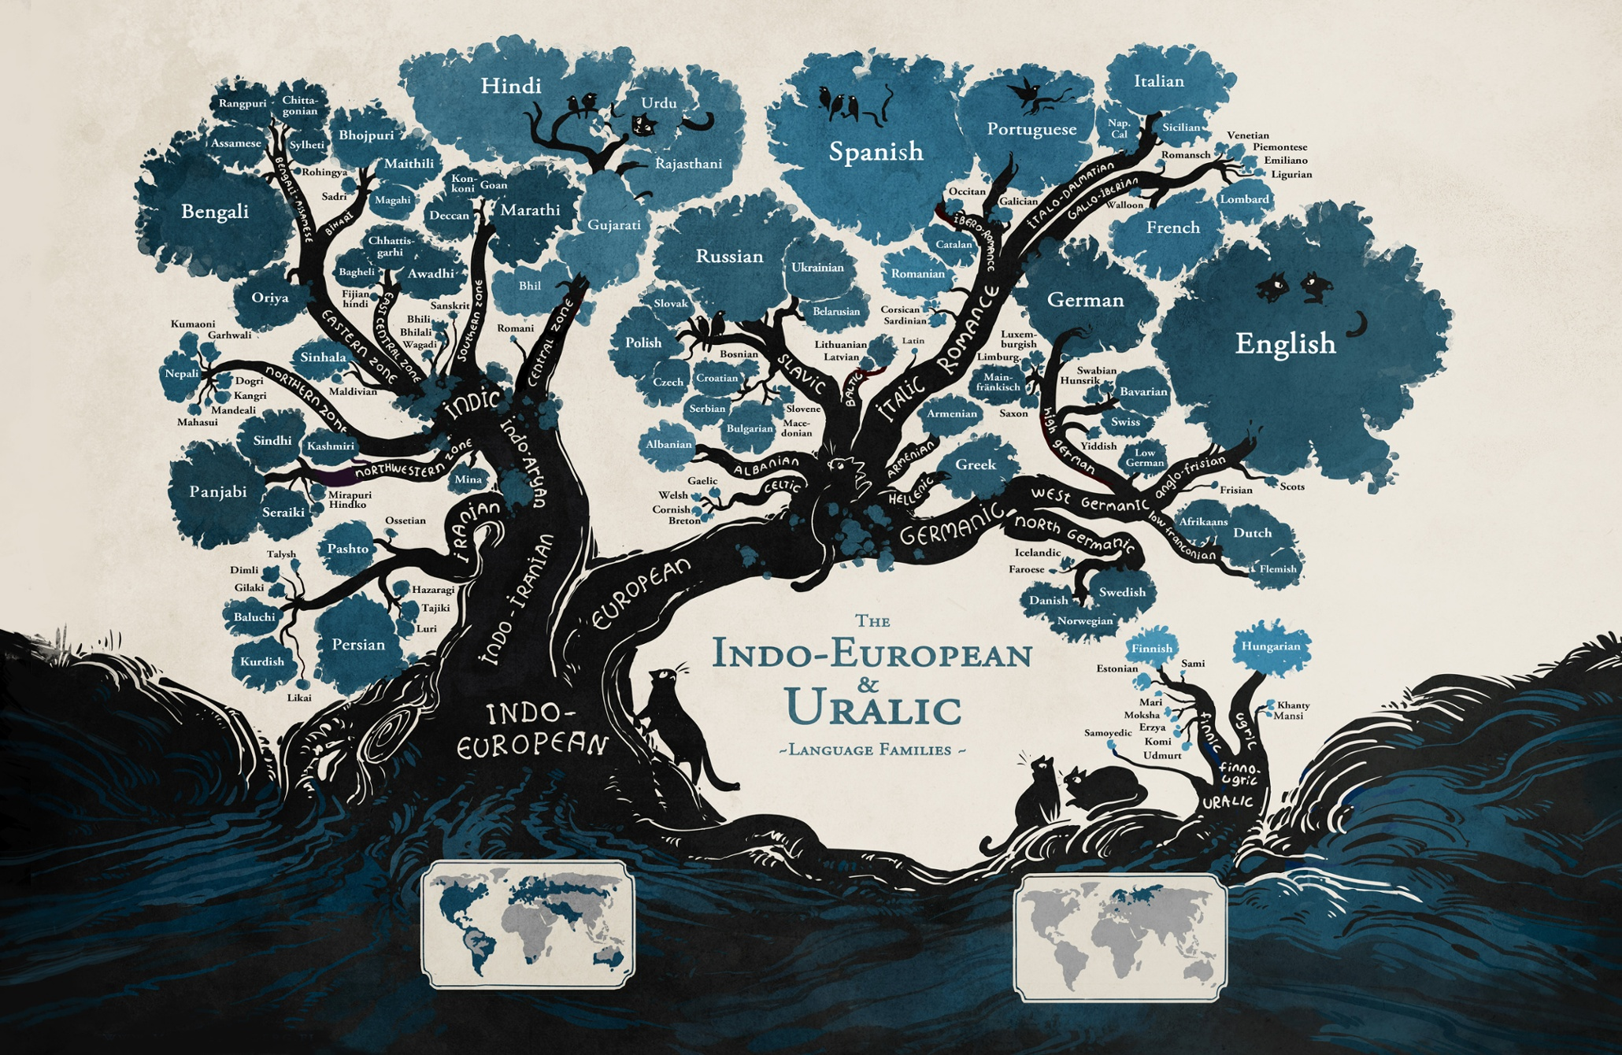
Classics Colloquium: University of Bristol – Why Classics?

Slide 9
Classics Colloquium: University of Bristol – Why Classics?
Minna Sundberg: Language Family Tree
Latin

Slide 10
Classics Colloquium: University of Bristol – Why Classics?
Critical thinking
Latin grammar teaches systematic thinking.
Useful for STEM subjects
Encourages critical evaluation of language, literature and civilisation.

Slide 11
Classics Colloquium: University of Bristol – Why Classics?
Culture
Aids cultural literacy
Teaches the foundations of philosophy and history
Encourages cultural insight

Slide 12
Classics Colloquium: University of Bristol – Why Classics?
Why Classics?
Grammar and vocabulary
Critical thinking
Culture

Slide 13
Classics Colloquium: University of Bristol – Why Classics?
The benefits of Classics: a personal view
State-school educated
Studied English Literature at Cambridge University
Now an English teacher at a large state school in Devon
“It widened my vocabulary considerably and it definitely made me use my memory more than any other subject”
“Where it really did come into its own was studying English at university: my study of Classics at school had expanded my vocabulary and had given me an awareness of the classical mythologies and stories.”
“My experience of learning Latin was almost certainly the thing that gave me the confidence to do Anglo-Saxon and also Greek.”
“It has been incredibly useful in teaching, because I teach new vocab through word roots ALL the time, so my knowledge of three ‘dead’ languages is surprisingly helpful!”

Slide 14
Classics Colloquium: University of Bristol – Why Classics?
HOW?
Latin for beginners
Enjoyment
games, songs, projects
Challenge
explicit teaching of grammar, use of linguistic terminology
Inclusivity
promoting self-esteem and self-reliance
Practicalities
When?
Where?
Which students?
Resources?

Slide 15
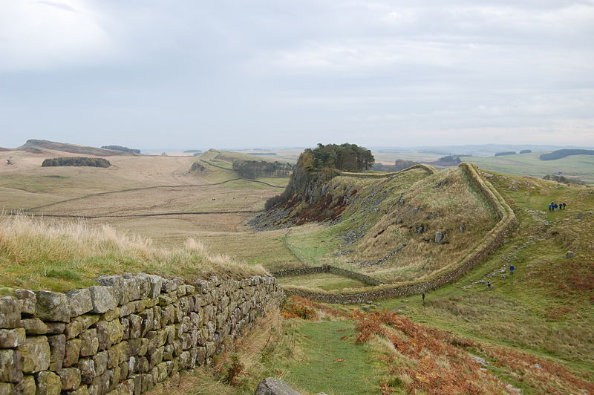
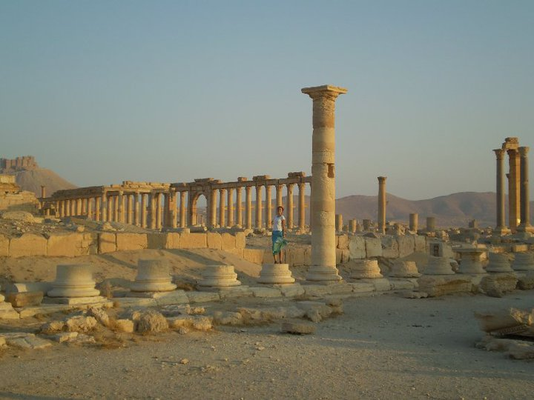
LO: To explore how the Romans have influenced the modern world; to be able to recognise key differences between English and Latin
How are these pictures linked?

Slide 16
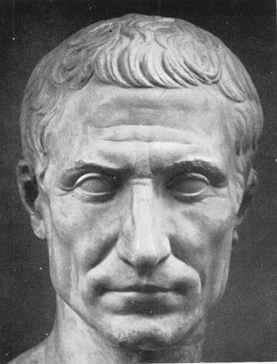
LO: To explore how the Romans have influenced the modern world; to be able to recognise key differences between English and Latin
CLASSICS: what does this mean? *Bonus: Who am I?
Ideas on a post-it. What do you already know about Classics? What questions do you have?
Classics is the study of ancient Greek and Roman civilisation in all its aspects: language, religion, philosophy, history, oratory, art, archaeology, myth, poetry and so much more .
*Bonus answer: I’m called Julius Caesar and I was a very important figure in Roman history. Apparently I said ‘veni, vidi, vici’ but that’s not all you should remember me for…

Slide 17
LO: To explore how the Romans have influenced the modern world; to be able to recognise key differences between English and Latin
What can you tell me about…?
A: LATIN
B: THE ROMANS

Slide 18
LO: To explore how the Romans have influenced the modern world; to be able to recognise key differences between English and Latin
The Romans: gone but not forgotten!
Individual
Pairs
Add your best idea from each box to the class version of the table.

Slide 19
LO: To explore how the Romans have influenced the modern world; to be able to recognise key differences between English and Latin
Are you ready to read some Latin?
Caecilius est in horto. Caecilius in horto sedet. Metella et Quintus in tablino sedent. servus est in via. coquus est in culina. coquus in culina dormit. Cerberus intrat et circumspectat. cibus est in mensa. canis salit. canis in mensa stat sed Grumio stertit…
Look carefully at this section of Latin.
1. Why do you think some sentences start with a capital letter and some don’t?

Slide 20
LO: To explore how the Romans have influenced the modern world; to be able to recognise key differences between English and Latin
Are you ready to read some Latin?
Caecilius est in horto. Caecilius in horto sedet. Metella et Quintus in tablino sedent.
Caecilius is in the garden. Caecilius sits in the garden. Metella and Quintus sit in the study.
2. Does Latin have a word for ‘THE’?
3. Look at sentence 2: does Latin use the same word order as English?
4. Why is ‘sedet’ used in sentence 2 but ‘sedent’ is used in sentence 3?

Slide 21
LO: To explore how the Romans have influenced the modern world; to be able to recognise key differences between English and Latin
Are you ready to read some Latin?
servus = slave
coquus = cook
Caecilius est in horto. Caecilius in horto sedet. Metella et Quintus in tablino sedent. servus est in atrio. coquus est in culina. coquus in culina dormit. Cerberus intrat et circumspectat. cibus est in mensa. canis salit. canis in mensa stat sed Grumio stertit…
canis = dog
Any ideas what the words in bold might mean? Do these Latin words remind you of any English words?
*HINT: 2 of these words refer to types of people, 1 is the name of an animal

Slide 22
LO: To explore how the Romans have influenced the modern world; to be able to recognise key differences between English and Latin
Are you ready to read some Latin?
Caecilius est in horto. Caecilius in horto sedet. Metella et Quintus in tablino sedent. servus est in atrio. coquus est in culina. coquus in culina dormit. Cerberus intrat et circumspectat. cibus est in mensa. canis salit. canis in mensa stat sed Grumio stertit…
Use the vocabulary list to help you translate this section of Latin.
Can you predict what is going to happen next?

Slide 23
LO: To explore how the Romans have influenced the modern world; to be able to recognise key differences between English and Latin
RECAP: How much can you remember?
3 ways in which the Romans have influenced our own society/culture
2 ways in which Latin differs from English
1 new Latin word you have learnt

Slide 24
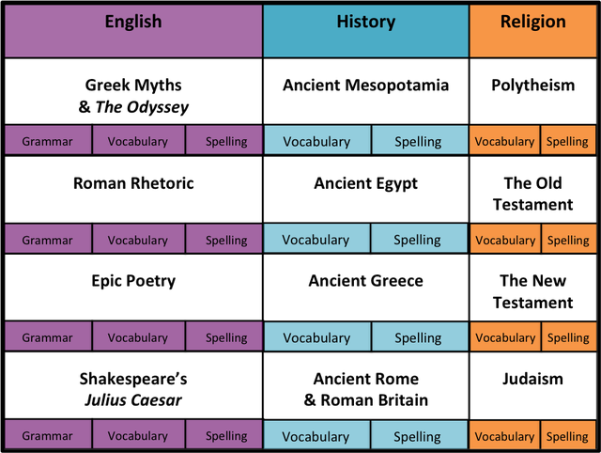
Classics Colloquium: University of Bristol – Why Classics?
Classics in other curriculum areas
Michaela Community School, Brent: a knowledge-based chronological approach
https://pragmaticreform.wordpress.com/2015/02/28/which-knowledge/
Year 7 English: 30 Greek and Latin word roots

Slide 25
Classics Colloquium: University of Bristol – Why Classics?
Classics in other curriculum areas
Vocabulary building
Rather than setting random lists of spellings and vocabulary, focus on word families – produce lists of words connected to a common root word
Regular ‘Word of the Day/Week’ starters
Core GCSE set texts (e.g. ‘Jekyll and Hyde’ and ‘A Christmas Carol’) often contain complex Latinate vocabulary: break down these words into their constituent parts to consolidate meaning
Teaching key reading skills through classical texts
Using Cicero’s speeches as a basis for analysing persuasive oratory and introducing rhetorical terminology
Using Roman epic poetry as a means of teaching inference skills and discussing structural features

Slide 26
Classics Colloquium: University of Bristol – Why Classics?
Any questions?

