Slide 1
Sacrifice in the Ancient Mediterranean

Slide 2
Introduction
What was sacrifice in the ancient Mediterranean?
Why did people sacrifice?
How does it relate to modern day?
Notes:
Los:
Learn what sacrifice is and was
Why people sacrifices
(For KS5) how it relates to modern day
Focus on Ancient Greece and Rome using activity sheets
(KS5) Also discuss sacrifice in modern day at the end

Slide 3
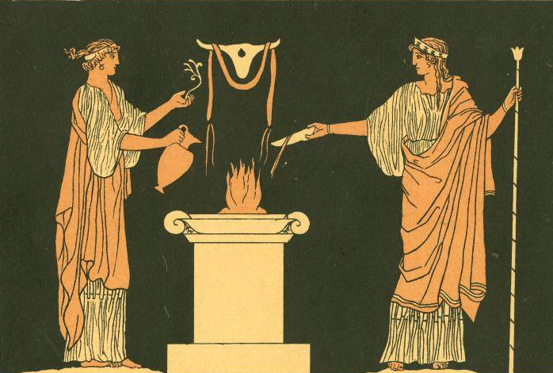
What is Sacrifice?
Sacrifice:
  An act of slaughter as an offering to a deity.
  Uses:
  Thank the gods
  Ask for gods’ help
  Celebrate the gods in religious festivals
Origins:
  Guilt from hunting
Notes:
Defined as:
An act of slaughter as an offering to a deity.
Usually used to
Thank the gods
Ask for gods’ help
Celebrate the gods in religious festivals
Believed to have originated from hunting practises
Done out of guilt and sorrow

Slide 4
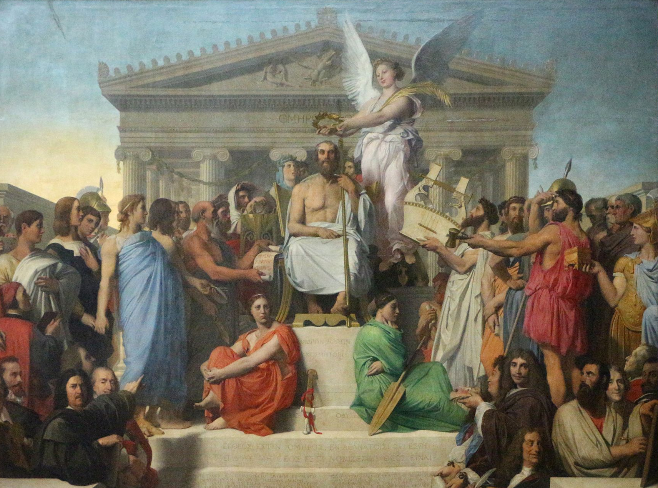
Ancient Greek And Roman Sacrifices
Polytheistic societies
  12 main gods
  Over 400 minor gods
  Usually sacrificed domestic farm animals
    Animal meat would be eaten
    Fat and offal burnt for the gods
  Occurred during:
    Wars
    Festivals
    Home
Jean-Auguste-Dominique Ingres, 1827
The Apotheosis of Homer
Notes:
Ancient Greece and Rome both polytheistic societies, meaning they believe in many gods
When they perform sacrifices, they specify which god(s) the sacrifice is for based on their needs
Both societies’ gods have similar titles (e.g Zeus=Jupiter : King of the gods, ruler of the skies)
Usually domestic animals sacrificed, e.g. chickens, sheep, goats, occasionally ox and bulls
People sacrificed their hunt to Artemis as well
Greeks and Romans sacrificed frequently during wars.
Sacrificed every morning before dawn, before attacks and other tasks, e.g. before building forts
Might sacrifice to Athena/Minerva (goddess of wisdom & battle strategy), Ares/Mars (god of battle violence).
Will sacrifice to Zeus/Jupiter
Religious festivals took place where a certain god/goddess was worshipped
E.g.
Olympia (Greek sporting festival dedicated to Zeus)
Dionysia (Greek festival celebrating theatre and arts; sacrifices made to Dionysus)
Veneralia (Roman festival celebrating Venus, goddess of love)
Mercuralia (Roman festival for merchants and commerce dedicated to Mercury, god of merchants and commerce)
At home, Hestia (goddess of the hearth) was given sacrifices before meals

Slide 5
Other Sacrifices: Egypt
Ancient Egypt, from Herodotus, Histories II:
  Sacrificed bulls
  Examined by Priests & marked
  Beheaded and carcass stuffed
Herodotus: Father of History and Father of Lies
  Plutarch (Ancient Roman historian) coined Herodotus ‘Father of Lies’
  Some of Herodotus’ accounts appear to be fanciful
  HOWEVER:
  Herodotus travelled around the world to better understand
  Often uses first-person voice to admit he doesn’t know whole truth
Notes:
Greek Historian Herodotus wrote about the Egyptian sacrifice
A priest test bulls to check if they are clean for sacrifice before
The priest marks ‘clean’ bulls, ready for sacrifice
They take the animal to the altar & light fires
Pour libations of wine & invoke god by name
Sacrifice animal by beheading and flaying carcas
Head is believed to be full of curses so either sold to Greeks in market or thrown down river
Fill body with loaves and honey and raisins and figs & other scents/spices and burn
Herodotus coined both ‘Father of History’ and ‘Father of Lies’
Stories often incredible
Historical accounts well-told lies
Did travel round the world a lot
Held curiosity to know world better
Sometimes uses his first-person voice to admit doesn't know the whole truth.
Discuss how accurate his account might be

Slide 6
Other sacrifices: Druids
Druids, from Caesar’s Gallic War VI:
  Human sacrifices
  Used for those with severe diseases or injuries in war
  Sacrifices criminals in a ‘wicker man’
Julius Caesar: trustworthy source or not?
  Caesar fought against Gauls
  Partially in Gaul to further political agenda
  Gallic War written as memoirs
Accurate or not?
Notes:
Julius Caesar (later to be emperor) went to Gaul to fight Gauls
Also wrote about Gauls and Druids
Practise private and public sacrifices
Sacrificed other humans for people suffering severe sicknesses or if injured in war
Believed human life can only be returned/given back if another life is given
Sacrifices in a ‘wicker man’ – a giant wooden statue of a man
Puts criminals in the wicker man and sets on fire
If no criminals left, they use innocent people
Caesar may/may nit be accurate
Caesar fought against Gauls
Partially in Gaul to further political agenda
Gallic War written as memoirs

Slide 7
Next Slide for ks5

Slide 8
Sacrifice Today
Now, few religions practise/promote sacrifice
UK Laws:
  “UK and EU slaughter regulations set minim welfare standards at slaughter and require all animals to be pre-stunned before slaughter to minimise their suffering. Member States may exempt slaughter in accordance with religious beliefs from the pre-stunning requirement and the UK implements this derogation.”, UK House of Commons Library, [accessed 15-08-2022]
Read the case study of Church of the Lukumi Babalu Aye v. City of Hialeah (1993)
Why might people object to sacrifice today?
Would ancient sacrifices be allowed today?
Consider both the case study and the UK laws above

