Slide 1
Developing a statistical analysis assistant for Small Area Estimation in StatJR
Professor William Browne,
Centre for Multilevel Modelling,University of Bristol
(with Chris Charlton, Nikos Tzavidis and Timo Schmid)

Slide 2
What will we cover ?
Small Area Estimation (SAE) and links to multilevel models
Unit level models and classical approaches
MCMC algorithms for SAE.
Stat-JR and eBooks.
A Statistical Analysis Assistant for Small Area Estimation.
Extensions

Slide 3
Small Area Estimation (SAE) – Basic Idea
In SAE the focus on estimating quantities of interest for each of a series of ‘small areas’ – for example voting constituencies, administrative regions or schools.
Each such ‘small area’ contains a large number of units – voters, people, children on which we can measure a variable e.g. voting intention, annual pay, exam results and we then wish to construct summary estimates (mean, variability, maximum etc.) of this variable for each small area.
There are two main approaches for SAE which depend on what data is available, area level models and unit level models and here we will concern ourselves with unit level models.

Slide 4
Unit Level Models
Unit level models are so called because we have some information on the individual units.
Unit level models require 2 datasets:
The first census (population) dataset contains a list of variables X for all units in the population.
The second survey (sample) dataset contains both Y, our variable of interest and the same X variables as in the census dataset.
The basic idea is to fit a model to the survey dataset relating Y to X and typically this is a multilevel model.
Then we use the estimates from this model to predict Y for all units in the census dataset.
Finally we can construct summary small area estimates by constructing summary statistics from the predictions on the census dataset.

Slide 5
Classical approach using emdi
The emdi package (Kreutzmann et al. 2007) in R will fit SAE models using a classical approach.
It offers direct estimation and model-based estimation using the empirical Bayes prediction approach of Molina and Rao (2010).
As well as calculating SAE estimates for the mean, standard deviation and quantiles it also calculates several poverty based indicators such as the Gini coefficient, poverty gap, headcount ratio and quintile share ratio.
It only fits normal responses but allows transformations (log and Box-Cox)
Other classical approaches include the World Bank method (e.g. Elbers et al., 2002)

Slide 6
MCMC approach in StatJR
In StatJR we have implemented the World Bank method which essentially contains 3 steps.
Firstly a 2-level (units within small areas) model is fitted to the sample dataset to produce chains of parameter estimates.
Secondly these estimate chains and the data for each unit in the population are used to then produce chains of values for each unit.
Finally the estimated values for the units in each small area at each iteration are then used to construct the aggregate small area estimates e.g. small area mean, sd, median etc.
As there is a chain of values we can therefore measure the uncertainty in these estimates.

Slide 7
Parallel processing speedups
Generally the sample dataset is significantly smaller than the population dataset and so the computations in stage 2 on the last slide are more computationally intensive than in stage 1.
However calculating predictions for each unit in each small area can be done independently conditional on stage 1 and so thus we farm out the process to different processors.
We investigated several approaches including OpenMP along with the standard C++ library functions for parallel processing.
In the end we found that the standard approach worked better and was a large speed up compared to the non-parallel approach.

Slide 8
eBooks
+
=
An electronic book is a book-publication in digital form.
In the US more books are published online than distributed in hard copy in book shops.

Slide 9
Statistical (and Mathematical) eBooks
The idea is can we incorporate statistical content into an eBook? Of course a statistical textbook is no different on paper to any other document when it comes to creating a pdf file (aside from maybe more equations!)
The difference is in what ‘enhancements’ we can add and so the idea here is combining the text book with the statistics package i.e. interactive examples, allowing the user to include their own dataset etc.

Slide 10
Statistical Analysis Assistants
We adapt our eBook system to allow workflows that will be constructed to describe how the steps in a statistical analysis fit together.
There may be many SAAs adapted to different researcher’s approaches – e.g. one might want to answer a research question/analyse a dataset as a specific expert might do it.
Opinion is divided on how far one can take the idea – from nowhere to complete automation i.e. pour in the dataset at the top and let the computer sort it out.
Probable end point will be somewhere in between or in fact a series of SAAs that lie on this continuum.
Here we will investigate an SAA for SAE.

Slide 11
Example: EU-SILC data from Austria 2006
This is the example data used with emdi and consists of a simulated dataset that mimics the European Union Statistics on Income and Living Conditions (EU-SILC) dataset for Austria in 2006.
The response of interest is equivalized household income (income / household size) and there are several explanatory variables.
The population (census) dataset is of size 25,000 individuals from 94 districts whilst the sample (survey) dataset is of size 1,945 individuals with some districts having no observations.
As the response is income we can look at some of the interesting poverty related summary measures.

Slide 12
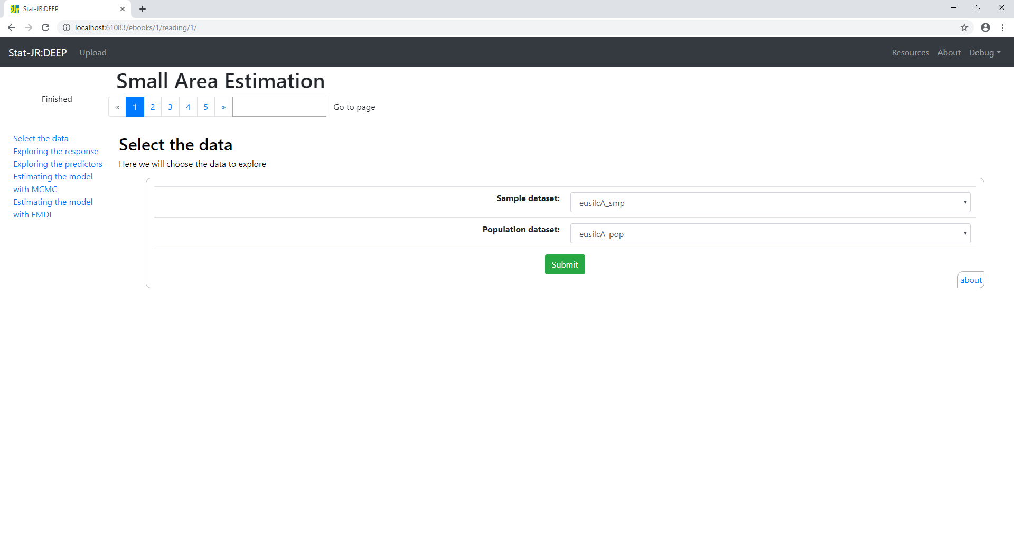
On page 1 of the eBook we simply input the datasets that contain the sample and population data.

Slide 13
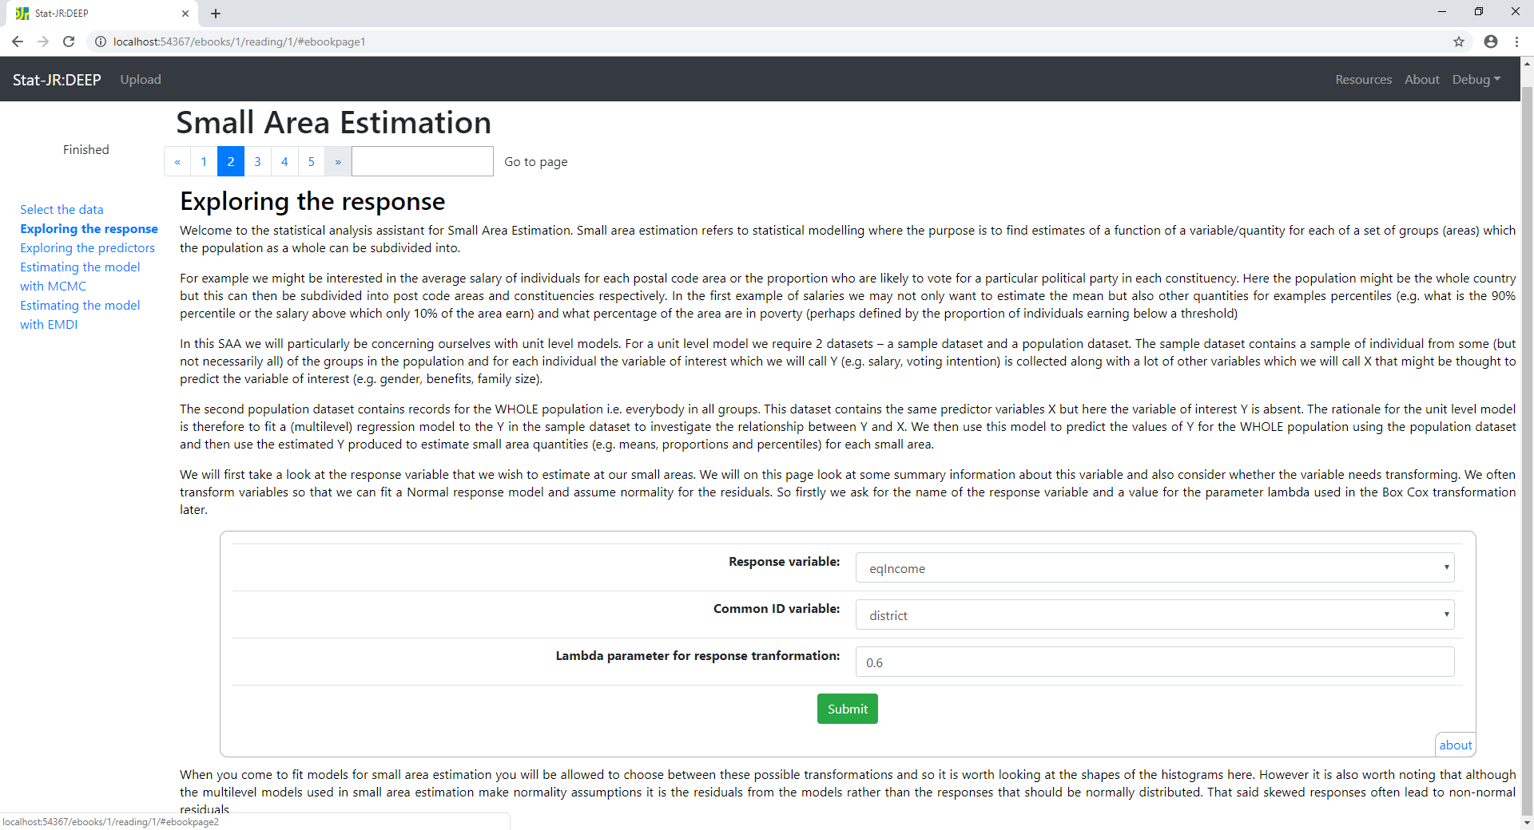
On page 2 we do some exploratory data analysis of the response variable including looking at possible transformations to allow normality.

Slide 14
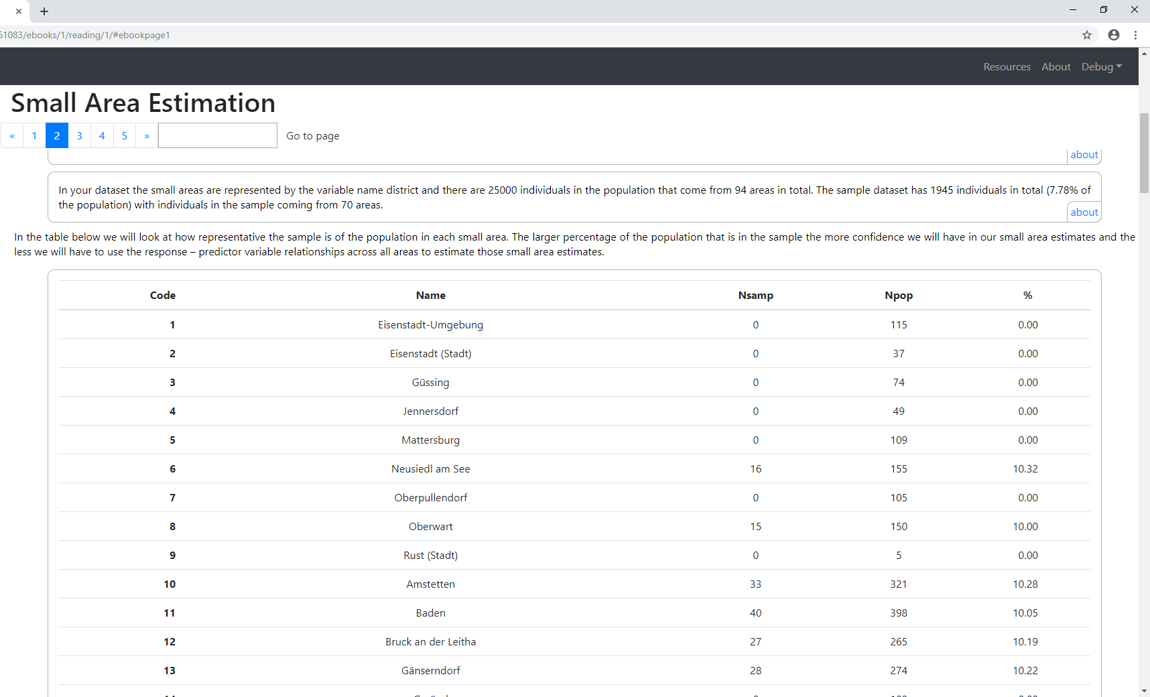
Here we see a summary of how big the sample is and then a table explaining the relative numbers in the sample from each small area

Slide 15
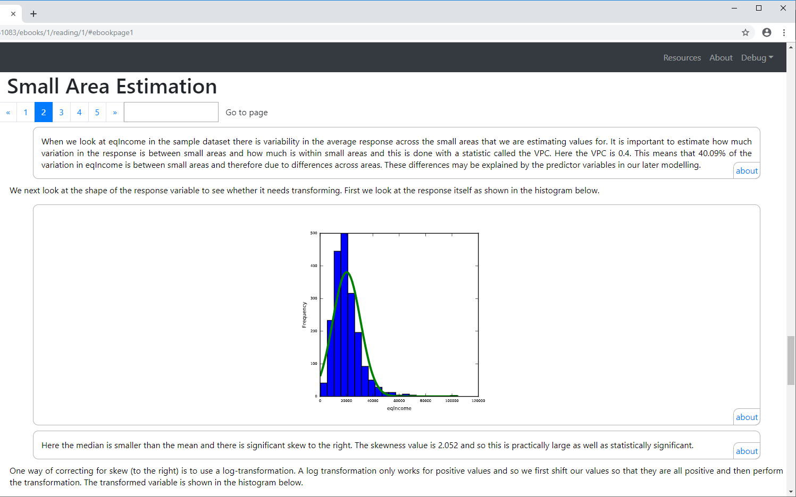
Next we look at the VPC to see how important the small areas are in the modelling. This is followed by a histogram of the untransformed variable.

Slide 16
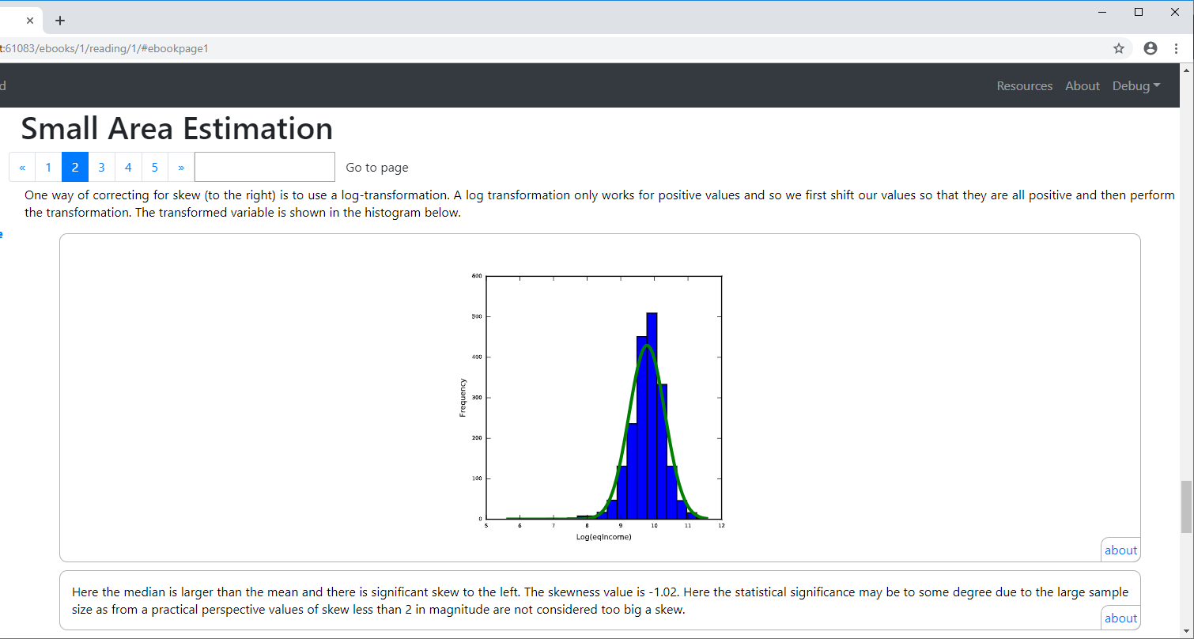
Next we look a log-transformed version of the response variable. Here this removes the skew to the right but induces skew to the left

Slide 17
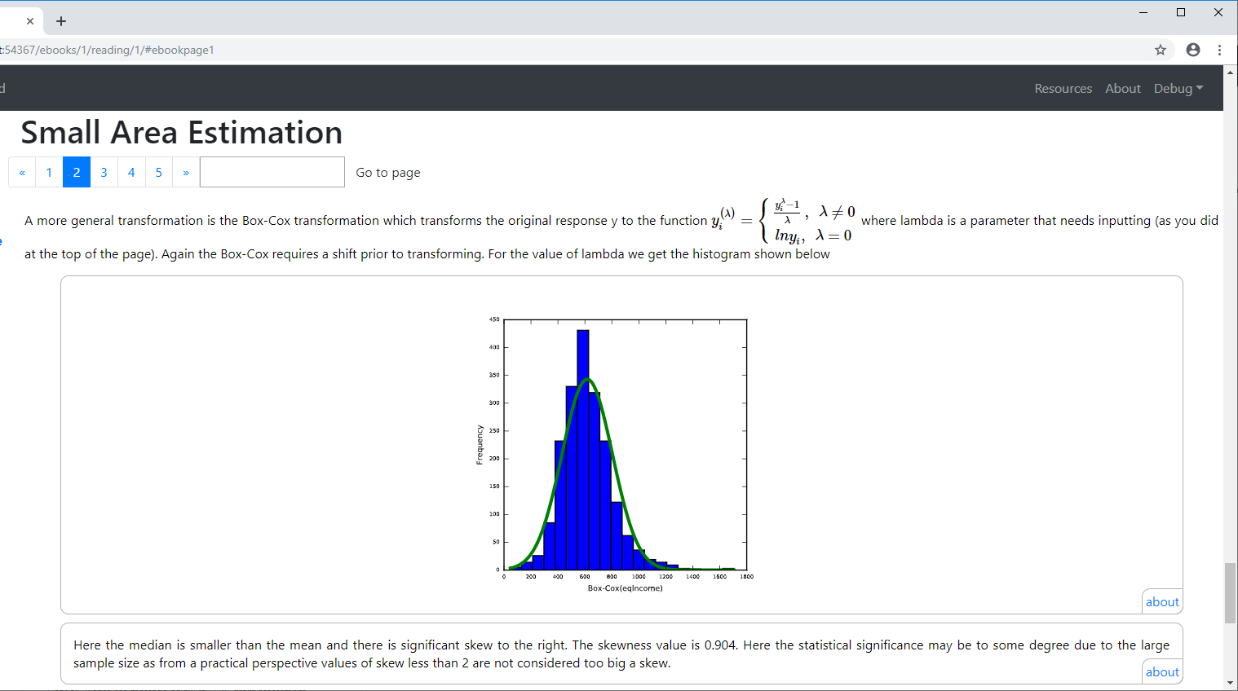
Finally we can look at the Box-Cox transform of the response and here for the value 0.7 for Lambda we still see a slight right hand skew

Slide 18
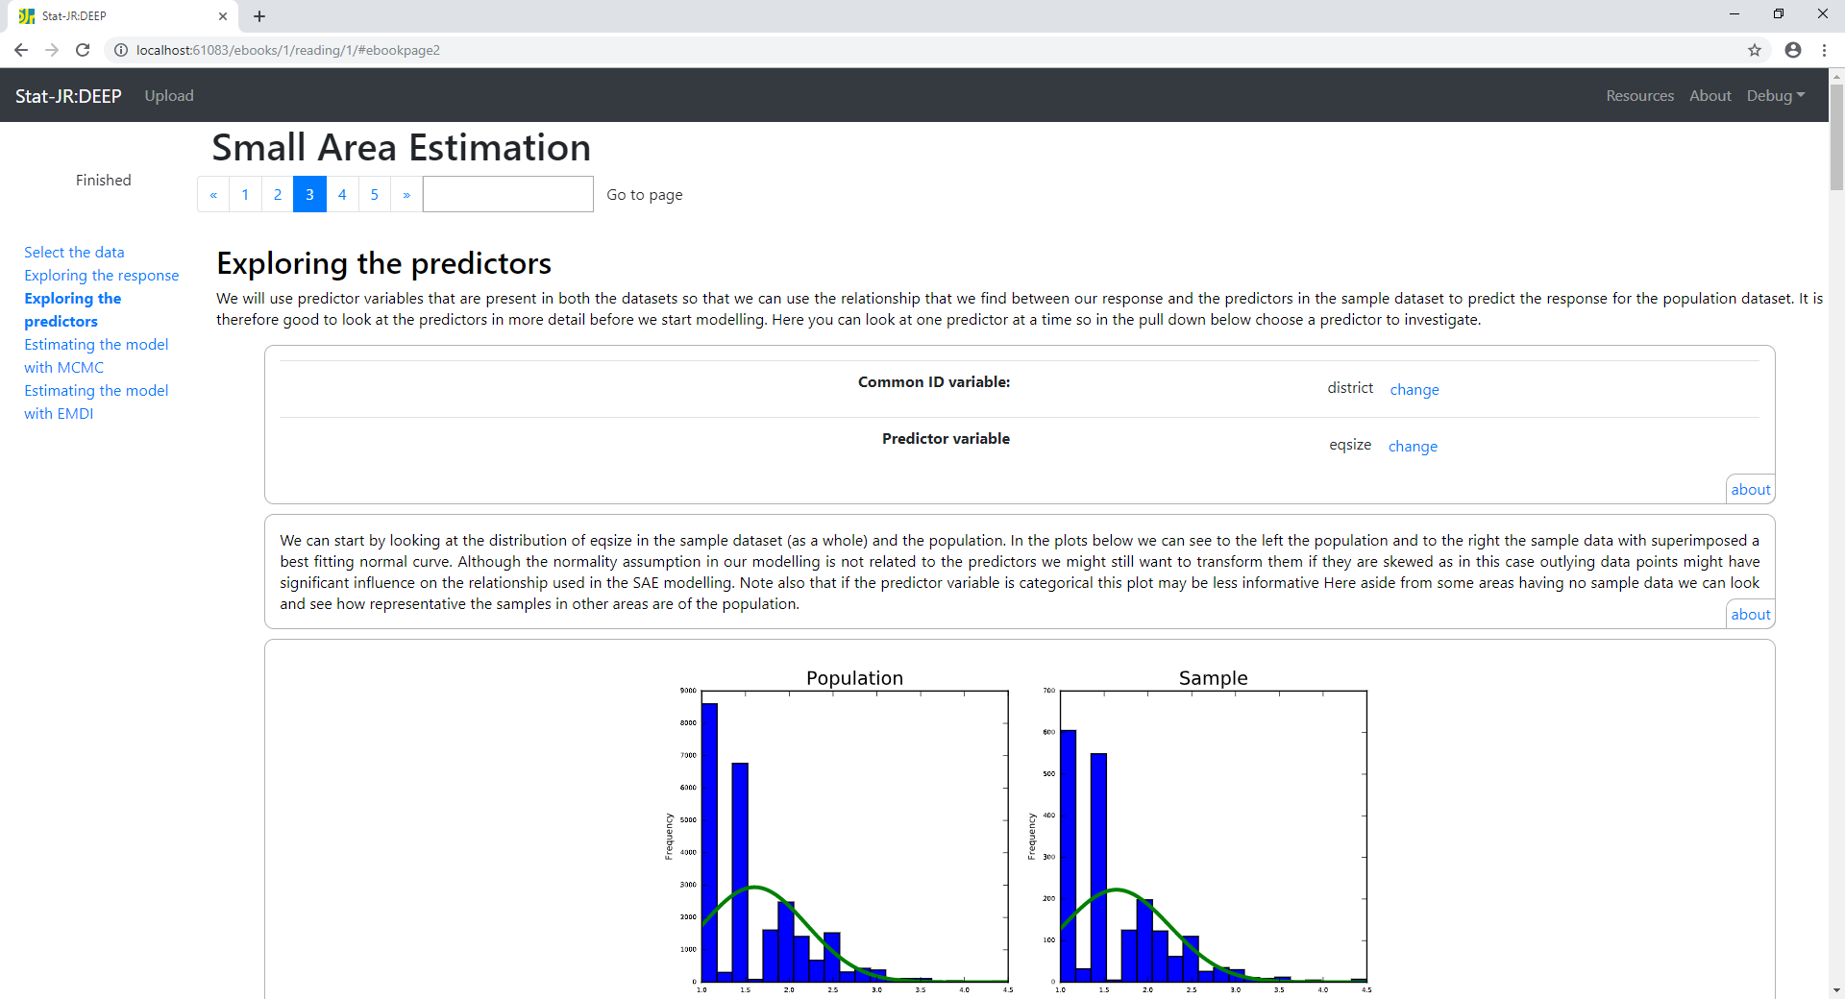
Page 3 allows us to look at any of the predictor variables before we then fit them in the model. Here we have chosen eq-size and we can see that the distribution of the variable is similar in the sample as in the population

Slide 19
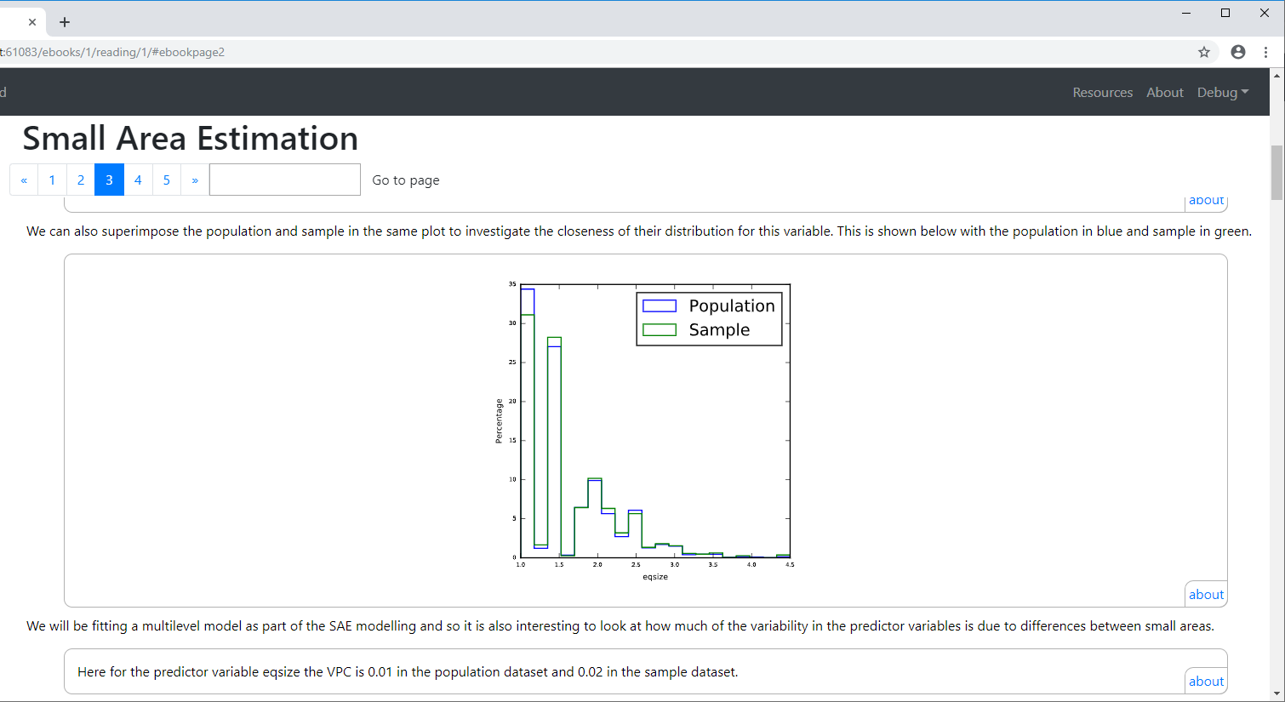
An alternative approach is to superimpose the two distributions for the population and sample on the same plot to look for differences. Here we also see the VPC calculated and the eqsize variable seems to exhibit very little variation across small areas

Slide 20
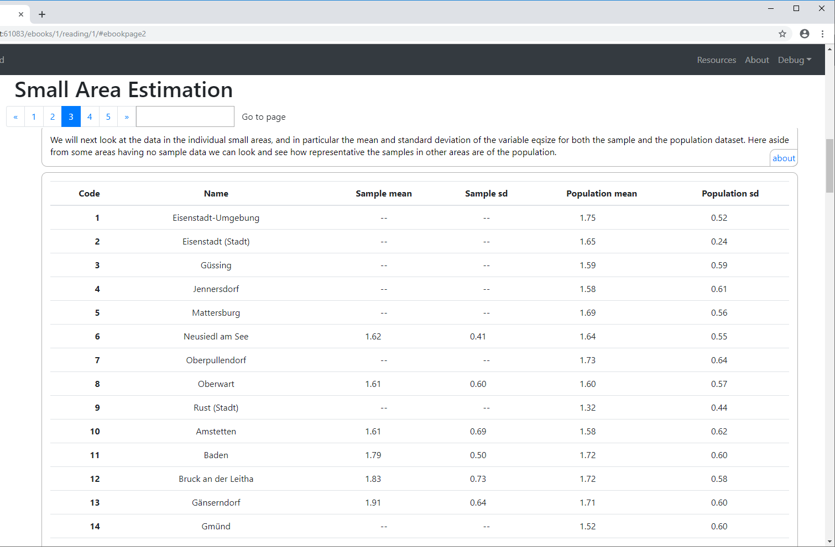
We can also look at differences for the sample and population for each small area

Slide 21
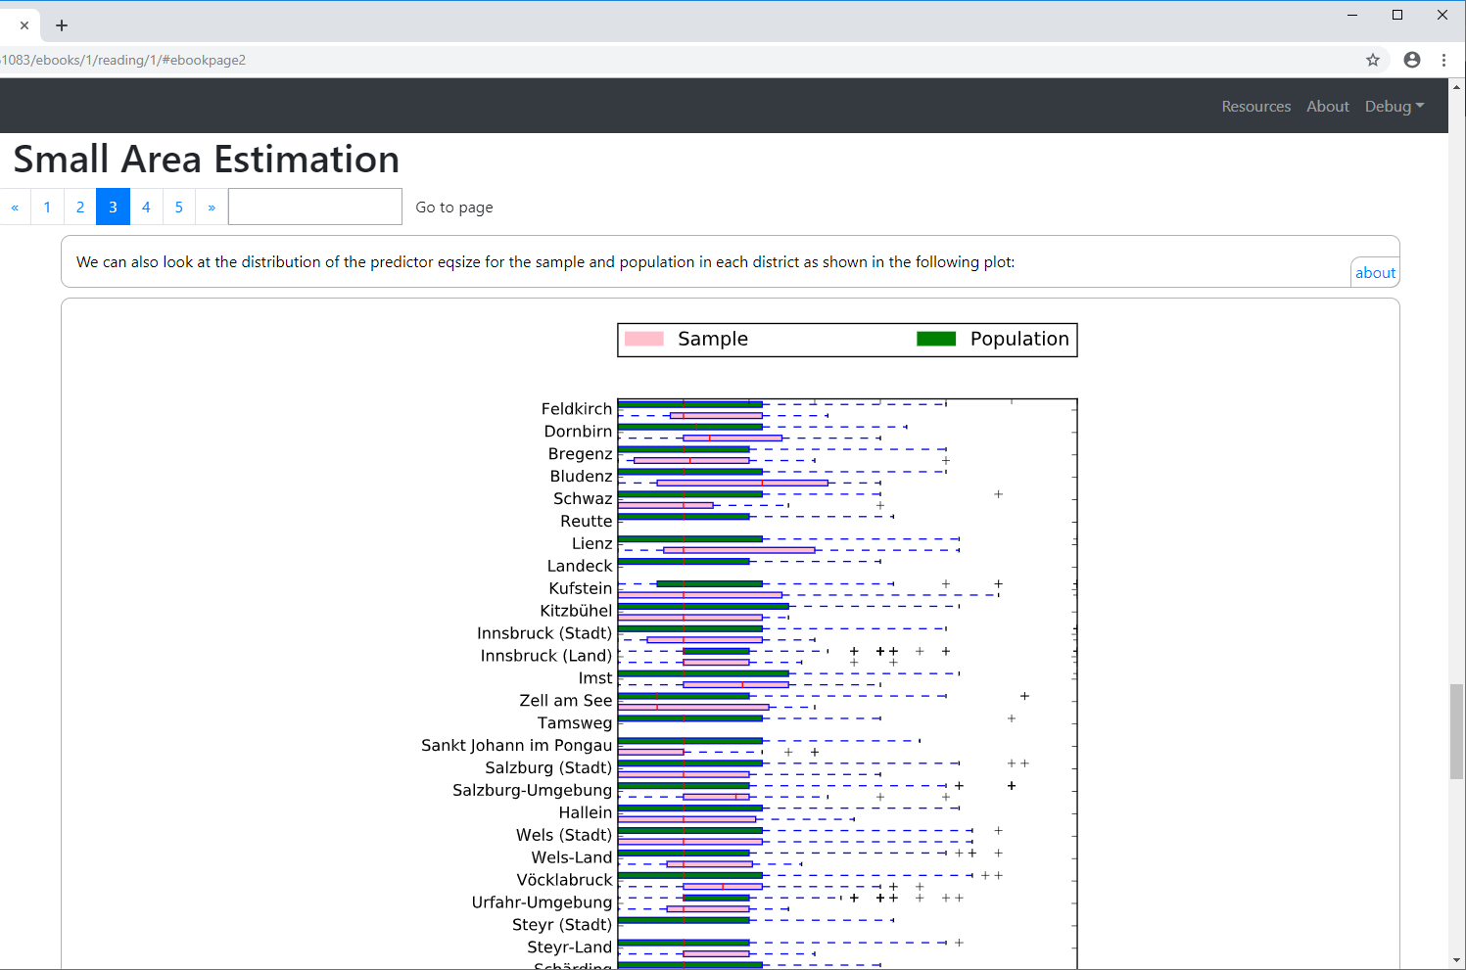
This can also be done graphically via box plots as shown below:

Slide 22
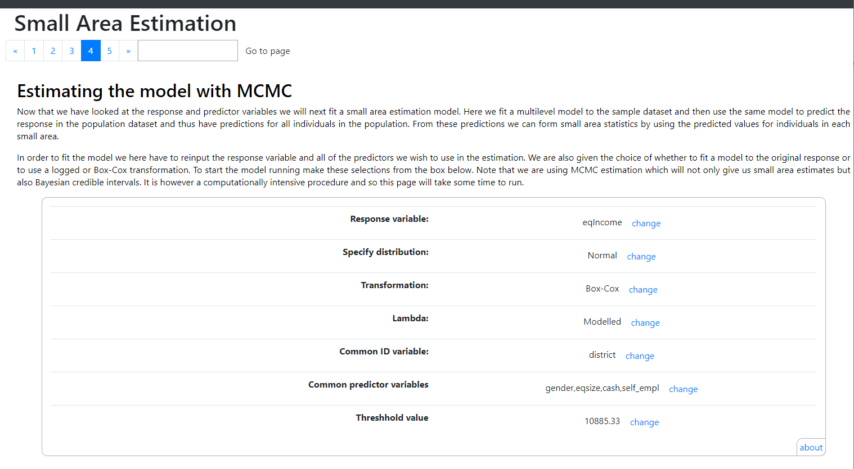
On page 4 we finally get to fit small area estimation models and here we try a model with predictors, gender, eqsize, cash, self_empl

Slide 23
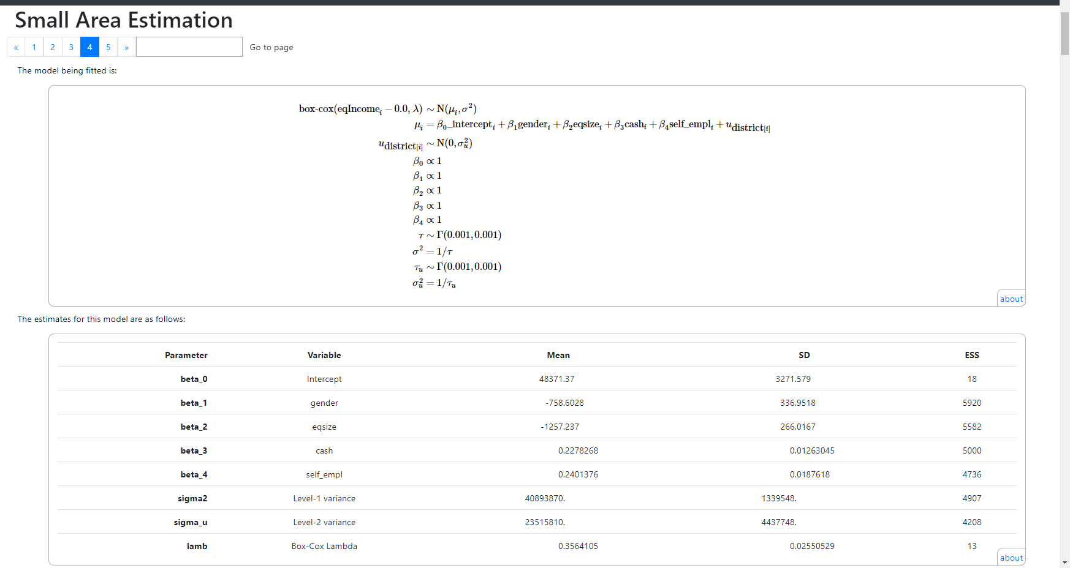
The template gives equations for the model being fitted to the sample data and some estimates for the model fit as shown here. Note the MCMC algorithm treats lambda as a parameter to be estimated in the modelling.

Slide 24
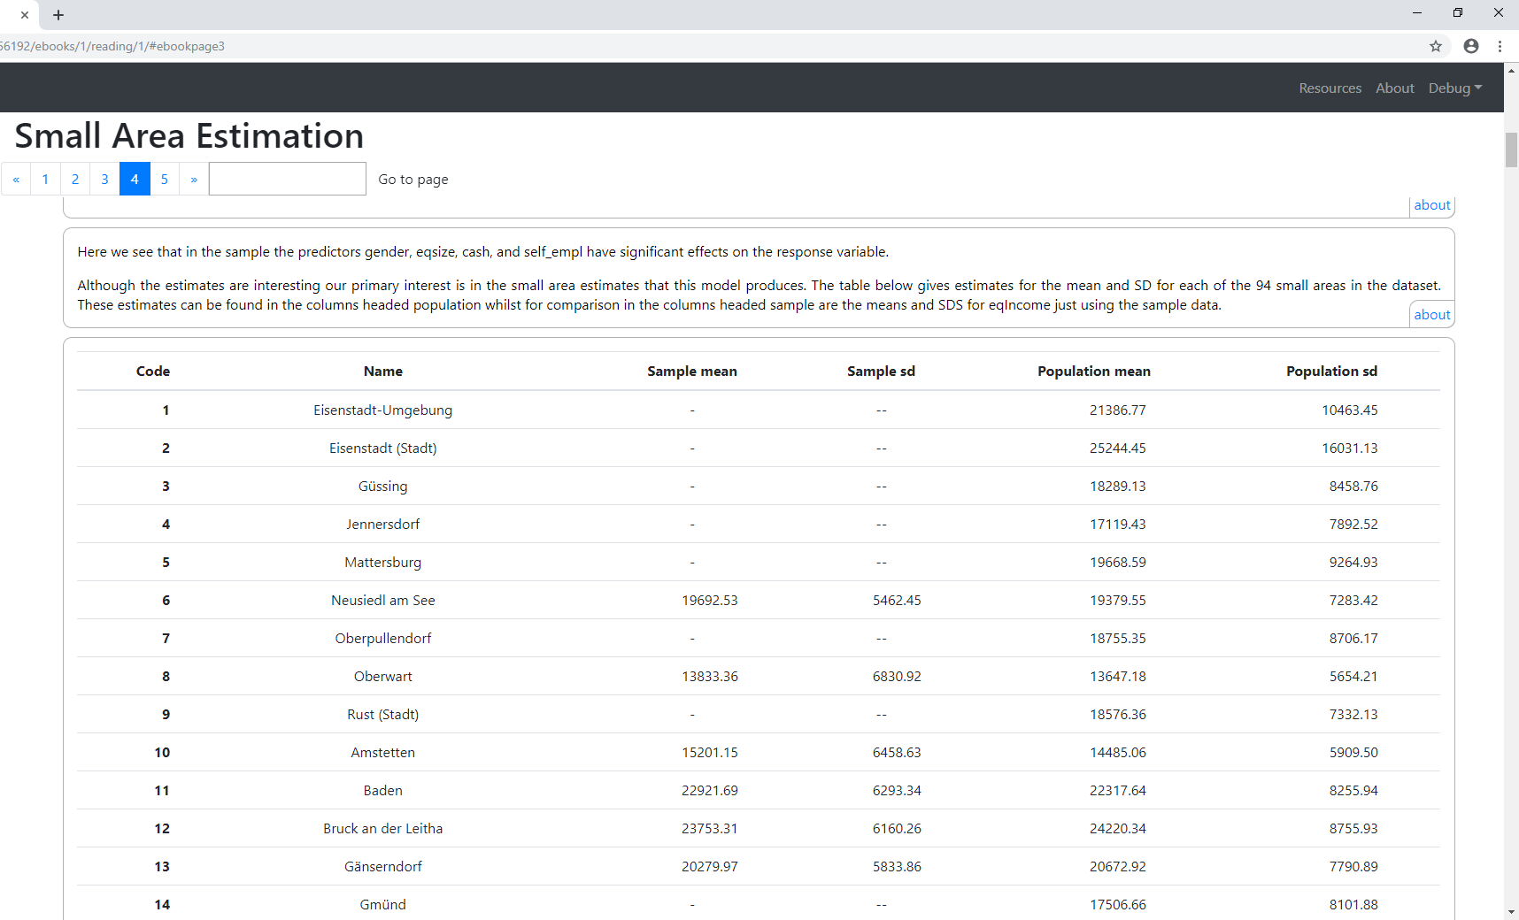
Here we see that the model has been used to produce mean and SD estimates for each of the small areas. These are compared with the mean and SD of the data in the sample (where present).

Slide 25
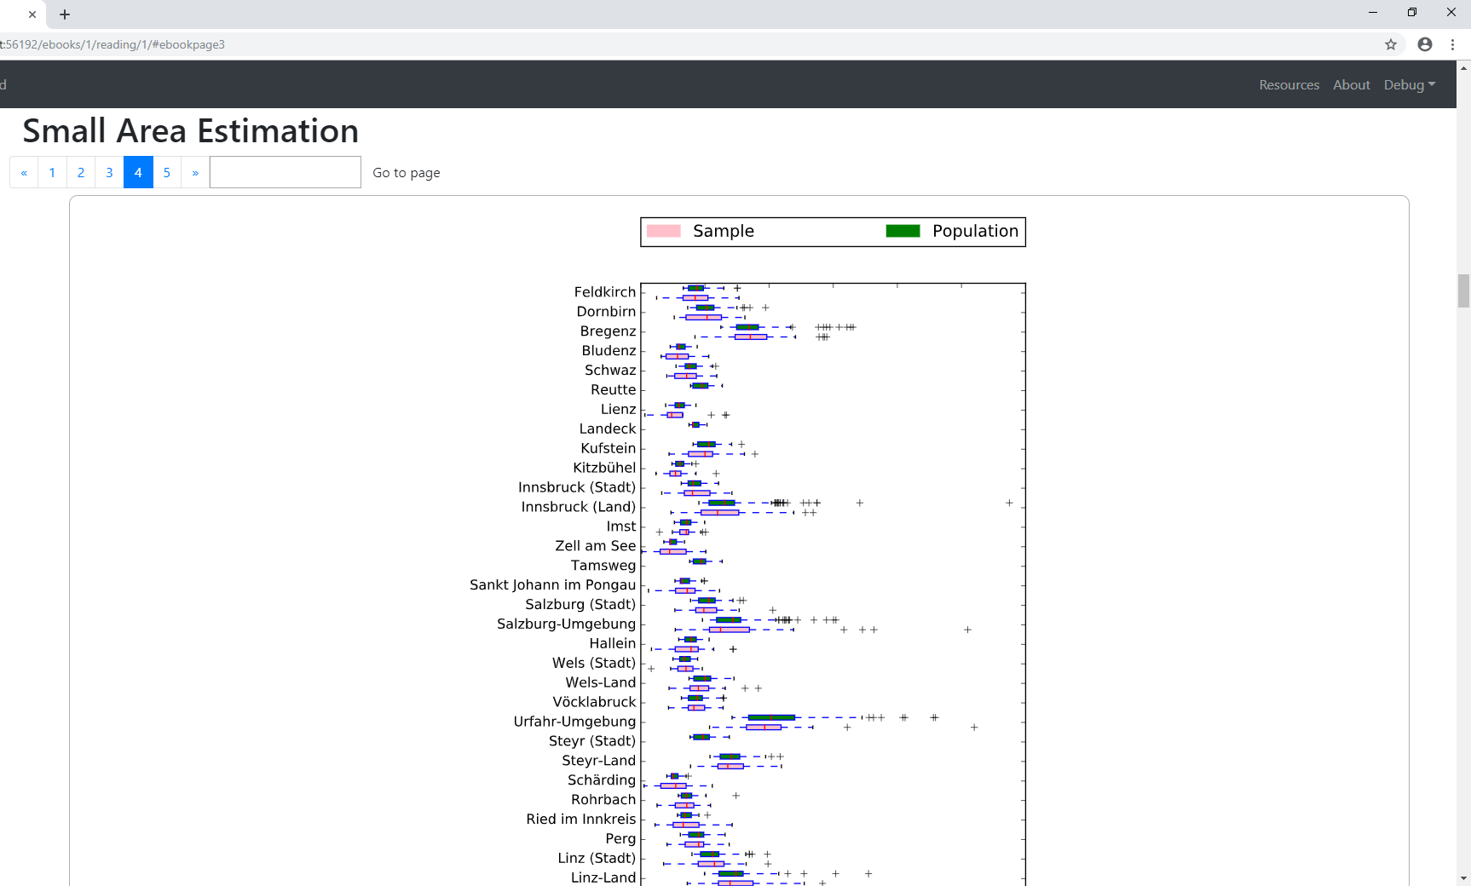
The estimates can be used to construct full distributional information as well as indicated in the box plots below – again comparing with the data from the sample alone

Slide 26
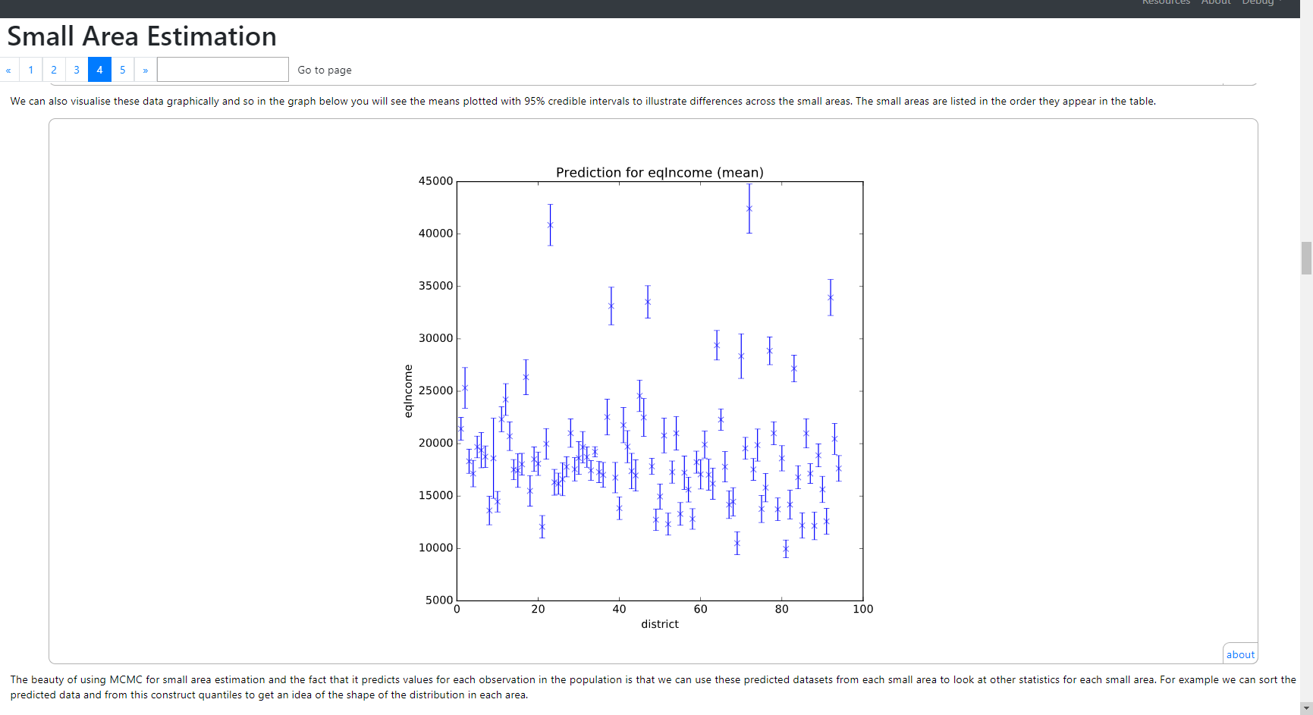
We can also plot the means along with credible intervals for each district graphically as shown below. Here we see the wide variety of mean estimates.

Slide 27
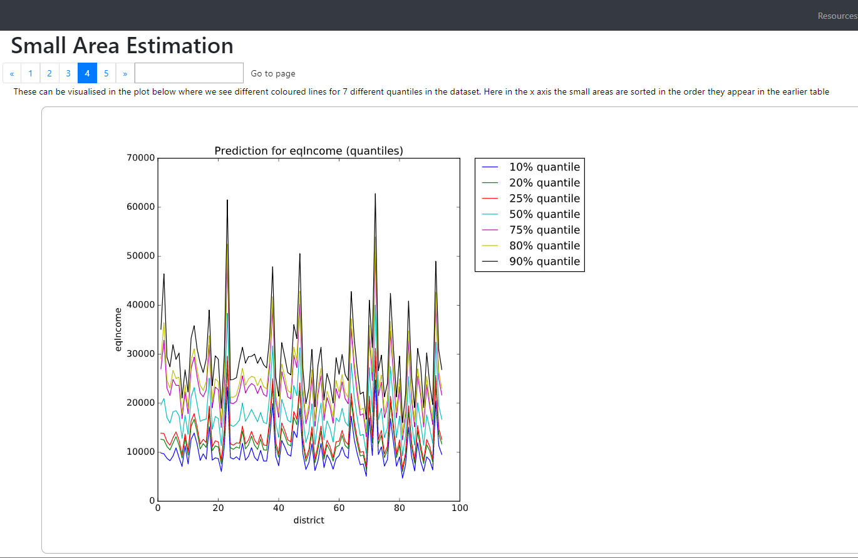
We can construct quantiles for each district from the predicted values for each individual and plot them as shown below.

Slide 28
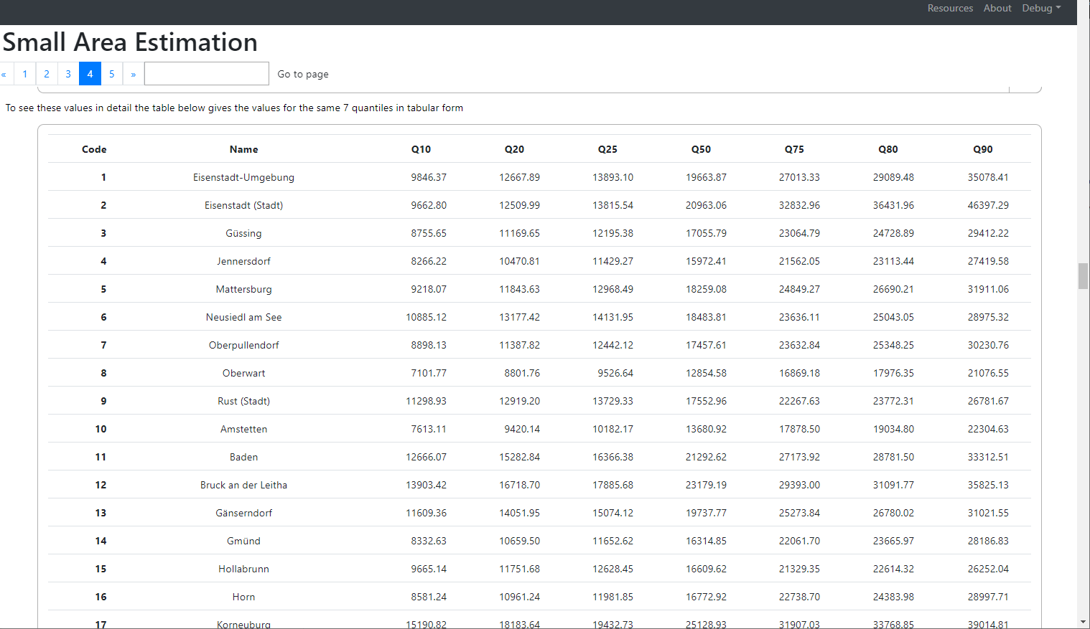
These are also made available in tabular format so that the individual names of the districts can be established and also the precise estimates.

Slide 29
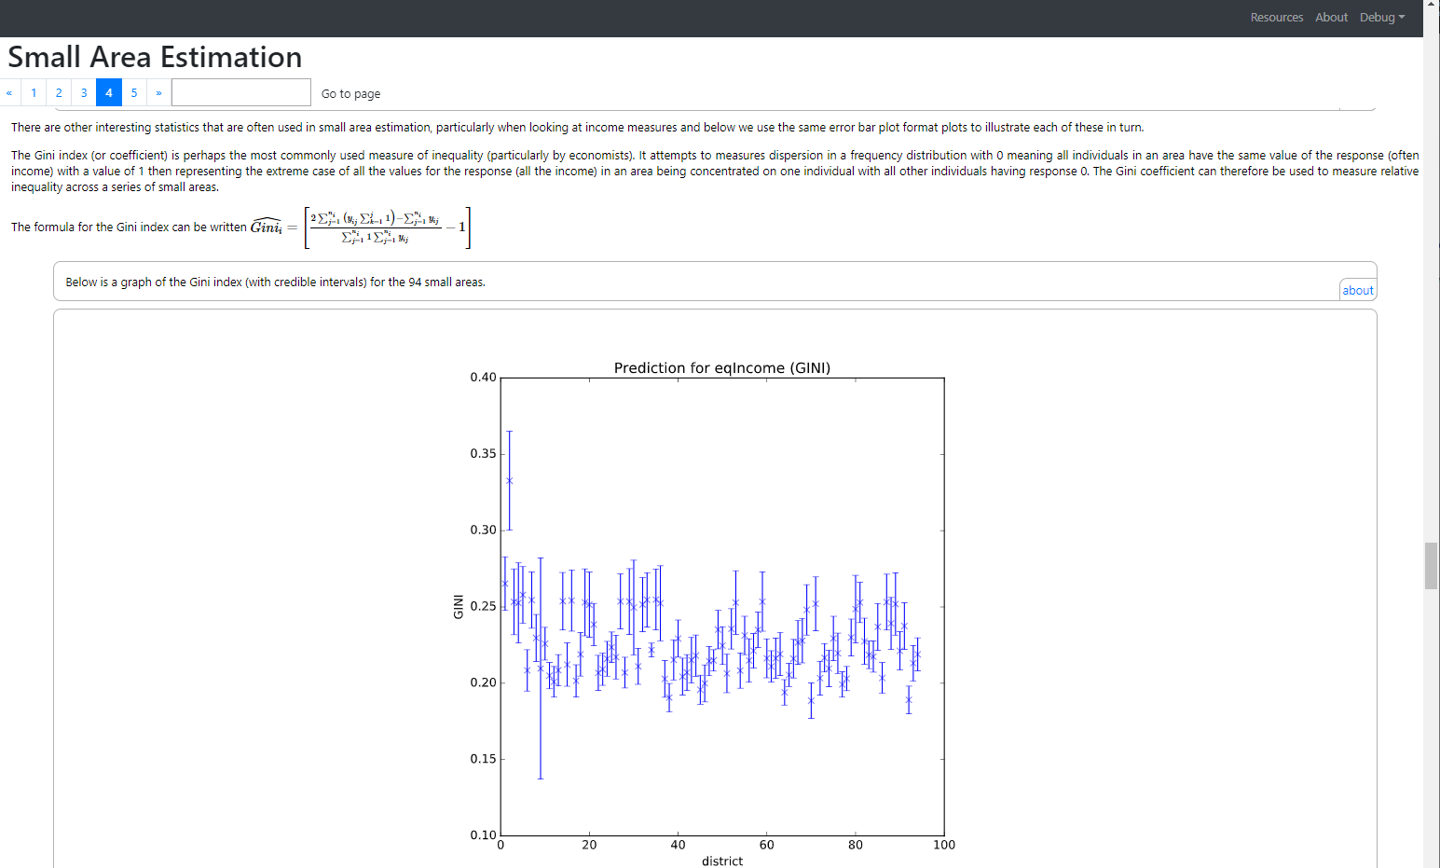
The output includes information on several poverty/inequality type indicators including the Gini index shown here. The Gini has a range of 0 to 1.

Slide 30
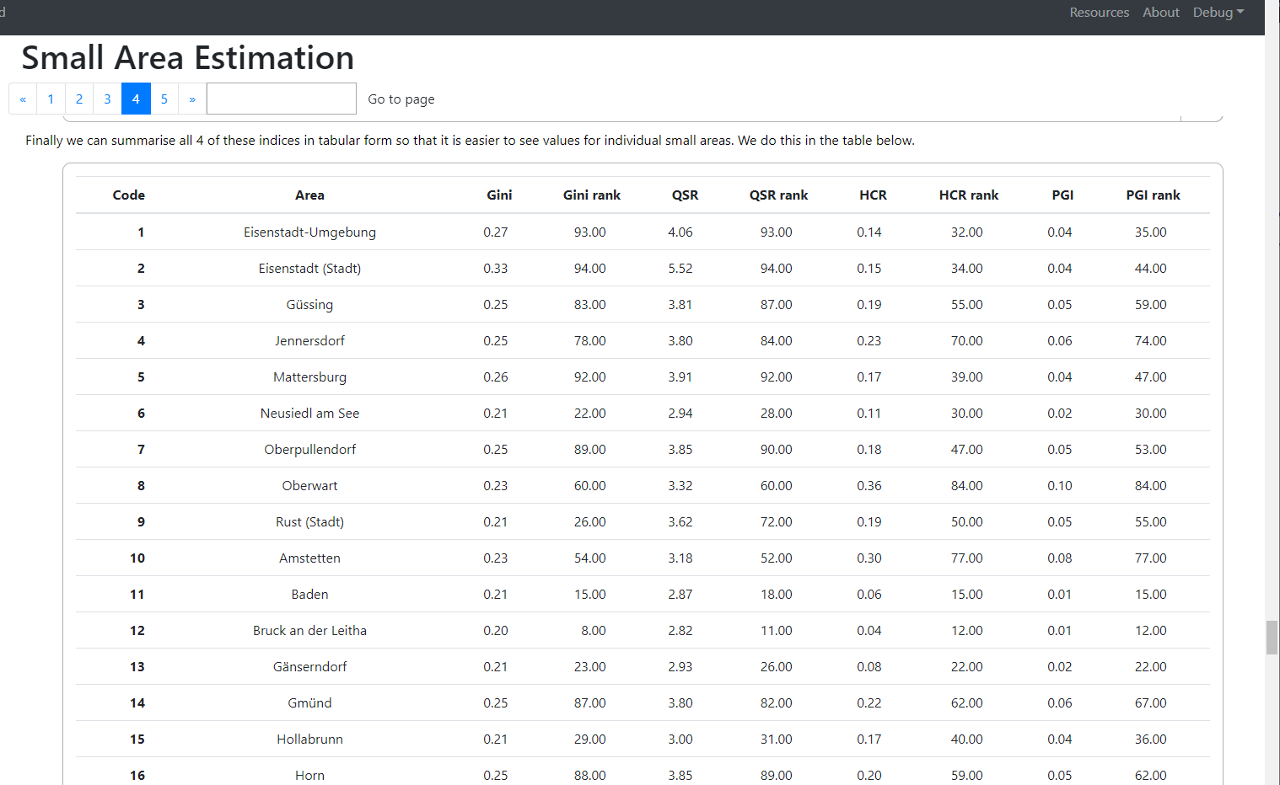
After graphs of each indicator (Gini, Quintile share ratio, head count ratio and poverty gap index their values are summarised along with ranks for the small areas in the table shown below.

Slide 31
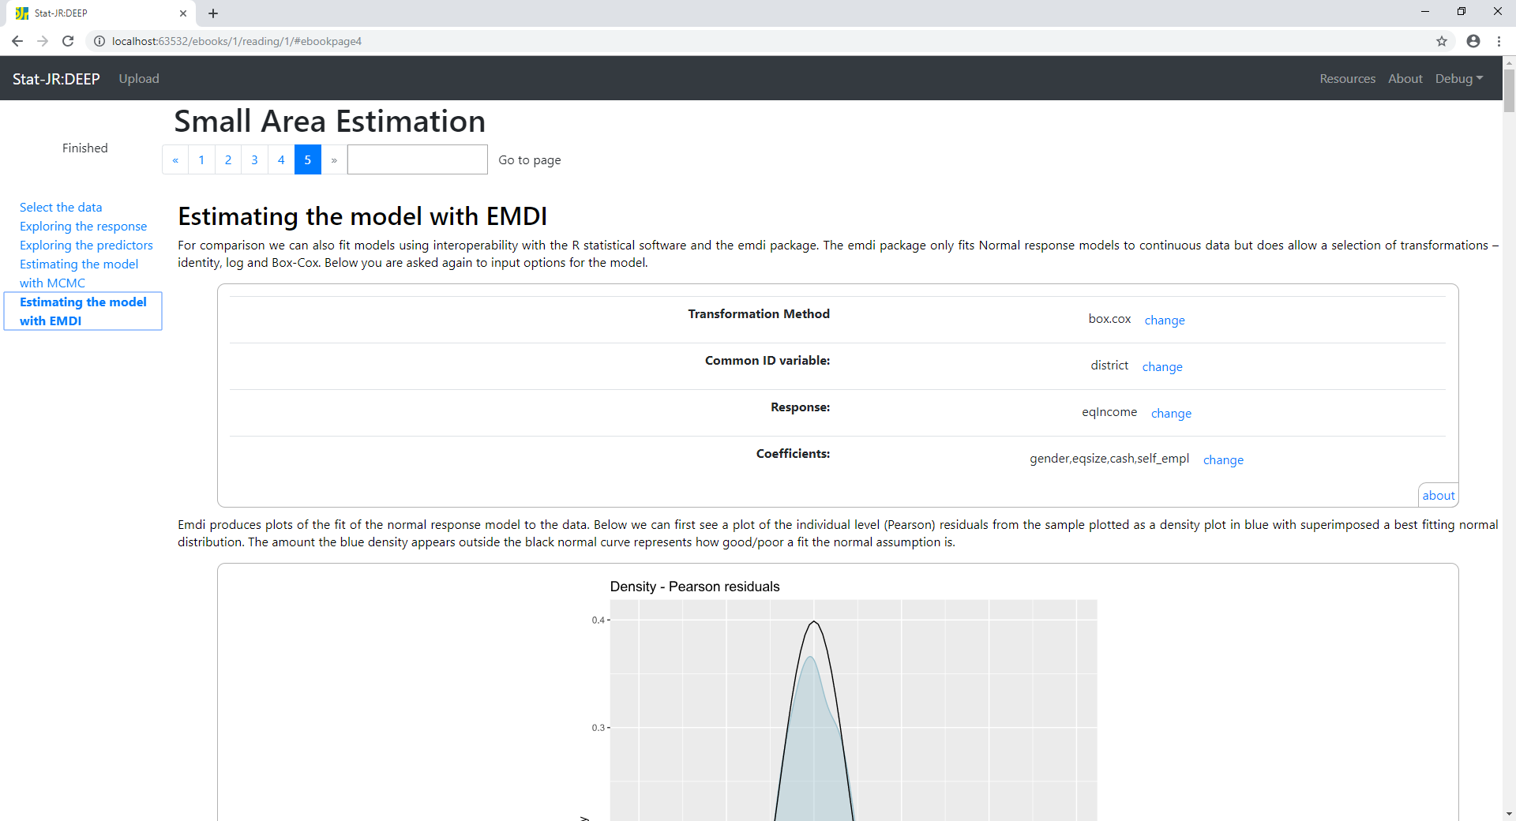
The software also allows fitting the same models using the EMDI package in R with StatJR acting as an interface to R and the same eBook used.

Slide 32
Extensions to current work – Binary responses
Given the current Brexit crisis we might be interesting in where in the UK wants to leave the EU and where wants to stay.
Small Area Estimation could be used along with data polling a random sample from the population.
The only difference is that a (multilevel) logistic regression model would be used for the remain / leave response and possible predictors like age, gender, ethnicity and voting constituency would be included.
Such an approach is often used with exit polls in parliamentary elections to predict the results in each constituency in the election and thus the overall result.

Slide 33
Summary
In this talk we have introduced SAE modelling and how the StatJR software can be used to fit such models.
We have seen that StatJR contains an MCMC implementation but also has interoperability functionality to allow calling of other software e.g. R
We have also seen that StatJR has an eBook interface that can be used to create easy to use interfaces to the underlying methodology and embed the model results in a larger modelling workflow.
Currently the templates and eBooks in StatJR are still in development but will be soon made available to the user community.
For more information on StatJR see http://www.bristol.ac.uk/cmm/software/statjr/

