Slide 1
School of Social and Community Medicine Induction for Postgraduate Students
2016-17

Slide 2
Faculty Structure
Faculty of Health Sciences
Centre for Health Sciences Education and 4 Schools
School of Oral and Dental Sciences
School of Veterinary Sciences
School of Clinical Sciences
School of Social and Community Medicine
Two main sites: Canynge Hall & Oakfield House
from 1 August 2017
School of Social and Clinical Medicine: SOCS+SSCM
Notes:
Centre for Health Sciences Education
School of Clinical Sciences
School of Social and Community Medicine
School of Oral and Dental Sciences
School of Veterinary Sciences
from 1 August 2017: School of Social and Clinical Medicine: SOCS + SSCM

Slide 3
Higher degrees in SSCM
Currently 78 PhD /MD students
Funding bodies: Wellcome, MRC, UoB, other, self-funding
Range of subjects, methodologies & settings: aetiological epidemiology, molecular/genetic epidemiology, statistics, mathematical and computational approaches, meta-analysis, health economics, health services research, primary care, psychiatry, ethics, child health
School policy
Entry, facilities, supervision, support, monitoring, reviews
Notes:
Mention that will get a feel for the very broad range of topics covered by our phd students and post-grads during the poster session

Slide 4
SSCM Postgraduate Team
Co-Directors of Graduate Studies
William Hollingworth (CH supervisors)
Nicola Wiles (OH/other supervisors)
Graduate Tutors
Tom Gaunt (Recruitment)
Jonathan Ives (Admissions)
Sandra Hollinghurst (Training)
Sarah Lewis (Annual Reviews)
Administrator: Sharen O’Keefe
Student Reps: Laurence Howe, Ryan Langdon

Slide 5
Buddies
Buddy system provides new students with a point of contact within the student network
Help out with any day-to-day issues & practicalities whilst settling into the School
NOT an advisory or support role – see Supervisor or Director of Graduate Studies
Notes:
Mention they will help orientate to social spaces within buildings

Slide 6
How students are supported at Bristol
Academic Schools – your ‘home’ for the duration of your studies
Student Services – professional support that you can be referred to or refer yourself
Students’ Union – advice, support, representation
Notes:
Academic Schools
Students ‘belong’ to a School or Schools if they are on a joint honours programme. They are the primary source of support for students.
They will direct your studies, support you to develop and refine skills, and help you further your knowledge and understanding of your discipline.
Student Services
The University has a range of professional services that you can either be referred to or you can refer yourself. They support wellbeing and academic-related matters.
Students’ Union
Run by students and a team of professional staff on behalf of the student body.
Advice: on all manner of issues that is independent of the University.
Support: (and guidance available) from professional advisers.
Representation: campaigning on issues important to student on your behalf

Slide 7
What Student Services are available to support you during your studies?
Students Health Service
Student Counselling Service
Disability Services
Careers Service
Just Ask (Students Union)
International Advice and Support Service
Multi-faith Chaplaincy
Accommodation Office
Notes:
Students’ Health Service
A full NHS GP practice offering free, comprehensive healthcare for all students within catchment area.
If you are ill for more than 7 days and it affects your attendance or performance then you need to see a doctor.
Please give a brief overview of the EC’s process and how we have to triangulate claims with supporting evidence, so advise students to consult their GP.
Student Counselling Service
Support with managing stress, academic pressure, dealing with procrastination etc. Full details on website.
Disability Services
Provide confidential advice and study support to disabled students. They can work with the school too.
They offer an appointment based service so please contact them to arrange to meet or speak with a Adviser.
Careers Service and your employability
We suggest that there is a brief mention of the existence of the Careers Service and the importance of employability, but signpost that more information will come via the School later in the term.
Just Ask (Student’s Union)
Just Ask is the Students’ Union advice and support service.
They run revision campaigns and help with queries year round.
International Advice and Support Service
It is helpful to recognise that international students will have had different prior academic experience.
Multifaith Chaplaincy
They offer support to all members of the University regardless of belief or background. Those without faith are equally welcome. They host a number of worship and meditation groups, lunches and other opportunities to explore faith and spirituality.

Slide 8
School Policies and sources of info
School PG website
http://www.bristol.ac.uk/social-community-medicine/courses/postgraduate/
School handbook: policies, procedures and useful information
http://www.bris.ac.uk/social-community-medicine/postgrad/pdf/postgradpolicy.pdf
Frequently Asked Questions
http://www.bris.ac.uk/social-community-medicine/postgrad/pdf/faqscurrent.pdf

Slide 9
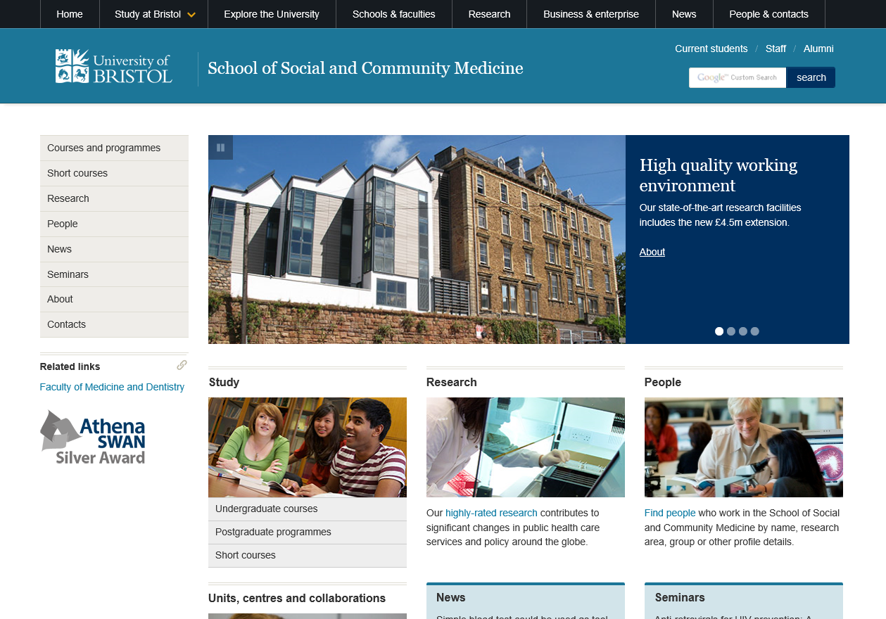

Slide 10
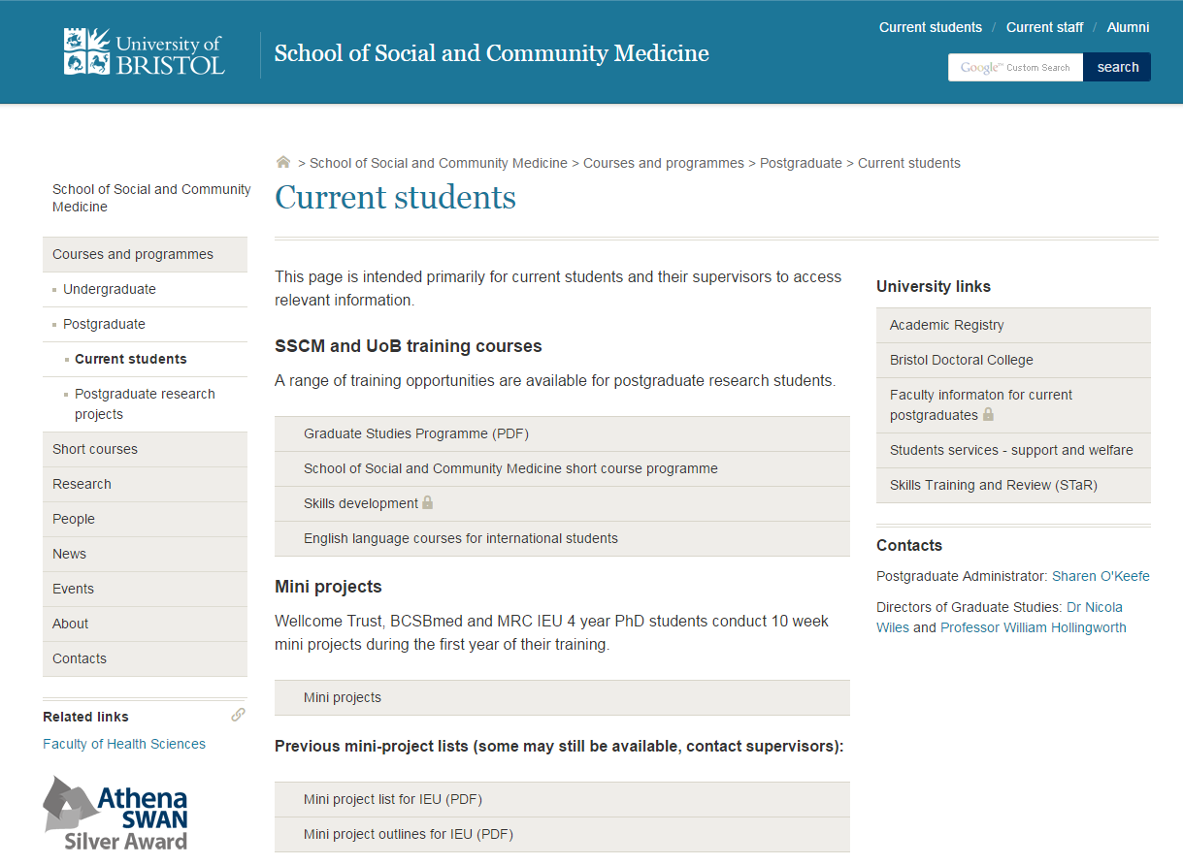

Slide 12
Health and Safety
The School policy should be read at:
https://www.bris.ac.uk/social-community-medicine/intranet/health-safety/
Students working with human tissue/biological samples MUST be introduced to the HTA Designated Individual (Sue Ring) and/or the biological safety officer (Wendy McArdle) for Human Tissue Act induction & Biological Safety registration
http://www.bristol.ac.uk/red/research-governance/human-tissue/
Notes:
Mention Health and Safety with Claire Snadden – she would also be a good person to ask about issues re: timing of access to buildings
Mention IT induction – will also be able to provide information on remote access to servers
Also mention there is a Lab safety induction that is mandatory for those students who will be working in the labs

Slide 13
Research conduct & misconduct
“A student’s research and dissertation are ultimately his or her own responsibility.”
Be aware of the University Code of Practice on Research Misconduct especially regarding
ethics
data protection
distortion/dishonesty regarding results
plagiarism
Notes:
Students should familiarise themselves with the University’s Regulations on Research Misconduct. Plagiarism, or the unacknowledged use of another person’s work, is a serious form of academic misconduct, and students should understand the consequences of plagiarism, as set out in the Examination Regulations and Student Disciplinary Regulations. All these documents are set out in Rules and Regulations for Students, the Statutes, Ordinances, Regulations and Official Records and on the Web.

Slide 14
Research ethics
Faculty of Health Sciences Committee for Ethics: https://www.bris.ac.uk/health-sciences/ethics/
Research in the NHS (IRAS & HRA): https://www.myresearchproject.org.uk/
Short Course on “Research Governance” – all MUST attend
Also be aware of School policies: https://www.bris.ac.uk/social-community-medicine/intranet/policy/index.html

Slide 15
Plagiarism
Plagiarism - unacknowledged inclusion in a student’s work of material derived from the published or unpublished work of another. This constitutes plagiarism whether it is intentional or unintentional. “Work” includes internet sources as well as printed material
Any thesis, dissertation, essay, or other course work must be the student’s own work and must not contain plagiarised material. Any instance of plagiarism in such coursework will be treated as an offence under these regulations. (University's Examination Regulations Section 3.1)
http://www.bristol.ac.uk/library/support/findinginfo/plagiarism/
Notes:
Mention plans to require electronic submission of thesis through plagiarism software package

Slide 16
Turnitin – Plagiarism detection software
From 1st January 2015 all postgraduate research students are required to submit an electronic version of their final dissertation for text checking (using Turnitin), in addition to the two hard copies submitted to the Exams Office.
The report from Turnitin will help to ensure that all submitted text for marking is the student's own and that appropriate systems for referencing and correct citation have been used.
You will have opportunities to receive formative feedback on submissions through Turnitin during the course of your studies.

Slide 17
Regulations
Cannot include work already submitted to any degree awarding body
http://www.bristol.ac.uk/exams/research/
PhD: should not exceed 80,000 words excluding references, appendices & lists of contents
Regulations different for MD and PhD by publication

Slide 18
Bristol Doctoral College
http://www.bristol.ac.uk/doctoral-college/about/
Provides a focal point for doctoral training activity across the University
Key aims are to:
Provide a hub of information and guidance for all PG students working towards a doctoral degree
Coordinate a central skills training and researcher development programme to support postgraduates

Slide 19
STaR
Online tool designed for PG researchers to:
Record meetings with supervisors, setting and managing research objectives;
Explore skills training and researcher development opportunities, planning and tracking development needs;
Access a public space on Pure (UoB's research information system) to upload publications and develop an online profile;
Keep or share documents and notes on any aspect of research;
Complete the forms and processes required for regular Progress Monitoring
http://www.bristol.ac.uk/doctoral-college/star/

Slide 20
Research and skills training
Short course programme:
http://www.bris.ac.uk/social-community-medicine/shortcourse/
Supervisors to approve all short courses and when it is best for these to be done
Spread short courses throughout the 3-4 years of your PhD programme to reflect training needs during each specific year
e.g. Year 1: Basic research training
Years 2/3: Advanced research training relevant to PhD
Years 3/4: Wider skills training, beyond the specific PhD requirements, if required)

Slide 21
Research and skills training (cont.)
SSCM Graduate Studies Programme
http://www.bris.ac.uk/social-community-medicine/postgrad/pdf/graduateprogramme.pdf
~monthly in term time
responsive to student needs
attendance expected at mini-symposiums

Slide 22
SSCM Graduate Studies Programme 2016/17
14th October 2016 | Library Induction –Sarah Herring Literature Searching -Sarah Herring | 9.30-10.45 11.15-13.15
31st October 2016 | Introduction to Endnote-Cath Borwick | 13.30-15.30
9th November 2016 | Introduction to Stata-Sue Ingle | 09.00-11.00
29th November 2016 | Systematic Literature Reviews-Cath Borwick | 13.00-15.00
7th December 2016 | Postgraduate Symposium (1st years and those in Year 2 of a 4 yr PhD) with lunch | 12.30-14.30
13th December 2016 | Pure and Open Access-Cath Borwick | 09.00-11.00
23rd January 2016 | Stress, resilience and self-care for PhD students-Alison Gregory | 13.00-14.00
25th January 2017 | Sam Creavin (Student led session)-Measures of diagnostic accuracy, study design and meta-analysis of diagnostic studies. | 12.00-13.00
20th February 2017 | Will Hunter 'Engaging with public audiences' Twitter, communications and public engagement | 13.00-14.30
23rd February 2017 | Stata hints and tips-Trainer TBC | 12.30-14.30
10th March 2017 | Creating a poster-Pete Moore | 9.30-12.30
29th March 2017 | Presentation skills- Pete Moore | 9.15-16.30
4th May 2017 | Submitting a thesis & turnitin-Will Hollingworth | 13.00-14.30
16th June 2017 | Applying for grant/fellowship funding-Collette Sheahan | 13.00-14.30
Thursday 13th July 2017 | Postgraduate Symposium (3rd years and 4th years) with lunch | 12.30-14.30
Notes:
http://www.bris.ac.uk/social-community-medicine/media/phd/current/graduateprogramme.pdf

Slide 23
Research and skills training (cont.)
Questionnaire design
guidelines have been drawn up using a wide range of epidemiological and HSR experience to ensure that data are collected, managed and analysed effectively
https://www.bris.ac.uk/social-community-medicine/intranet/research/quesdesign.html
Other UoB training available via STaR
https://www.bris.ac.uk/doctoral-college/current/star-pgr/

Slide 24
SSCM Discussion Board
Blackboard is the Univ online learning environment
There is a SSCM discussion board
You will automatically be added when you start your PhD
The board is set up with a few forums for resources, lab techniques, statistics and useful information

Slide 25
Registration
Be aware of your minimum & maximum periods of study
For full-time PhD, minimum period of study is 3 years, maximum 4 years
some studentships e.g. UoB: 3 years
others e.g. Wellcome Trust: (1+ 3) 4 years
For full-time MD, minimum period of study is 2 years, maximum 5 years
Notes:
Regulations state that the period allowed for writing up is one year – which applies to 3-yr PhD programmes – NW/WH seeking clarification for those on 4-yr PhD programme
Mention that in regs – part-time students are not always treated on a pro-rata basis so need to check before assuming.
e.g. Period allowed for writing up for 3-yr PhD students is one year for both full-time and part-time students

Slide 26
Suspensions and Extensions
Suspensions
Stop clock (maternity leave, illness, family or financial probs)
Form and supporting docs, Support of supervisors, Funder approval
Request to DGS
Considered by Graduate Dean
Extensions
Extend study period (‘exceptional circumstances’)
At least 3-4 months before end of period of study
Form and supporting docs, Support of supervisors, Funder approval
Request to DGS
Considered by Graduate Dean if <12 months, otherwise Vice Chancellor
Additional fee may be payable
Visa implications for international students

Slide 27
Holidays
Students are entitled to 25 days holidays per year in addition to the days when the university is closed.

Slide 28
Health and Sickness absence
You need to register with a GP
Student Health Services if within catchment area
http://www.bristol.ac.uk/students-health/
If you are ill, you should inform your supervisor by phone or email and on return to your studies complete a sickness form and return it to: Nancy.Horlick@bristol.ac.uk
If unwell for 8 days in a row – need sick ((un)‘fit’) note
It is very important to see a doctor if you are unwell for more than 7 days and illness is affecting your attendance or performance

Slide 29
Supervision
Always two supervisors, occasionally three
Assistance, advice, guidance, encouragement...
Regular formal meetings
Timely feedback on progress
Change of supervisor is possible

Slide 30
Defining roles: students and supervisors
Role of student
Role of supervisors

Slide 31
Role of postgraduate student
Research/thesis is student’s responsibility
“Candidate must satisfy the examiners that s/he is well acquainted with the general field of knowledge to which the subject relates …
Dissertation must be a significant original contribution to knowledge, showing evidence of originality and critical power …
Literary form must be satisfactory.”

Slide 32
Role of the supervisors
To provide encouragement and guidance
To advise about appropriate training courses, seminars, conferences etc.
To meet student regularly and provide feedback on written work and progress
To advise on submission of dissertation and examination procedures

Slide 33
Conduct of the research: student
Meet regularly with adviser
Submit legible written work regularly
Meet deadlines set whenever possible
Take responsibility for re-negotiating deadlines not met
Student is responsible for recording minutes of supervisor meetings & formal action points
use proforma or STaR’s ‘objectives’ and ‘notes & narratives’
Submit annual progress reports (via STaR)
Attend appropriate training, seminars, conferences etc.
Attend Graduate Studies Programme

Slide 34
Conduct of the research: supervisors
To encourage student to attend appropriate training, seminars etc.
To provide guidance with
Selecting a topic
Planning the research
Progress of the research
Submitting the dissertation
Publishing research

Slide 35
Conduct of relationship
Regular meetings
not less than once per fortnight in first year and not less than once per month thereafter (F/T)
at least one hour in duration
written work should be delivered before meeting, allowing sufficient time for reading & comments
comments on written work should be available in advance

Slide 36
The first meeting
Should occur in first week!
Should discuss
supervisory arrangements
arrangements for written research plan
nature of degree (MD/PhD)
expected completion date(s)
arrangement for future meetings/progress

Slide 37
Budgets
Know your budget for consumables, training, travel & conferences
This will vary depending on your funder
Don’t forget about cost of printing and binding your thesis at the end!

Slide 38
The relationship: student and supervisors
Very important
Needs a lot of work
Relationship needs to change over time
Beginning: student and teacher
Middle: hard work, negotiation
End: independent researchers

Slide 39
Some potentially difficult issues
Comments by supervisors should be constructive
Supervisors must indicate if
progress is not sufficient
research is below standard
literary style is inadequate
Student and supervisors need to work together

Slide 40
If it goes wrong...
If there is a dispute with the supervisors
discuss with Graduate Tutor or DGS
discuss with Head of School (Prof Jonathan Sterne) (or Graduate Dean – Dr Kate Whittington)
Try to resolve dispute
Bring in new/extra supervisor
Change supervisor

Slide 41
Monitoring progress
Initial review: 6 months
Progress in first 6 months and plans for next 6 months – signed by student and supervisors
To identify any problems or barriers early
Signed off by Grad Tutor
Annual progress reviews thereafter
modified requirements for part-time students and 4yr (1+3) students

Slide 42
1st year Annual Progress Review: Procedure
Occurs towards the end of first year via STaR
Student asked to
Reflect on progress over 1st year and detail plans for the remainder of the degree (‘Looking Back’ and ‘Planning Ahead’ sections in STaR)
Upload report summarising previous year’s research & outline of thesis
Student to present progress to supervisors and (usually two) senior academics not involved in project
independent member(s) won’t be eligible to be your internal examiner

Slide 43
1st year Review: Outcomes
Complete review form
Overall progress assessment – supervisors
Comments from indep interviewer
Comments by student
Form signed by Graduate Tutor
Outcome
Continue with PhD
Decision delayed pending further review
Transfer registration to MRes

Slide 44
Feedback from students
PG representatives
Training needs to Graduate Tutor
Annual student survey

Slide 45
Key things to do this week
Arrange to meet with your supervisors
Attend all induction activities arranged by the School
Get to know the University precinct
Register with a GP
Contact Disability Services if you have a disability and you haven’t already in touch with them

Slide 46
Any Questions?

