Slide 1
Seeds of Change: growing a living history of Bristol
Quiz

Slide 2
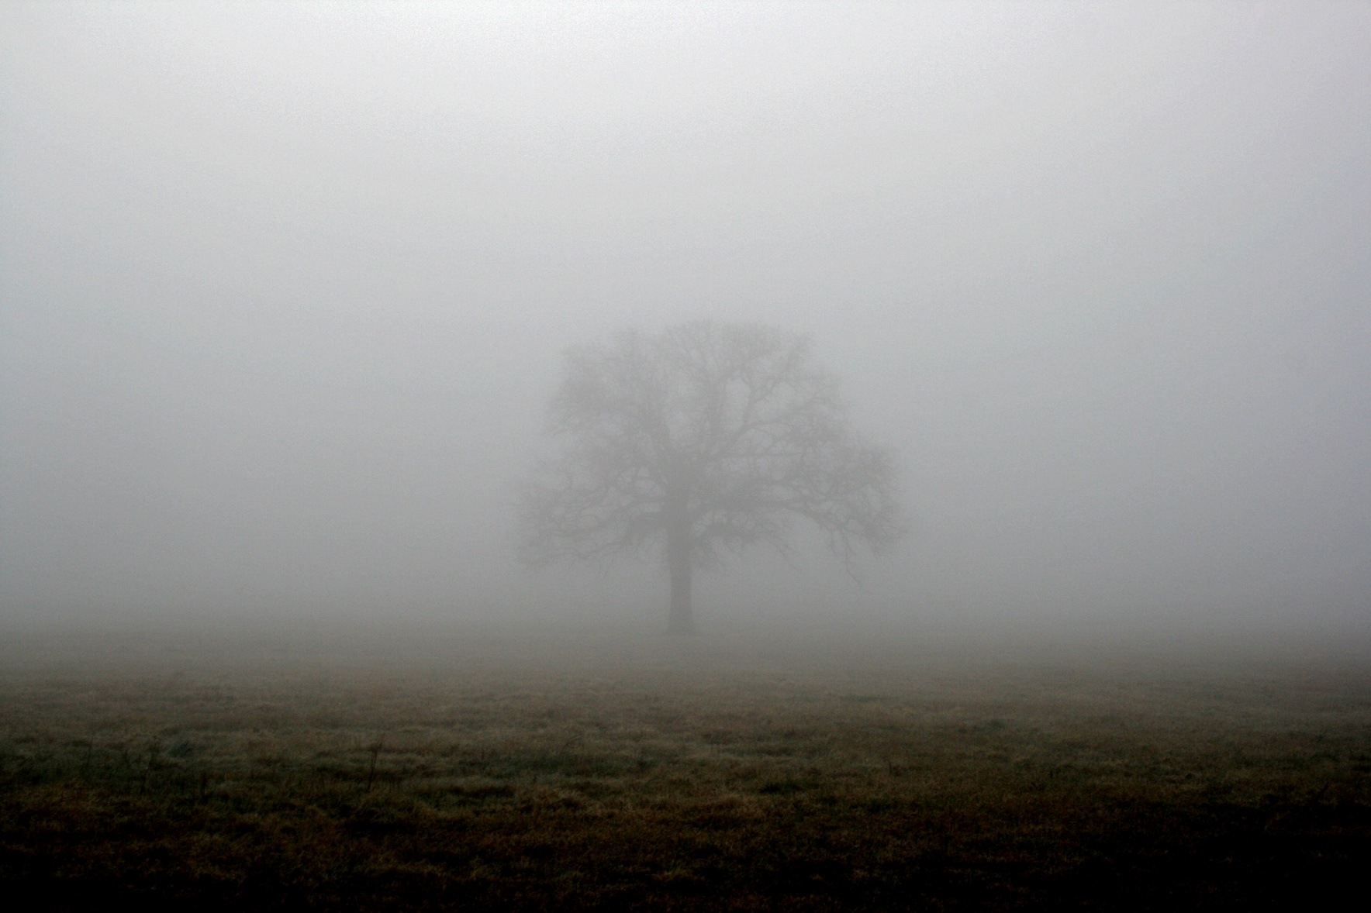
Notes:
Nigella damascena
Love in a Mist

Slide 3
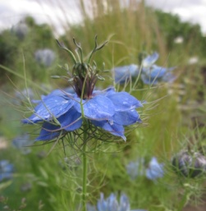
Love in a Mist
Nigella damascena

Slide 4
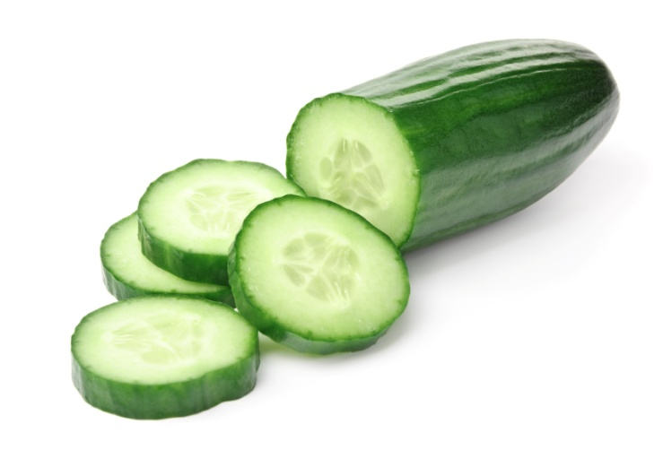

Slide 5
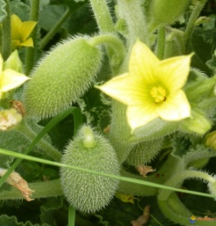
Squirting Cucumber
Ecballium elaterium

Slide 6
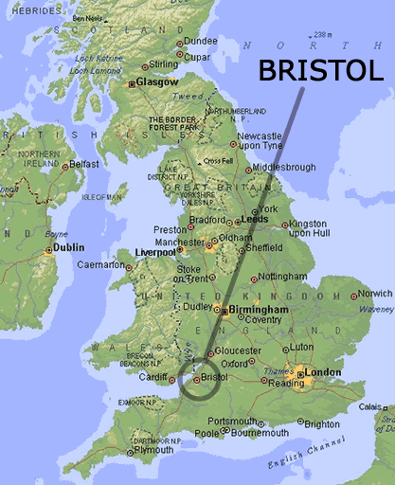
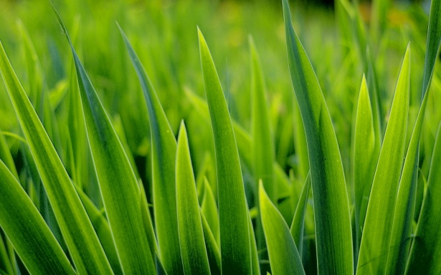

Slide 7
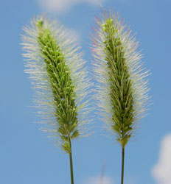
Green Bristle Grass
Setaria viridis

Slide 8
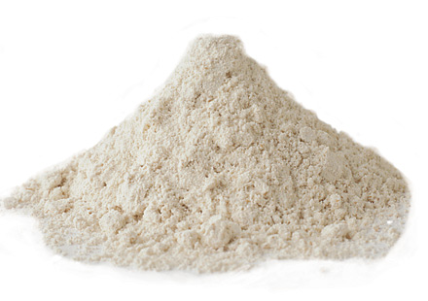

Slide 9
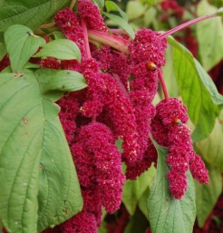
Tassel Flower
Amaranthus caudatus

Slide 11
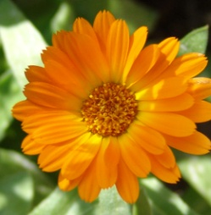
Marigold
Calendula officinalis

Slide 13
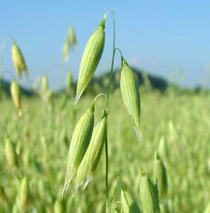
Oats
Avena sativa

Slide 14
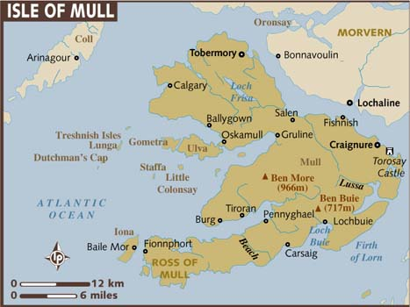

Slide 15
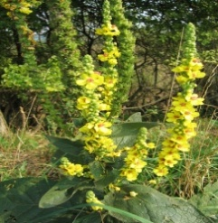
Dark mullein
Verbascum nigrum

Slide 17
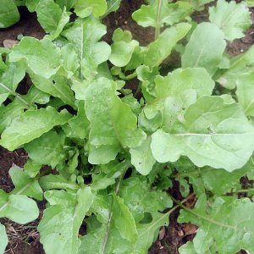
Rocket
Eruca sativa

Slide 18
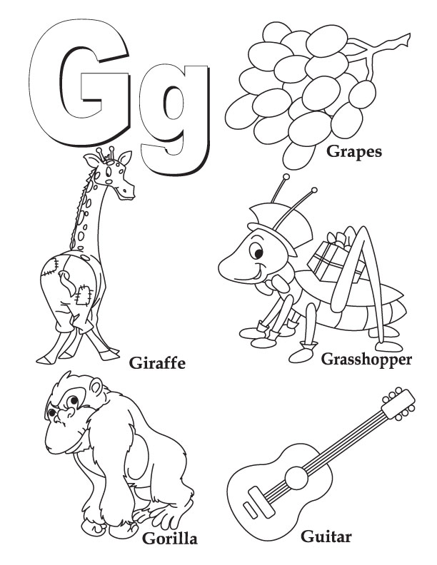

Slide 19
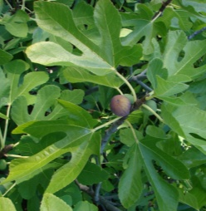
Common Fig
Ficus carica

Slide 21
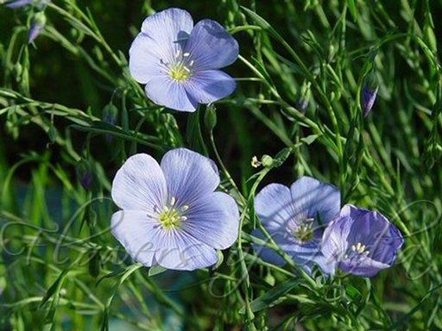
Linseed or Flax
Linum usitatissimum

Slide 23
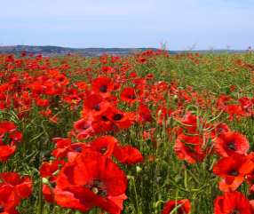
Wild Poppy
Papaver rhoeas

Slide 24
Spain
France
Italy
Turkey
India
China
The Caribbean
Morocco
Tunisia
Cyprus
Egypt

Slide 25
The End!

