Slide 1
Workshop B: Globalising Infrastructure
Impacts and Opportunities for Research Administration/Research Support Services
Provocateur: Glenn Swafford, Oxford

Slide 2
Images: http://melbourneourhome.blogspot.com/2011/09/worlds-most-livable-city.html, http://www.open-trip.com/melbourne-tours.html, http://dla-plantastic.blogspot.com/2011/09/melbourne-most-livable-city.html, http://www.educationabroadnetwork.org/university-of-melbourne.html, http://journalweek.com/travel-to-melbourne/

Slide 3
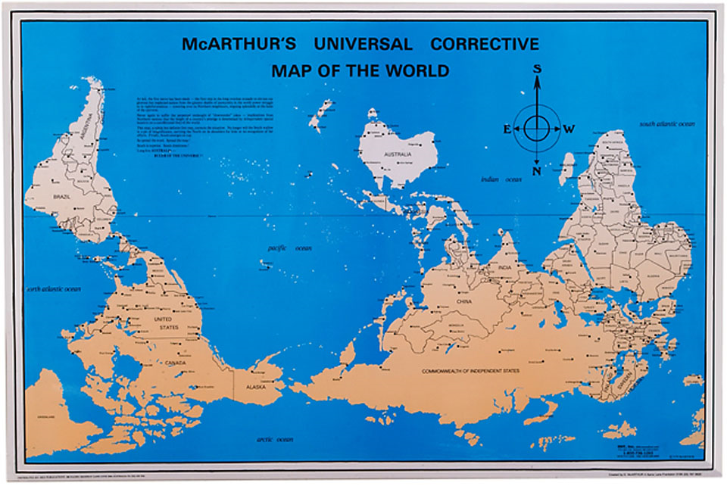
Map from http://flourish.org/upsidedownmap/

Slide 4
http://www.chem.ox.ac.uk/oxfordtour/

Slide 5
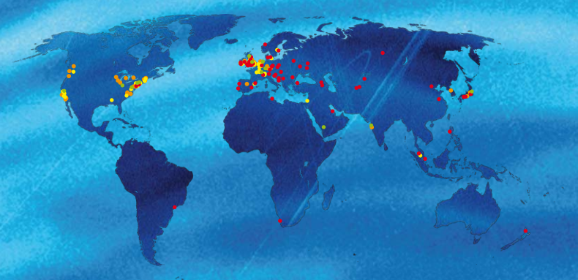
An international community in Oxford
More than a one-third of our students -- 15% of full-time undergraduates and 61% of full-time postgraduates -- are non-UK citizens
40% of academic staff are non-UK citizens
An extensive presence overseas
Oxford University Press, the world’s largest, operates in over 50 countries
More than 58,000 alumni living in 189 countries outside the U.K.
Overseas offices
Overseas research programs, incl. in Tropical Medicine
Isis Innovation technology licensing, consulting and KT management advice
Isis Innovation

Slide 6
The Research Support Network at Oxford
Oxford’s researchers
HoDs
Peers
PIs/ Group Leaders
Sponsors
Oxford’s researchers
Department Administrators and Research managers, coordinators, grants advisers, research finance officers, project managers
Research Services
Research Accounts
Legal Services, PRAS, Personnel Services, OUCS, Bodleian Libraries, Ethics committees, OLI
Research Facilitators (divisional, departmental)
Isis Innovation
Technology transfer, consulting, enterprise development

Slide 7
Some of the issues we are experiencing in terms of international research support services
International grants (incl. new and diverse funding)
International contracts and sub-contracts
International consortia
Intellectual Property
Publication and data management protocols
Infrastructure access and use
Human research and animal research ethics
Clinical studies, interventions, therapeutic products, access to medicines
Import and export controls
Financial management (incl. budgets, purchasing, reports, currency management, controls, Acc. Standards, reporting, taxation, auditing)
Operating research groups permanently based overseas
Visas, work permits (visitors, students, consultants), settlement
Cultures, incl. communication, ‘work styles’

Slide 8
Structures
Office of International Research Administration, Brown University
(In the UK) - European Research Offices in many universities
Cooperative ventures, e.g.
Web site image: http://research.brown.edu/rschadmin/international_research_administration.php

Slide 9
Skills
Oxford’s Professional Development Program for Research Administrators
Oxford KE Network
Oxford Research Facilitators’ Network
Oxford Research Project Managers’ Group
Oxford’s Skills Development Group (doctoral, post-doctoral)
Oxford Learning Institute Program for PIs

Slide 10
External networks and resources for research managers and administrators
Informal, often 1:1, often ‘by chance’
(More) Formal
Images: http://employmentgenius.com/2011/09/27/why-should-you-build-professional-networks/

Slide 12
ERASMUS Staff Mobility - Training for higher education institution staff at enterprises and at higher education institutions
TEMPUS: modernising higher education in EU neighbours

Slide 13
Professional Bodies

Slide 14
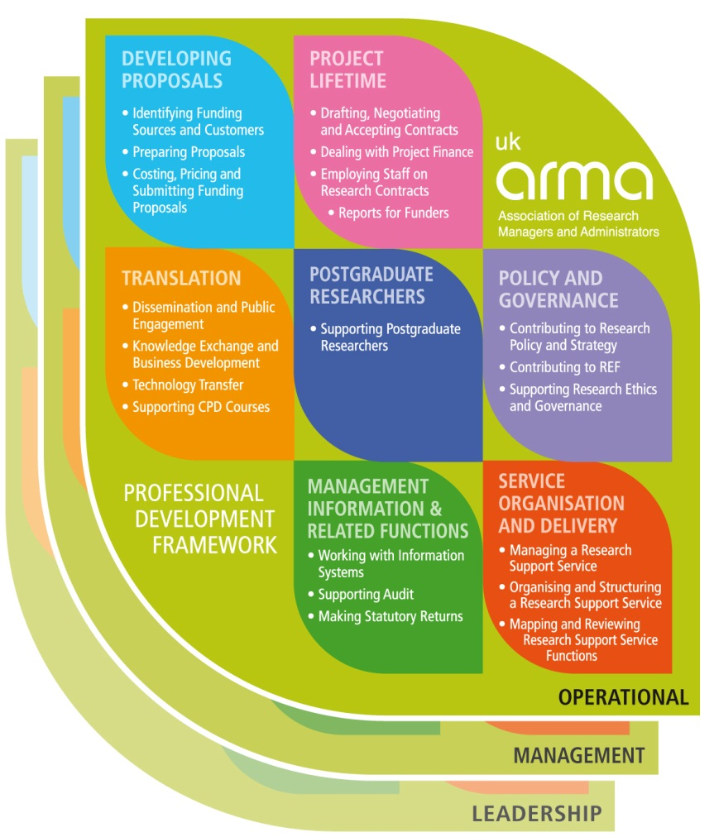
ARMA’s Professional Development Framework
The PDF has 20 areas organised under seven (7) headings.
Each area is described from three perspectives – ‘Doing’, ‘Managing’ and ‘Leading’
Each includes the tasks that research managers and administrators undertake and the knowledge, skills and behaviours required

Slide 15
Image from http://www.astm.org/SNEWS/JA_2008/wilhelm_ja08.html

Slide 16
Four Observations (in Sum) For the discussion mix
Global research is creating new demands and new opportunities for us (research administrators) as service providers
Professional networks (local, national and international) can help us to respond and develop
Different (extended) skill sets and resources are required
Research administrators can do more to
facilitate international research collaboration

