Slide 1
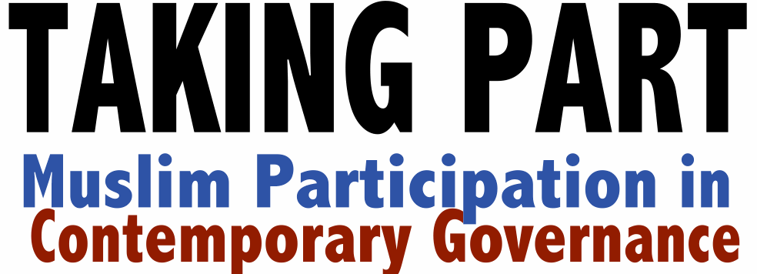

Slide 2
Muslim Participation in Contemporary Governance
MPCG
Religion & Society large project: Muslim Participation in Contemporary Governance (MPCG), based at the University of Bristol
Study of 1997-present, New Labour to the Coalition
Research based on:
Policy analysis
112 interviews with key governance actors
Comparative local case studies in Birmingham, Leicester and Tower Hamlets

Slide 3
The state’s engagement with Muslims is not reducible to security concerns
1
Security concerns, including Prevent agenda, have had a major impact on ways in which govt engages with Muslims
But, engagement has occurred across a range of policy domains and is not reducible to security concerns

Slide 4
3 key policy fields in which state-Muslim engagement has taken place
2
State-Muslim engagement has arisen in 3 policy fields with different norms and logics:
Equalities, Diversity & Cohesion [Chapter 3]
Faith Sector Governance [Chapter 4]
Security, including Prevent [Chapter 5]
These 3 fields are not often studied together; but can provide a more rounded account

Slide 5
Muslims have been increasingly active and effective within governance
3
Muslims have become increasingly active within governance as:
parliamentarians; councillors; civil servants; policy advisors; experts; partners in local governance networks
Muslim activism has been significant in driving gains in recognition of religious (as distinct from ethnic/racial) difference in policy & legislation

Slide 6
Increasing recognition that the ‘take me to your leader’ approach is unwanted and unworkable
4
Muslim representation in govt has gone through different phases
Early fragmented organisation from 1970s
Consolidation in the 1990s (umbrella bodies)
Pluralisation from 2005 (with competing claims)
Govt approaches of ‘take me to your leader’ and, sometimes, ‘this is your leader’ are no longer considered desirable

Slide 7
Greater willingness to work with a ‘democratic constellation’ of Muslim organisations and interests
5
Greater recognition of diversity of Muslim civil society organisations
Umbrella bodies have been criticised for their inability to represent all Muslim at all times – but they do not claim to do this
Need for more accountable, transparent mechanisms of representation by govt

Slide 8
Attempts to construct simple ‘extremist’ and ‘moderate’ binaries are unproductive
6
PM David Cameron’s Munich Speech signalled a hardening government line on this issue, yet:
“I just went to a meeting two weeks ago and the Home Office is still working with those groups. […] if you want to reach hardline Salafi communities, you have to work with hardline Salafi people, that’s just the way it is. You’re not going to reach them through cuddly Sufis. There’s a sense of realpolitik about this whole thing.” – advisor, 2012

Slide 9
Muslim claims for recognition are typically voiced within a commitment to a shared civic and national paradigm
7
Surveys consistently demonstrate that Muslims identify with Britishness at higher levels than white Britons
Many take the view that faith is compatible with/requires civic engagement
Govt has engaged with British Muslims best when it has engaged with them as citizens

Slide 10
Despite narratives on the ‘death of multiculturalism’ recognition of group differences endure locally
8
New Labour and the coalition both engaged in anti-multiculturalist rhetoric at times
Yet, new possibilities are developing for multiculturalism (in ad hoc, uneven ways):
1/4 of new academies are faith schools
New, sophisticated approaches to multicultural citizenship (e.g., Tower Hamlets Fairness Commission; An-Nisa/RMW Khidmah project)

Slide 11
Muslims are not outliers but allies with other faith actors in supporting a religious presence in governance and public life
9
Coalition supports role of religion in public life, albeit with Christian centrality
e.g. Near Neighbours
Role of the CofE in administering NN is welcomed by many Muslim actors
Muslim participation in NN is high
Support for CofE’s role by many Muslims

Slide 12
There is substantial variation at local level in state engagement with Muslims and implementation of key policies
10
E.g. implementation of Prevent varies
In Leicester, has a strong interfaith character
In Tower Hamlets, bottom-up community engagt
Birmingham has been more security-led
This has implications for the intended separation of Prevent and ‘integration’

Slide 13
Conclusion: What does the future hold?
Looking ahead
“We were so focused on legislation and winning the battles on legislation, in some ways, we lost sight of the war which was sort of building the narrative that comes with the legislation.” – Mohammed Abdul Aziz
Policy gains have been achieved at the same time as the symbolic politics of public discourses on Muslims and multiculturalism have worsened
This will be an area of continuing struggle

Slide 14
Continue the debates…
Looking ahead
Taking Part Report is now available online:
bit.ly/takingpart
_____________________________________________
Public Spirit: ‘Spirited debate on faith and public policy’
publicspirit.org.uk
Coming May 2013

