Slide 1
BAICE Conference 2016:
The University of Nottingham
Quality Education and the Role of the Teacher in Fiji: Mobilising Global and Local Values
Michael Crossley, Cresantia Frances Koya Vaka’uta, Rosiana Lagi, Simon McGrath, Konai Helu Thaman, Ledua Waqailiti
University of Bristol, The University of the South Pacific, The University of Nottingham

Slide 2


Slide 3
Structure for the Presentation
Project origins and aims
Core research question
Theoretical perspectives
The changing Fijian policy context
Research methodology and methods
Implications for policy and practice
Implications for theory

Slide 4
Project Origins and Aims
Previous collaboration between Bristol and USP. International research partnership
BA and USP funding – 2014 - 2016
Joint planning: N and S
Practitioner perspectives on the nature and quality of education; challenges of teachers’ work and lives; priorities for qualitative reform; theoretical implications

Slide 5
Core Research Question
How are issues of teacher becoming, being and belonging understood in Fiji by different stakeholders … and what implications does this have for the drive to improve the quality of teaching and learning ?

Slide 6
Theoretical Perspectives
Need to understand quality as a matter of purposes and contexts – contested not technical
This is informed by policy transfer and postcolonial concerns
Importance of thinking about teachers’ work and lives
Influence of notions from capabilities approach regarding what are teachers valuable beings and doings

Slide 7
The Changing Fijian Policy Context
1978 Education Act
National Curriculum Framework 2013
Policy Circular October 2015
Current series of education fora and work on reviewing 1978 Act

Slide 8
Policy Tensions
NCF stresses learner-centredness and draws heavily on UNESCO language alongside cultural groundedness
Recent policy statements talk of return to examinations, improving teacher quality and benchmarking against Australia, New Zealand and India
Yet, NCF is officially still the guiding document

Slide 9
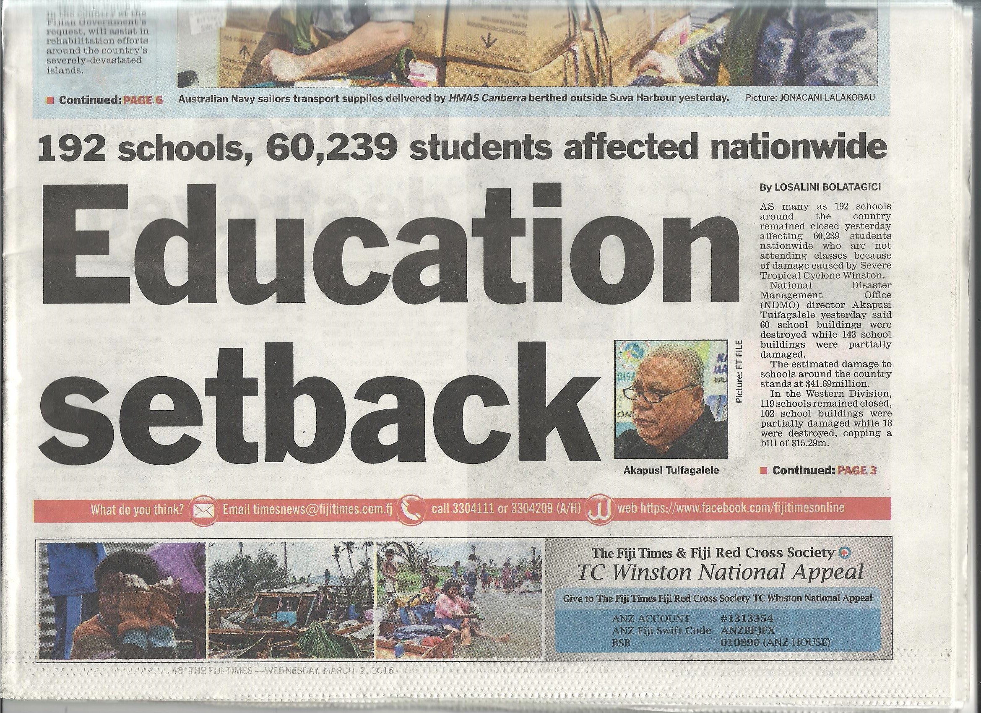

Slide 10
Research Methodology and Methods
Interpretive & Qualitative Methodological positioning
Mixing Western and Pacific approaches to research
Mixed Methods including:
Questionnaires
Talanoa
Talanga
Research Ethics – R/Permit MOE (2014), USP R/Ethics (2015)
Practitioner participants – Teachers, Teacher Trainees, Teacher Educators

Slide 11
Implications for Policy and Practice
Reported to the Fiji MoE through meetings and a concise Education Policy Briefing paper in 2016
Three levels of priority: those already attracting attention; deserving more attention; urgent new priorities
Emphasising: more realistically paced, consistent and coordinated reform; clarification of the place of the NCF in future policy; critical reflection on the resurgence of high stakes examinations and performativity culture; implications for teacher education nationwide

Slide 12
Implications for Theory
Core debate is about what model of education makes sense in Fiji but drawing on local, regional and global is complex – not a simple case of policy transfer
For education policy to have a chance of success it must be able to call on or create a shared imaginary of what it means to educate, be educated and be an educator

Slide 13
Conclusions
Recover from Cyclone Winston February 2016
Impact on policy and practice…
Research capacity strengthening: USP/UK
Ongoing writing and further research
Contributions to the 20th CCEM in Fiji (2018)…

