Slide 1
Professor William Browne and Chris Charlton Centre for Multilevel Modelling
Progress with STAT-JR
April 2011 – September 2011

Slide 2
Summary
Personnel updates
Different forms of STAT-JR
Changes to webtest look and feel
Faster Estimation – Optimising C code
Interoperability changes
Changes to Templates
New / In progress templates
Overall progress / One zip file!!

Slide 3
Personnel Updates
A new 12 month RA at Bristol advertised yesterday to start ASAP. Hoping for either a statistician or programmer. Will require an overall no-cost extension to the project.
George officially part of project as Co-Investigator.
Camille rejoins us in January 2012 from maternity leave.
Richard started in July and will work for a 12 month period.
Chris & Camille both funded on LEMMA III so funded until September 2014.

Slide 4
Different forms of STAT-JR
Webtest - the format we have demonstrated up to now. Allows user to investigate 1 template and 1 dataset. A dataset can be output from 1 template and then used by the next. We will come back to this.
Cmdtest – this format involves the use of a Python script and allows the template to be called from within a script. Helpful for our test suite and potential for tasks like simulations.
E-book – Danius will talk about progress
here later.

Slide 5
Command Test (cmdtest)
Written by Chris straight after last meeting.
Currently used with model templates only.
Syntax example:
m = RunStatJR(template='Regression1', dataset='tutorial', invars = {'y':'normexam', 'x':'cons, standlrt'}, estoptions = {'burnin': '1000', 'iterations': '5000', 'thinning': '1', 'seed': '1'})
Here fits a single level regression with the settings given.

Slide 6
Cmdtest example 2
Here is a second example for a template which has interoperability
m = RunStatJR(template='1LevelCat', dataset='tutorial', invars = {'y':'normexam','D': 'Normal', 'x': 'cons,standlrt,girl,schgend', 'cons_cat': 'No', 'standlrt_cat': 'No','girl_cat': 'Yes', 'schgend_cat': 'Yes' }, estoptions = {'burnin': '1000', 'iterations': '5000', 'thinning': '1', 'seed': '1', 'Engine' : 'eSTAT', 'EstM' : 'Yes'})
Note can get invars information from the inputs box in webtest.

Slide 7
Webtest look and feel
Since April this has changed a little:
If E-STAT engine is to be used then the Algebra system is called after Next and before Run.
Algorithm algebra is displayed in the main window (maybe need this to be optional).
The Run and Test Code buttons now give same answers.
There is a More button that works with E-STAT, MLwiN, OpenBUGS and JAGS.
The change estimation settings button allows the same model to be easily fitted with different software.

Slide 8
Example – 2 level Model tutorial dataset
Here are the initial inputs and upon pressing Next things happen.

Slide 9
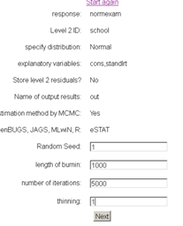
Example – 2 level Model tutorial dataset
Here are the initial inputs and upon pressing Next things happen.

Slide 10
Example – Equations and model code

Slide 11
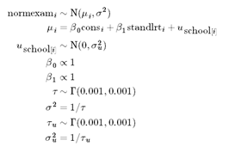
Example – Equations and model code

Slide 12
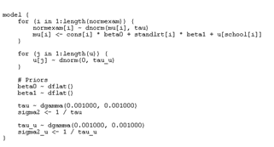
Example – Equations and model code

Slide 13
Example – algorithm code

Slide 14
Algorithm - continued
First line is output from Bruce’s algebra system, second line is the result of including known constants and simplifying

Slide 15
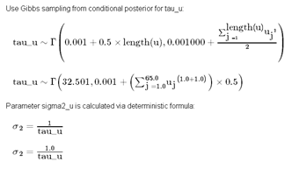
Algorithm - continued
First line is output from Bruce’s algebra system, second line is the result of including known constants and simplifying

Slide 16
Results of pressing the Run button

Slide 17
Results of pressing the Run button

Slide 18
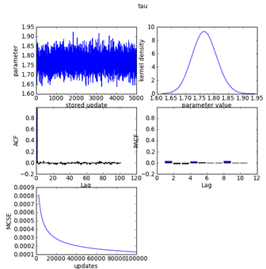
Results of pressing the Run button

Slide 19
Running for a further 5,000 via more
We typed 5,000 in the Extra Iterations box and pressed More. Note the iterations increased to 10,000.

Slide 20
Running for a further 5,000 via more
We typed 5,000 in the Extra Iterations box and pressed More. Note the iterations increased to 10,000.

Slide 21
Run vs Test Code buttons
The Run button will create sections of C++ code that are compiled and run from Python.
The Test Code button (as does the Code button) creates a complete C++ program. This is then compiled and is called as an external process in a similar way to interoperability with other packages.
Both methods give identical answers.
Note that when the program has finished the screen will update quicker than previously as only the current graph is calculated to save time.

Slide 22
Faster Code ?
For most templates we are now faster than WinBUGS, OpenBUGS and JAGS though these packages may give better mixing for some models where we use Metropolis.
For mixed response models, factor analysis and some other templates we are faster than MLwiN but for others we are not.
Speed ups achieved by optimising code via rearranging terms and removing constants from loops amongst other things.
Test Code / Run now comparable.
Need to produce a test suite of timings.

Slide 23
Interoperability
BUGS language used by:
WinBUGS – original implementation of BUGS for Windows.
OpenBUGS – more recent implementation which is open source.
JAGS – Just Another Gibbs Sampler developed by Martin Plummer. Doesn’t fit all BUGS models and has some limitations though often faster.
E-STAT to some extent.

Slide 24
Interoperability – State of play
Some templates have lots of interoperability included.
Some have only E-STAT and work is needed particularly when E-STAT code diverges from standard WinBUGS code.
For many templates there is greater effort required to write interoperability to MLwiN, STATA, R etc.
Camille’s original code also created plots from the packages which may not be required.
Let’s look at 2-level Mod:

Slide 25
WinBUGS (3 chains)
Here equation comes up without running algebra. We used change estimate settings to save typing in first 5 boxes.

Slide 26
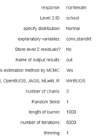
WinBUGS (3 chains)
Here equation comes up without running algebra. We used change estimate settings to save typing in first 5 boxes.

Slide 27
WinBUGS (2)
Takes a while as doing 3 times as many iterations. Note sixth multiple chains graph of Brooks-Gelman-Rubin diagnostic.

Slide 28
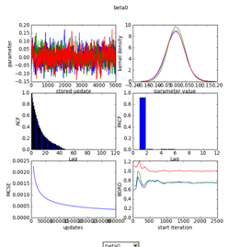
WinBUGS (2)
Takes a while as doing 3 times as many iterations. Note sixth multiple chains graph of Brooks-Gelman-Rubin diagnostic.

Slide 29
Brooks, Gelman,Rubin (BGR) diagnostic
MCMC diagnostic based on ANOVA type analysis of set of chains. If convergence is achieved then between chain (green) and within chain (blue) variability should be similar and their ratio (red) should converge to 1.0

Slide 30
OpenBUGS
An interesting example showing non-convergence here! Can do More as OpenBUGS saves state of chain on exit.

Slide 31
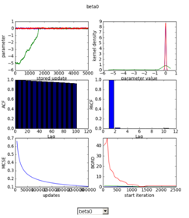
OpenBUGS
An interesting example showing non-convergence here! Can do More as OpenBUGS saves state of chain on exit.

Slide 32
OpenBUGS (2)
Here 10k more doesn’t help as we really need to lengthen burnin and that is hard to do without starting again.

Slide 33
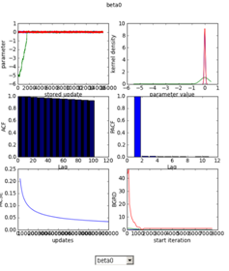
OpenBUGS (2)
Here 10k more doesn’t help as we really need to lengthen burnin and that is hard to do without starting again.

Slide 34
OpenBUGS with burnin 3000 main run 3000
Here the convergence issue goes away and although mixing is not perfect it is better than before

Slide 35
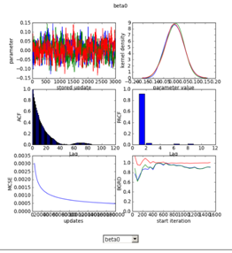
OpenBUGS with burnin 3000 main run 3000
Here the convergence issue goes away and although mixing is not perfect it is better than before

Slide 36
JAGS
JAGS is multiple chains and runs in the Python window i.e. doesn’t flash up like WinBUGS. Here lack of convergence in 1 chain – note that JAGS is quicker than other 2

Slide 37
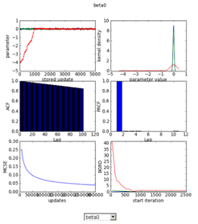
JAGS
JAGS is multiple chains and runs in the Python window i.e. doesn’t flash up like WinBUGS. Here lack of convergence in 1 chain – note that JAGS is quicker than other 2

Slide 38
MLwiN
Model code is replaced by macro code for running MLwiN

Slide 39
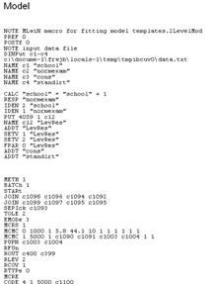
MLwiN
Model code is replaced by macro code for running MLwiN

Slide 40
MLwiN (2)
Currently single chain but in theory could set MLwiN off three times with different starting values to get multiple chains

Slide 41
R - MCMCglmm
A fairly short R macro in this case calling the MCMCglmm package. Note behind the scenes the data files are also constructed.

Slide 42
R - MCMCglmm
A fairly short R macro in this case calling the MCMCglmm package. Note behind the scenes the data files are also constructed.

Slide 43
R – MCMCglmm
MCMCglmm uses fancy block updating method (that E-STAT uses in other templates) so mixing is better.

Slide 44
The download button
All files generated by a model fit are stored in a temporary directory and the download button will zip them up into a file called model.zip. Note here the top 2 png files are two parameters we happened to view diagnostics for. The script and data files used can be viewed (big files) whereas packages specific files like the bottom png file can be stored (see overleaf)

Slide 45
R output file extracted from the download

Slide 46
Changes to Model Templates
Currently in the process of assessing the vast number of model templates.
Removed redundant and incomplete templates and so list down to around 50-60.
Of these many need interoperability adding and/or latex model code adding.
A short help file would be good for each including examples of their use.
Plan is to get all these ready for beta release.
Any help greatly appreciated!

Slide 47
New / In progress templates
Prediction templates
Mixed response templates
Capture Recapture template
Continuous time survival template

Slide 48
Prediction templates
In MLwiN there has been quite a bit of effort made with regard the customised prediction window that allows ‘out of sample’ prediction.
In STAT-JR we have a template 1levelpred that does out of sample prediction for a 1 level model.
This template requires the equivalent of the cut function in WinBUGS and in our case we have the zxfd trick.
We have modified the template so that non-normal models can do out of sample prediction.

Slide 49
Set up for the model
Basically we require the explanatory variables for the actual model and the same explanatory variables for the missing cases in additional columns – for now we use the same variables

Slide 50
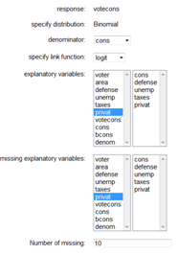
Set up for the model
Basically we require the explanatory variables for the actual model and the same explanatory variables for the missing cases in additional columns – for now we use the same variables

Slide 51
Model code
model {
for (i in 1:length(votecons)) {
votecons[i] ~ dbin(p[i], cons[i])
logit(p[i]) <- cons[i] * beta0 + defense[i] * beta1 + unemp[i] * beta2 + taxes[i] * beta3 + privat[i] * beta4
}
for (j in 1:10) {
mvotecons[j] ~ dbin(missp[j], cons[j])
logit(missp[j]) <- cons[j] * betazxfd0 + defense[j] * betazxfd1 + unemp[j] * betazxfd2 + taxes[j] * betazxfd3 + privat[j] * betazxfd4
dummy[j] ~ ddummy(mvotecons[j]) }
# Priors
beta0 ~ dflat()
beta1 ~ dflat()
beta2 ~ dflat()
beta3 ~ dflat()
beta4 ~ dflat()
}

Slide 52
Results
All predicted probabilities are between 0 and 1 and looking at the out datafile produced will show that the columns for mvotecons always take values 0 or 1.

Slide 53
Mixed Response templates
Cover mixture of continuous, ordered category and unordered category responses via latent variable modelling.
Have 3 templates for 1 level, 2 level and N level models.
Models currently can only be fitted in REALCOM and then only for 2 levels.
They deal with missing data and we have now got the imputation imputing variables on the original scale.
Could extend to responses at several levels and wrap up in a ‘super template’ that calls this template as part of the process.

Slide 54
Example – setup with jspmix

Slide 55
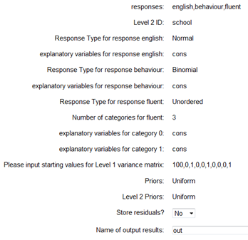
Example – setup with jspmix

Slide 56
Mixed Response continued
Model fit is really fast <30s versus 45 minutes in REALCOM!!
Model uses latent variables for responses and imputation can be done every x iterations to allow several imputed datasets to be formed.
Note the reverse rules of construction of latent variables are used to work back to original variables i.e. if LV between specific thresholds or LV1 > LV2 and LV1 > 0 etc.

Slide 57
Datasets constructed
Here datasets stored in iter0, iter1000 etc.

Slide 58
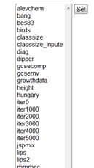
Datasets constructed
Here datasets stored in iter0, iter1000 etc.

Slide 59
Datasets summary
The dataset contains the 3 response variables with imputed values in this case there are complete cases so the responses are as given in the original data but the conversion from latent variables is still performed.

Slide 60
Capture/Recapture template
Models used in statistical ecology where interest is in population size / stability.
Birds are caught (in annual cohorts) then marked and when they are next recaptured is recorded.
Product Multinomial models for each cohort are used where the probabilities of capturing a bird in each year can be constructed from the product of series of survival and recapture probabilities.
This template uses e-STAT but also WinBUGS and R code supplied by the book by King et al.

Slide 61
The dipper dataset

Slide 62
The inputs

Slide 63
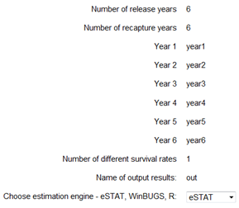
The inputs

Slide 64
Model code for E-STAT

Slide 65
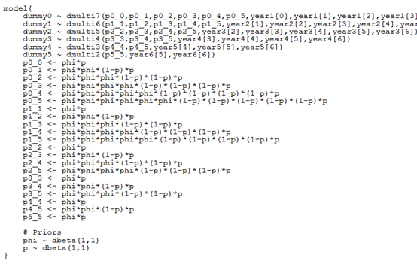
Model code for E-STAT

Slide 66
Results
Recapture probability p = 0.8941
Survival probability
Phi = 0.5628
These are held constant across years.
Other models allow these to vary etc.

Slide 67
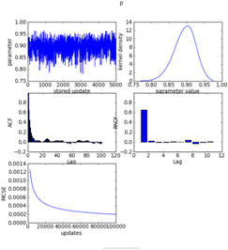
Results
Recapture probability p = 0.8941
Survival probability
Phi = 0.5628
These are held constant across years.
Other models allow these to vary etc.

Slide 68
Continuous Time Survival template
I had a veterinary epidemiology collaborator from Greece, Pol Kostoulas visit for 6 weeks this summer.
He worked on a template for fitting general continuous time survival models. This template requires the ability to deal with censored responses.
This has been implemented rather crudely in STAT-JR and the template contains a WinBUGS implementation via the I(,) mechanism.
The template is not yet finished.

Slide 69
Kidney example from WinBUGS examples

Slide 70
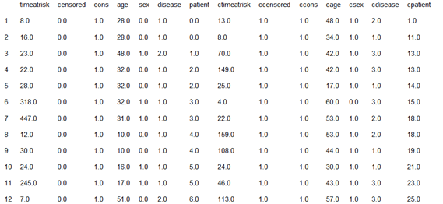
Kidney example from WinBUGS examples

Slide 71
Kidney inputs

Slide 72
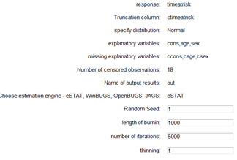
Kidney inputs

Slide 73
Kidney results
Here censoring values for observations 10-17 are
46,113,5,5,16,54,6 and 8 respectively

Slide 74
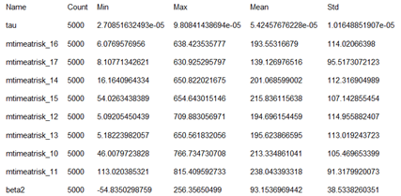
Kidney results
Here censoring values for observations 10-17 are
46,113,5,5,16,54,6 and 8 respectively

Slide 75
Overall Progress
Distributed document prior to meeting.
We have diverged in many ways from original plan.
Interested in opinions on whether this is an issue.
Last session this afternoon to discuss this further.
Chris has investigated portable Python and we now have a (very large) zip file that will allow the user to install all files to run STAT-JR in one go.
Other packages to be interoperated with will need to be installed separately.

Slide 76
Work for new postdoc
Depends on background
If more programming based need to write runSTATJR and RtoMLwiN/RtoSTATJR.
If more statistical then can:
advise on further MCMC algorithms – plan to implement slice-sampling soon.
write further templates with Chris.

Slide 77
Upcoming events
Giving a seminar to MRC Biostatistics Unit in 2 weeks time.
Plan to give updated version of Amsterdam talk.
Also been invited to talk to Glasgow statistics group and hope to get feedback from them.
Next Easter – 2nd Manchester workshop and MCMC workshop for LEMMA III.
Any other publicity – Paul mentioned demonstration in an E-mail.

