Slide 1



Professor William Browne
School of Veterinary Science and Centre for Multilevel Modelling ( & many co-workers!)
Progress with STAT-JR
October 2010 – April 2011
And purpose of this meeting

Slide 2
Summary
2
Aims of meeting
Slides from Amsterdam
2levelmod to demonstrate Tags, LateX, More button, Interoperability
Faster Estimation – C code
Multiple membership models
Mixed Response Models

Slide 3
Aims of meeting
A lot of give and take:
We are giving the wider team the chance to test the STAT-JR system in earnest with assistance from the developers
We want to take away thoughts on what works, what doesn’t work, how things might be improved, what features are desired – what do we want from the E-books stage of the project. – i.e. lots of feedback!

Slide 4
Aims of Meeting
We’ll start with a quick demo of some new features
We will then interject with (short) talks from the wider project team.
After lunch we’ll have a breakout session where anything goes – suggest pairing programmers and statisticians here.
We’ll then have time for group feedback
Finally a presentation on E-books.
Then groundhog day tomorrow!

Slide 5
New since last meeting
An alpha release in December
Some extensive if hard-going documentation
Some further new templates
Some additional functionality
Difference between (infra)structure and content
Iterative process of development.

Slide 6
The E-STAT project and STAT-JR
6
STAT-JR developed jointly by LEMMA II and E-STAT
Consists of a set of components many of which we have an alpha version for which contains:
Templates for model fitting, data manipulation, input and output controlled via a web browser interface.
Currently model fitting for 90% of the models that MLwiN can fit in MCMC plus some it can’t including greatly sped up REALCOM templates
Some interoperability with MLwiN, WinBUGS, R, Stata and SPSS (written by Camille)
Also runmlwin in Stata -> MLwiN written by George

Slide 7
STAT-JR
7
Jon identified 3 groups of users:
Novice practitioners who want to use statistical software that is user friendly and maybe tailored to their discipline
Advanced practitioners who are the experts in their fields and also want to develop tools for the novice practitioners
Algorithm Developers who want their algorithms used by practitioners.
See http://www.cmm.bristol.ac.uk/research/NCESS-EStat/news.shtml for details of Advanced User’s guide for STAT-JR

Slide 8
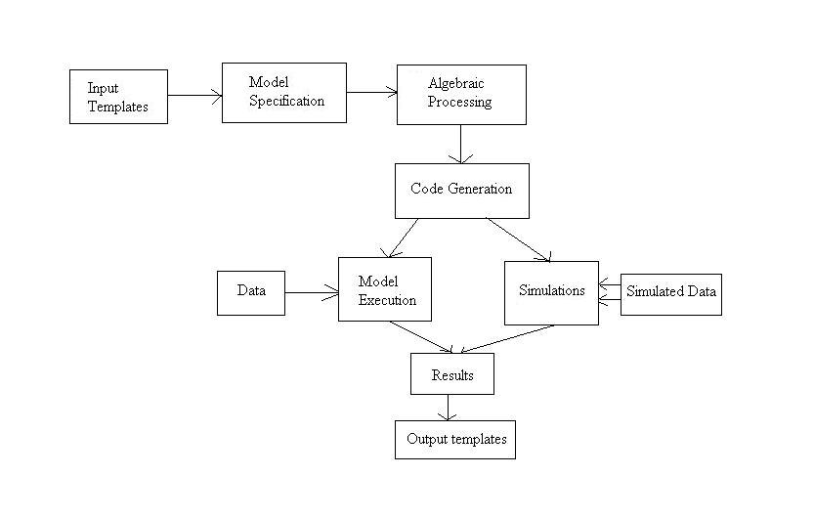
STAT-JR component based approach
8
Below is an early diagram of how we envisioned the system. Here you will see boxes representing components some of which are built into the STAT-JR system. The system is written in Python with currently a VB.net algebra processing system. A team of coders (currently me, Chris, Danius, Camille and Bruce) work together on the system.

Slide 9
Templates
9
Consist of a set of code sections for advanced users to write.
For a model template it consists of at least:
an invars method which specifies inputs and types
An outbug method that creates (BUGS like) model code for the algebra system
An (optional) outlatex method can be used for outputting LaTeX code for the model.
Other optional functions required for more complex templates

Slide 10
Regression 1 Example
10
from EStat.Templating import *
from mako.template import Template as MakoTemplate
import re
class Regression1(Template):
'A model template for fitting 1 level Normal multiple regression model in E-STAT only. To be used in documentation.'
tags = [ 'model' , '1-Level' ]
invars = '''
y = DataVector('response: ')
tau = ParamScalar()
sigma = ParamScalar()
x = DataMatrix('explanatory variables: ')
beta = ParamVector()
beta.ncols = len(x)
'''
outbug = '''
model{
for (i in 1:length(${y})) {
${y}[i] ~ dnorm(mu[i], tau)
mu[i] <- ${mmult(x, 'beta', 'i')}
}
# Priors
% for i in range(0, x.ncols()):
beta${i} ~ dflat()
% endfor
tau ~ dgamma(0.001000, 0.001000)
sigma <- 1 / sqrt(tau)
}
'''
outlatex = r'''
\begin{aligned}
\mbox{${y}}_i & \sim \mbox{N}(\mu_i, \sigma^2) \\
\mu_i & =
${mmulttex(x, r'\beta', 'i')} \\
%for i in range(0, len(x)):
\beta_${i} & \propto 1 \\
%endfor
\tau & \sim \Gamma (0.001,0.001) \\
\sigma^2 & = 1 / \tau
\end{aligned}
'''

Slide 11
Invars function
11
11
'''
invars = '''
y = DataVector('response: ')
tau = ParamScalar()
sigma = ParamScalar()
x = DataMatrix('explanatory variables: ')
beta = ParamVector()
beta.ncols = len(x)
'''

Slide 12
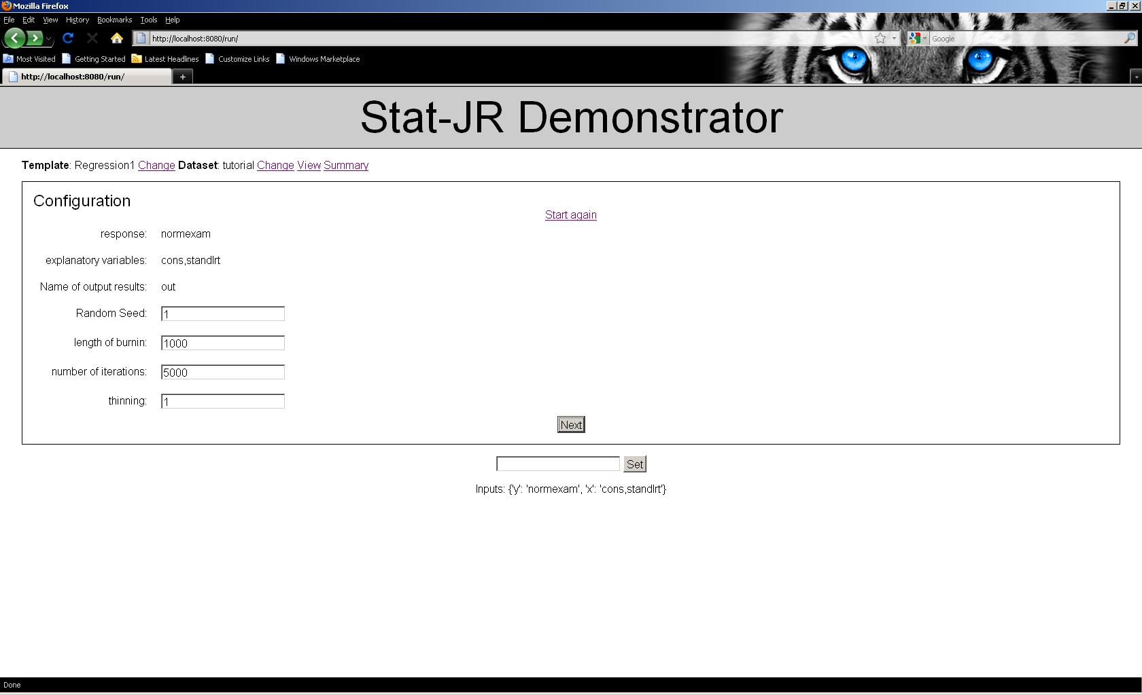
An example of STAT-JR – setting up a model
12
Notes:
An ex

Slide 13
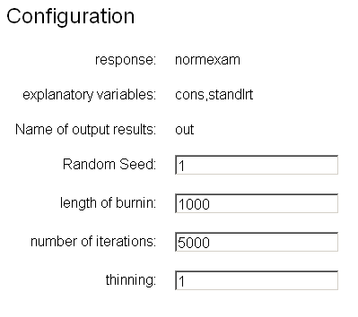
An example of STAT-JR – setting up a model
13
13
Notes:
An ex
13

Slide 14
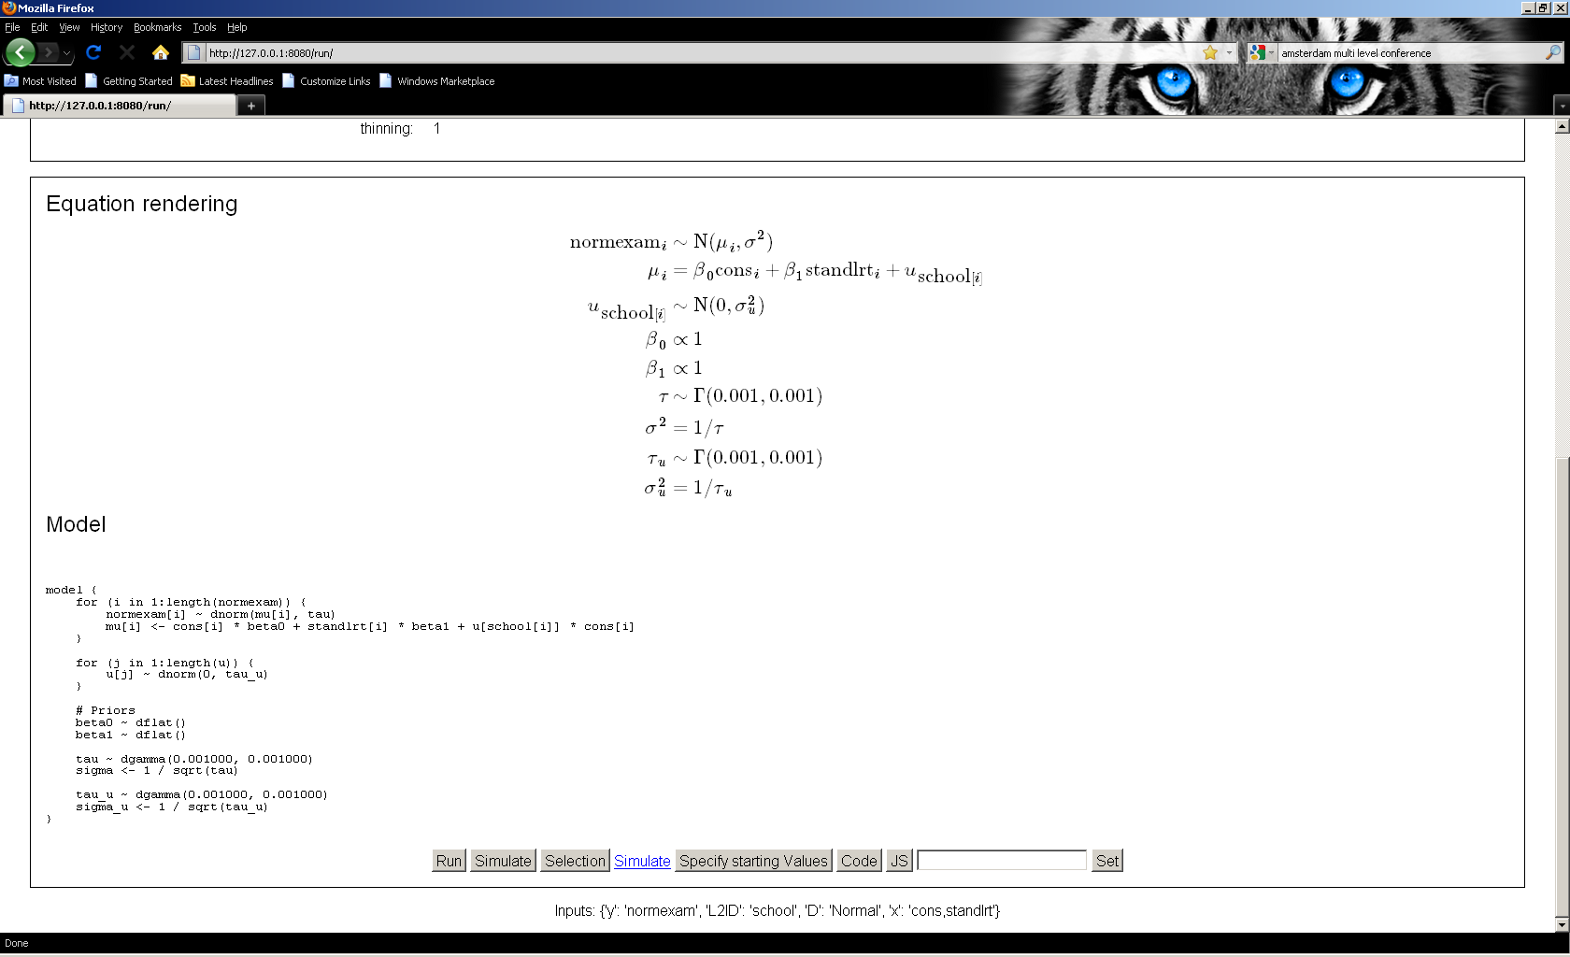
Equations for model and model code
14
Note Equations use MATHJAX and so underlying LaTeX can be copied and paste. The model code is based around the WinBUGS language with some variation. This is a more complex template for 2 level models.

Slide 15
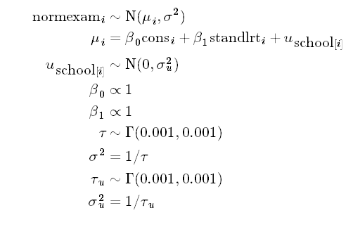
Equations for model and model code
15
15
Note Equations use MATHJAX and so underlying LaTeX can be copied and paste. The model code is based around the WinBUGS language with some variation. This is a more complex template for 2 level models.

Slide 16
Outbug function
16
16
outbug = '''
model{
for (i in 1:length(${y})) {
${y}[i] ~ dnorm(mu[i], tau)
mu[i] <- ${mmult(x, 'beta', 'i')}
}
# Priors
% for i in range(0, x.ncols()):
beta${i} ~ dflat()
% endfor
tau ~ dgamma(0.001000, 0.001000)
sigma <- 1 / sqrt(tau)
}
'''

Slide 17
Model code in detail
17
model {
for (i in 1:length(normexam)) {
normexam[i] ~ dnorm(mu[i], tau)
mu[i] <- cons[i] * beta0 + standlrt[i] * beta1 + u[school[i]] * cons[i]
}
for (j in 1:length(u)) {
u[j] ~ dnorm(0, tau_u)
}
# Priors
beta0 ~ dflat()
beta1 ~ dflat()
tau ~ dgamma(0.001000, 0.001000)
tau_u ~ dgamma(0.001000, 0.001000)
}
For this template the code is, aside from the length function, standard WinBUGS model code.

Slide 18
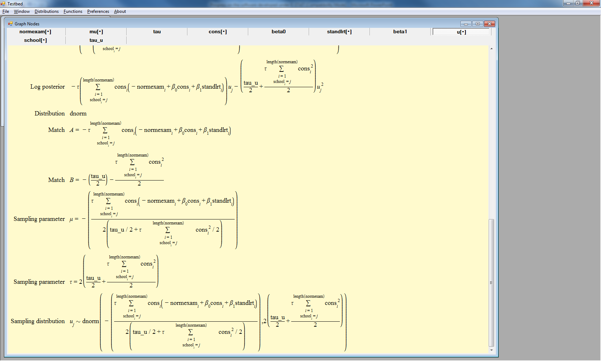
Bruce’s (Demo) algebra system step for parameter u
18

Slide 19
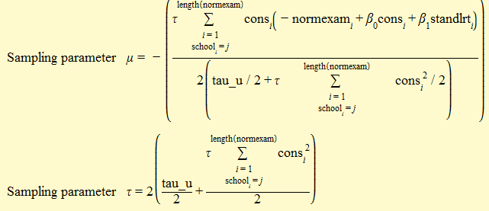
Bruce’s (Demo) algebra system step for parameter u
19
19

Slide 20
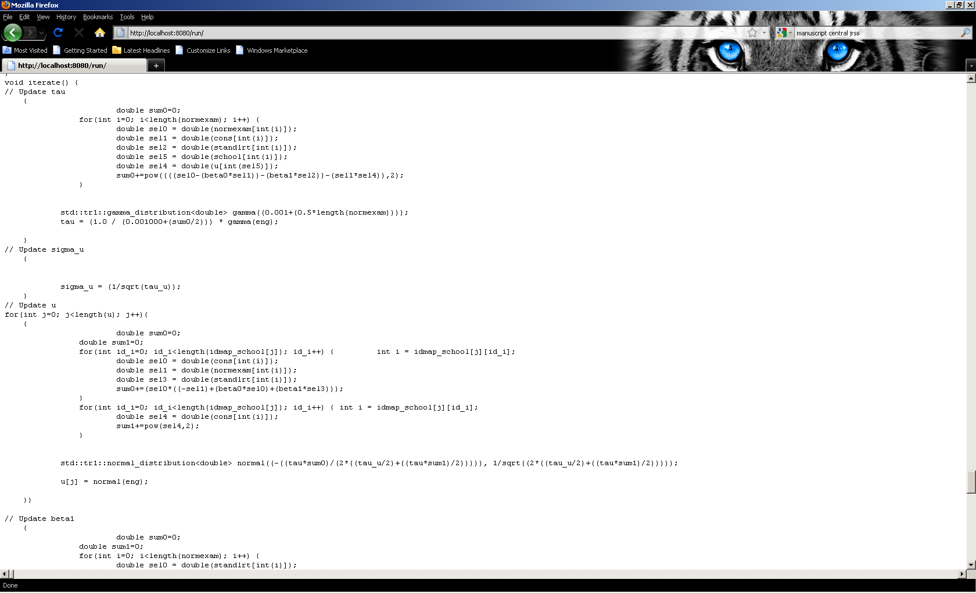
Output of generated C++ code
20
The package can output C++ code that can then be taken away by software developers and modified.

Slide 21
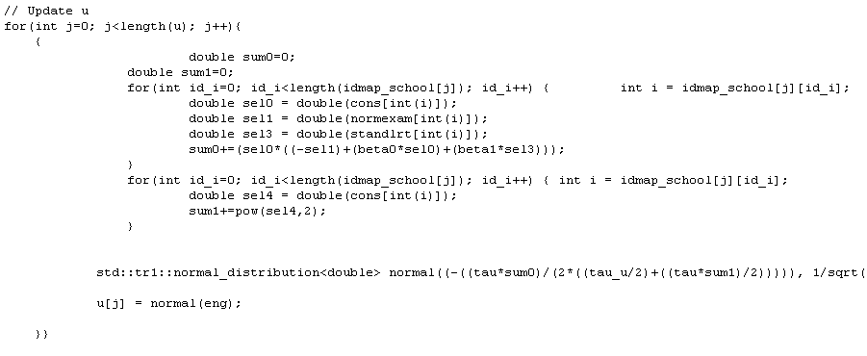
Output of generated C++ code
21
21
The package can output C++ code that can then be taken away by software developers and modified.

Slide 22
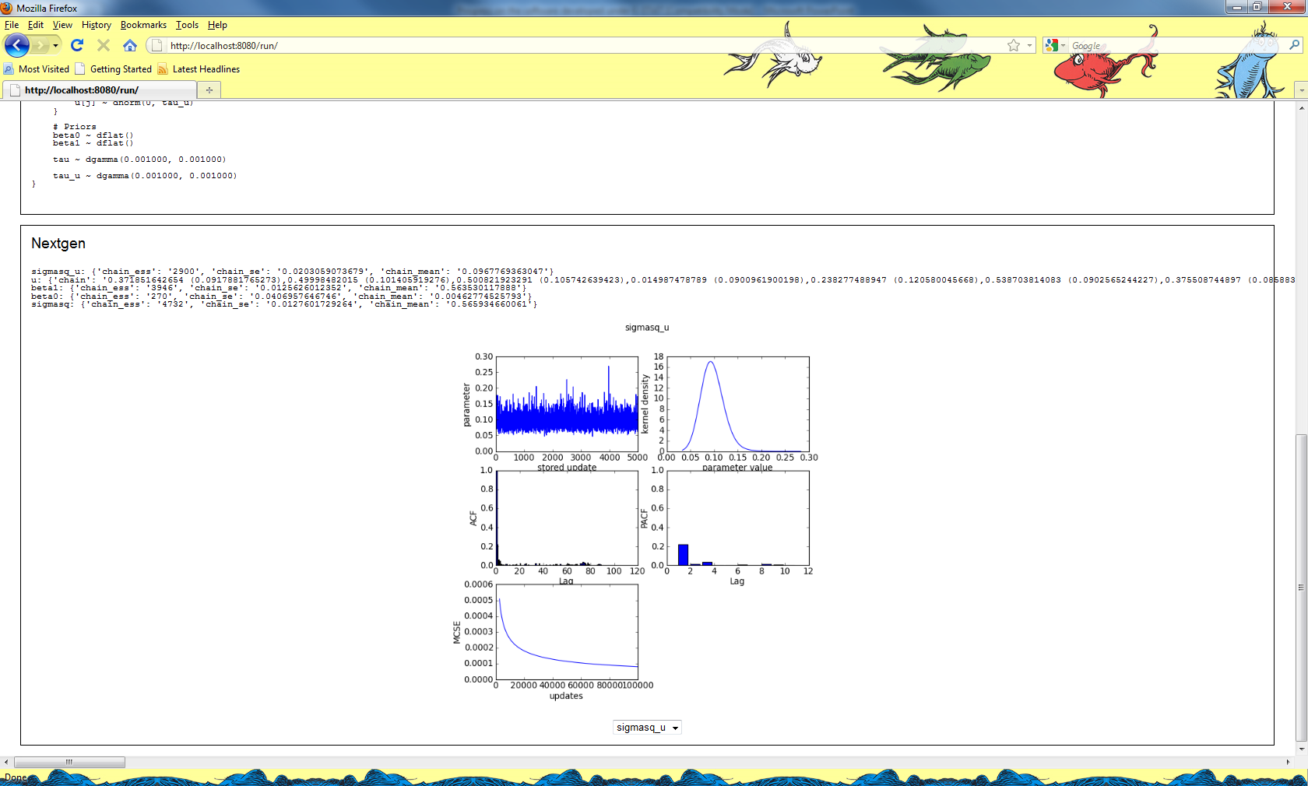
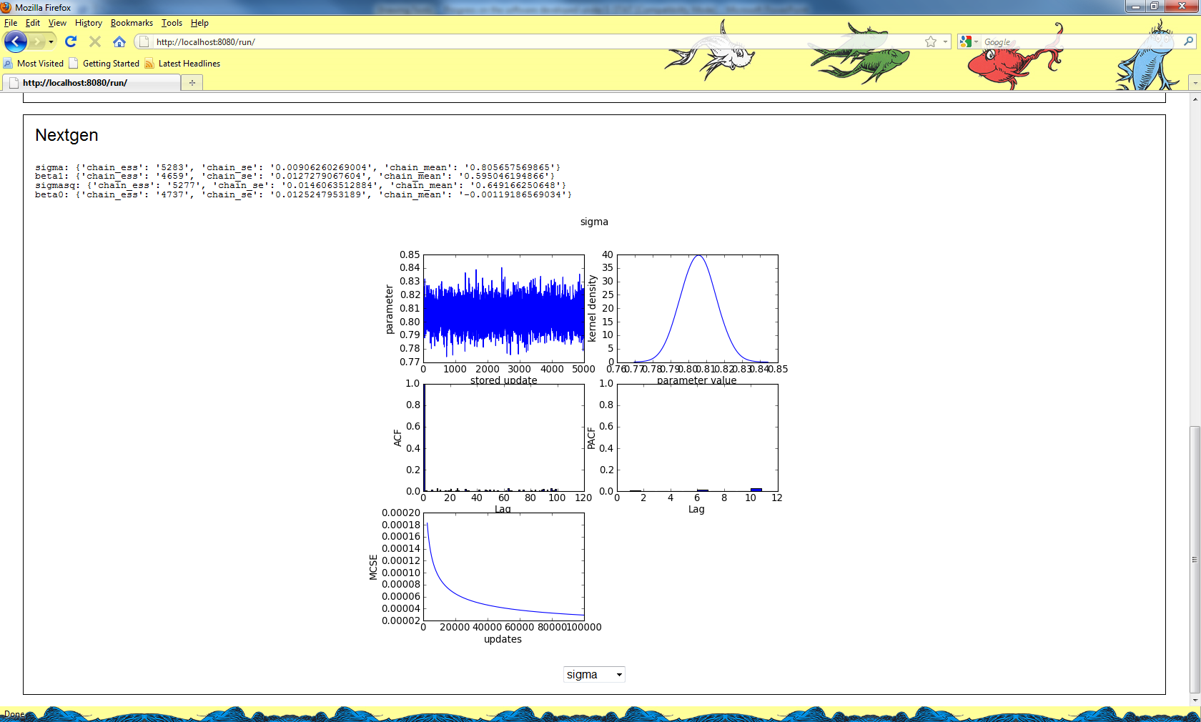
Output from the E-STAT engine
22
Here the six-way plot functionality is in part taken over to STAT-JR after the model has run. In fact graphs for all parameters are calculated and stored as picture files so can be easily viewed quickly.

Slide 23
Output from the E-STAT engine
23
23
Here the six-way plot functionality is in part taken over to STAT-JR after the model has run. In fact graphs for all parameters are calculated and stored as picture files so can be easily viewed quickly.

Slide 24
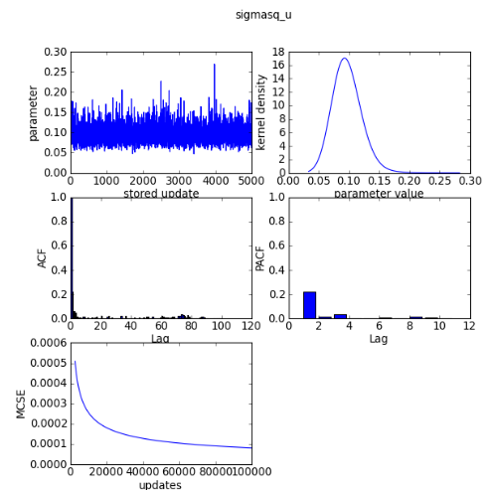
Output from the E-STAT engine
24
24
Here the six-way plot functionality is in part taken over to STAT-JR after the model has run. In fact graphs for all parameters are calculated and stored as picture files so can be easily viewed quickly.

Slide 25
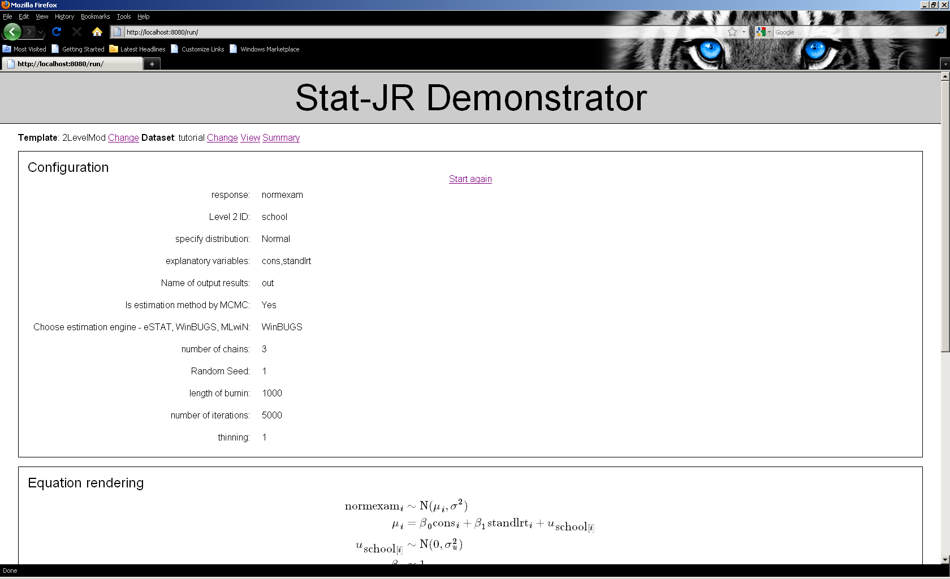
Interoperability with WinBUGS
25
Interoperability in the user interface is obtained via a few extra inputs. In fact in the template code user written functions are required for all packages apart from WinBUGS. The transfer of data between packages is however generic.

Slide 26
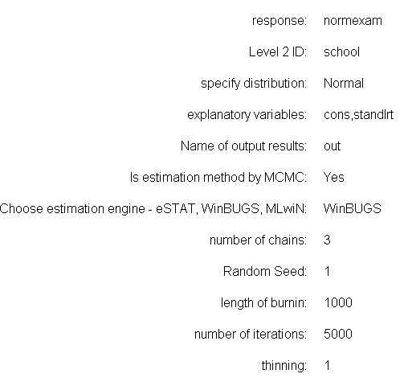
Interoperability with WinBUGS
26
26
Interoperability in the user interface is obtained via a few extra inputs. In fact in the template code user written functions are required for all packages apart from WinBUGS. The transfer of data between packages is however generic.

Slide 27
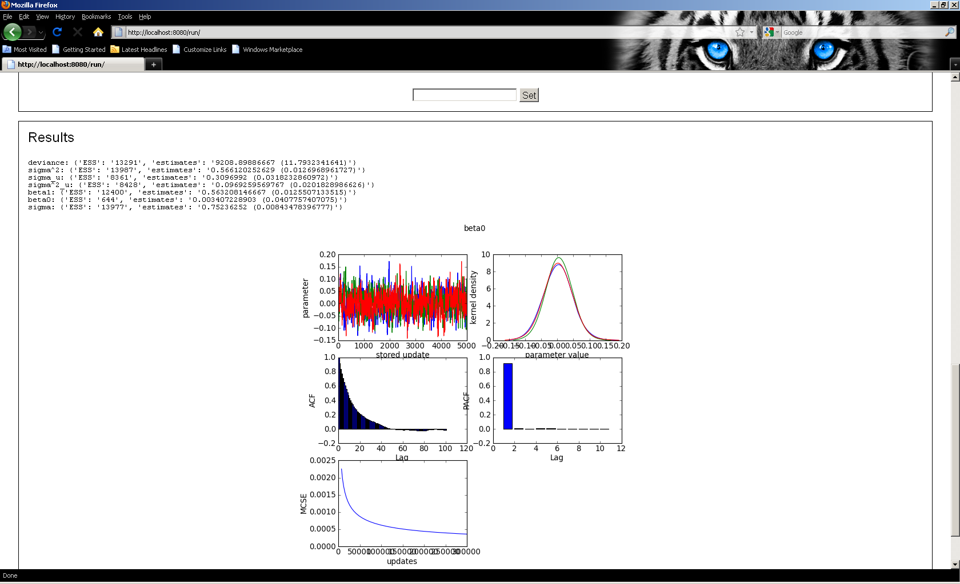
Output from WinBUGS with multiple chains
27
STAT-JR generates appropriate files and then fires up WinBUGS. Multiple Chains are superimposed in the sixway plot output.

Slide 28
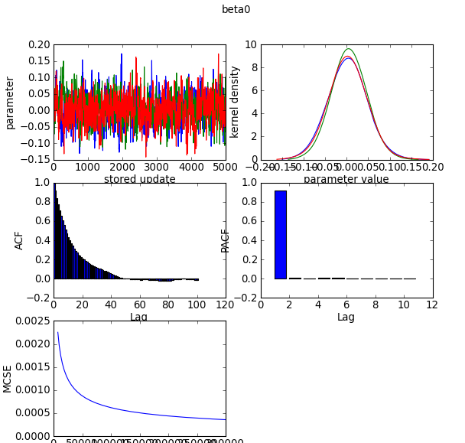
Output from WinBUGS with multiple chains
28
28
STAT-JR generates appropriate files and then fires up WinBUGS. Multiple Chains are superimposed in the sixway plot output.

Slide 29
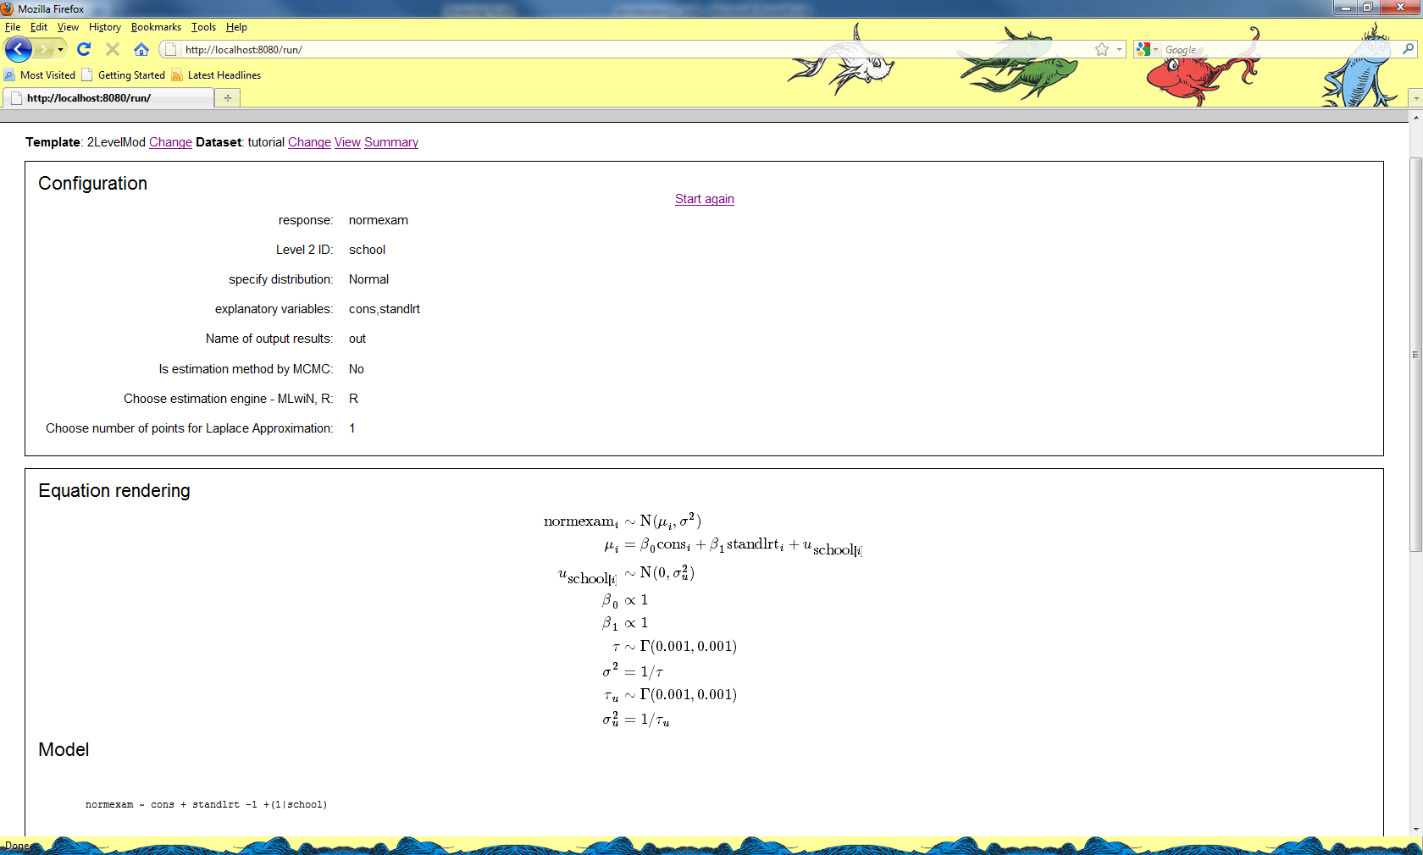
Interoperability with R
29
R interoperability for a 2-level model can use the glmer or the mcmcglmm functions

Slide 30
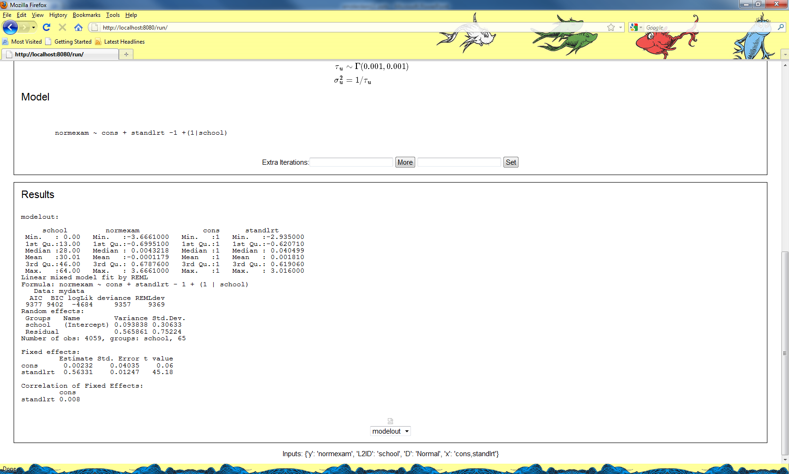
Output from R
30
Currently the R output is displayed but other files including the scripts are stored in a directory and will be made available when the e-Book work is done.

Slide 31
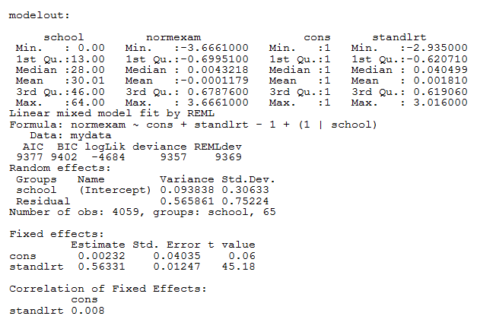
Output from R
31
31
Currently the R output is displayed but other files including the scripts are stored in a directory and will be made available when the e-Book work is done.

Slide 32
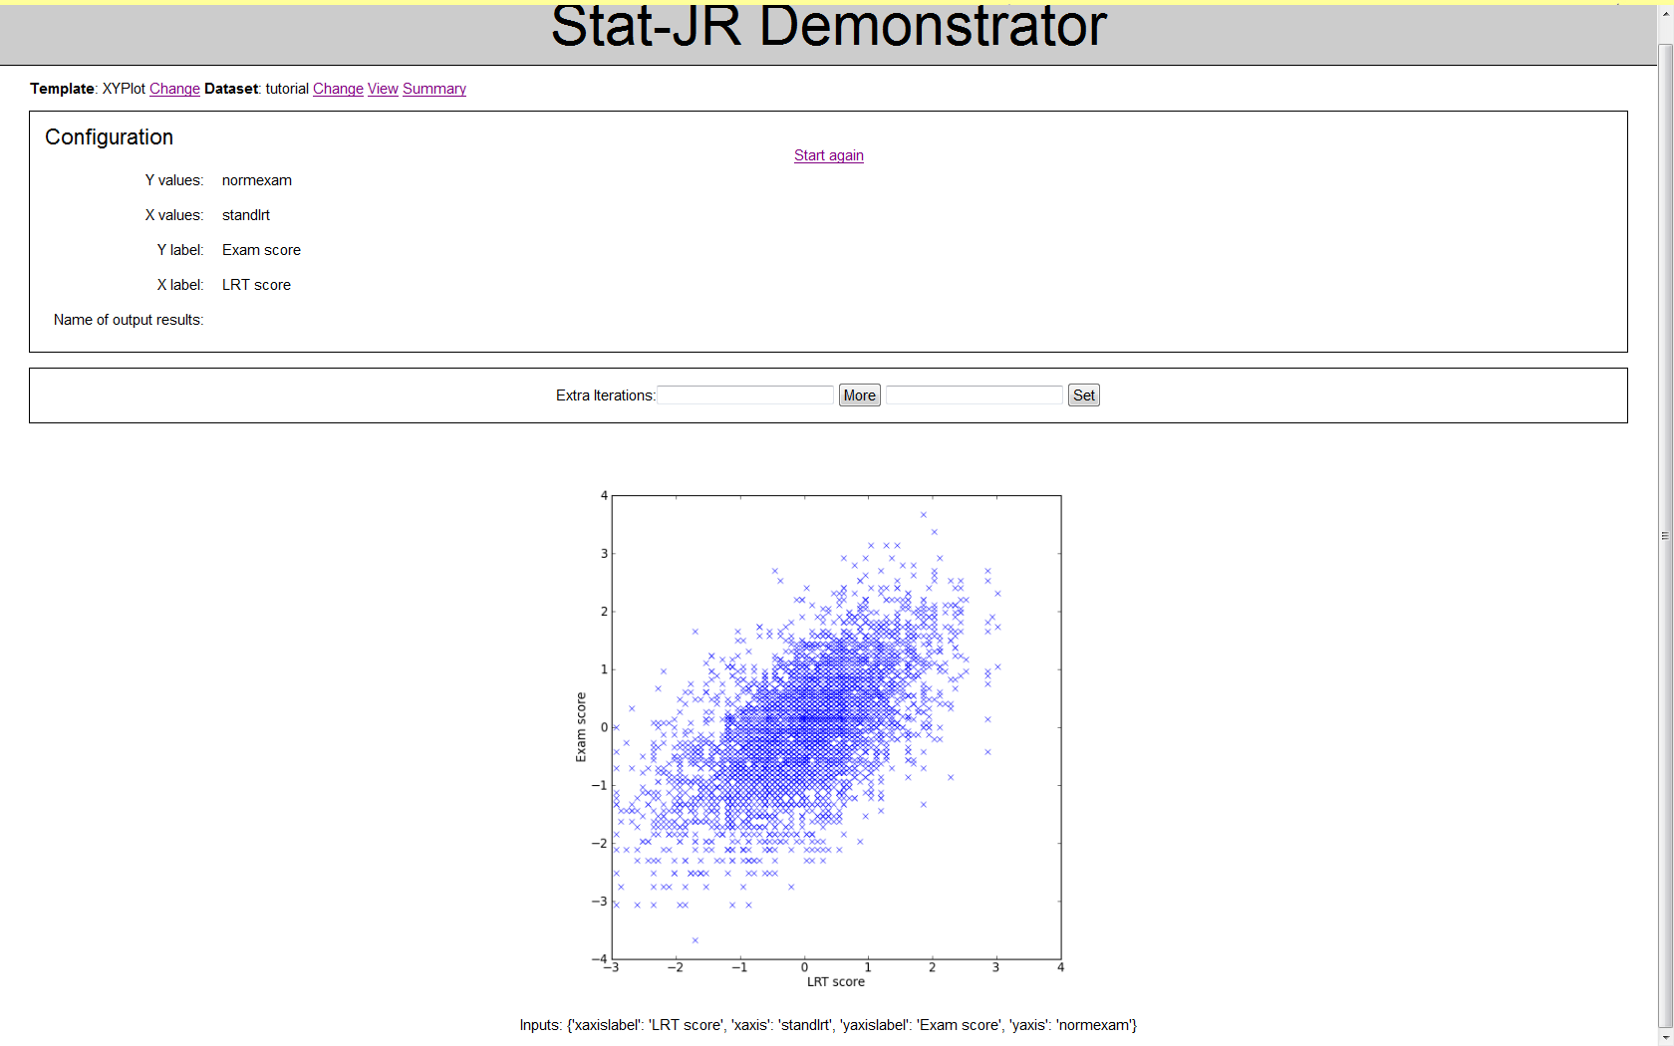
Other templates - TemplateXYlabel
32
Can make use of Python’s fantastic graphics! Or potentially other package graphics via interoperability.

Slide 33
The E-STAT project – still to come
33
We have lots of work to do:
Parallel processing.
E-books.
Optimising code generation.
Improving algebra system.
Suites of templates for missing data and social network models.
Interoperability with SAS and hooking up more templates for other packages.

Slide 34
2-level Models
34
Show how Tags work via MLwiN/R tags
Set up 2level model using tutorial dataset
Run using E-STAT, Illustrate use of the More button
Now show using WinBUGS & multiple chains
Then using MLwiN
Finally using R (mcmcglmm)
Go back to E-STAT and show code and explain speed ups

Slide 35
Multiple Membership models
35
Test using the Wage example from the MLwiN manual
Using the template MultipleMembership2lev
Response logearn (4 companies and weights)
Predictors cons, age-40, sex, parttime
Again can do in WinBUGS or MLwiN if required
Can also show code potentially.

Slide 36
Mixed Response Models
36
Start with multivariate normal with missing (gcsemv)
Show imputation
Then do a mixed response model with unordered and Binomial (jspmix)
Use MVnormal2level and Mixed2level templates

