Slide 1
Stat-JR: eBooks Richard Parker

Slide 2
Quick overview
To recap…
Stat-JR uses templates to perform specific functions on datasets, e.g.:
1LevelMod fits 1-level models;
2LevelCat fits 2-level models (& allows for categorical explanatory variables, hence ‘Cat’!)
A large number of templates will be provided as standard with Stat-JR, but (advanced) users can also write their own.
Users can use their own datasets (of course!), but a number of sample datasets will also be supplied with Stat-JR for demo purposes.

Slide 3
Both webtest and eBooks can use templates to perform functions on datasets; however, some of the benefits of doing so in eBooks include:
Embedding inputs and outputs within textual information
Textual information can either be provided with the eBook as standard, or users can add their own;
Flexibility in how this is displayed: e.g. can either invariably be displayed in an eBook, or can appear alongside outputs (e.g. result summaries, etc) as they become available.
Log / recording tool of template executions
eBooks keep a record of each execution of a template (e.g. each instance of a model run), with all the information which accompanies it (e.g. which variables were included in model; result summaries; diagnostic plots; etc).
Tailoring & specificity: e.g. by pre-specifying inputs
Ease of authoring
Generally easier than authoring templates; so if wanted to employ two templates (e.g. run them in sequence, with the second employing output from first), would be easier (for many) to do so via eBooks than modifying a template directly (e.g. by combining actions of two in one).
Not a solution in all circumstances, though: there will still be situations where template authoring/modification is necessary to achieve certain objectives.

Slide 4
Quick overview: eBook structure 3 main parts…
.n3 file
Here you specify which templates and datasets are to be used in the eBook, and in which activity region they are to be used in.
You can also specify which inputs (as required by a template for it to run to completion), you’d like to pre-specify, and the value you’d like to give them.
Let’s have a look at a .n3 file…

Slide 5
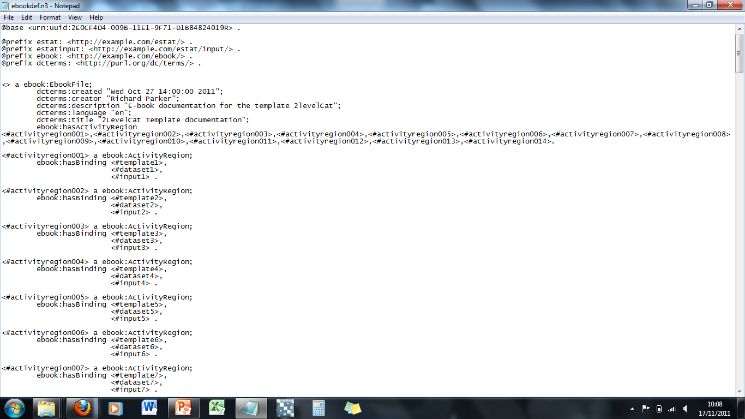
Unique ID
(This bit always stays the same!)
Some general info about the eBook
List all the activity regions you want to include in eBook…
…discrete activity regions ensure only those resources needed in whichever part of an eBook is being currently-viewed are uploaded – more efficient!
Assign unique binding names (perhaps to e.g. the same template) to avoid naming confusion during eBook execution…

Slide 6
…a little further down we’re assigning specific templates & databases to the binding names created above…

Slide 7
…and finally indicating which inputs (as required by the templates) are to be pre-specified, and the value assigned to them…
…importantly: any input not mentioned here is assigned a value by the user (via a prompt) whilst he/she is reading the eBook.

Slide 8
Quick overview: eBook structure 3 main parts…
html file
Specify where you want ‘static’ content (e.g. text or objects) and ‘dynamic’ content (e.g. user input prompts; output from template executions) to appear in the eBook;
specify content of textual ‘static’ information (i.e. type the words you want to appear!); can specify whether you want it to appear alongside (or be replaced by) ‘dynamic’ info, or whether it is to be displayed all the time.

Slide 9
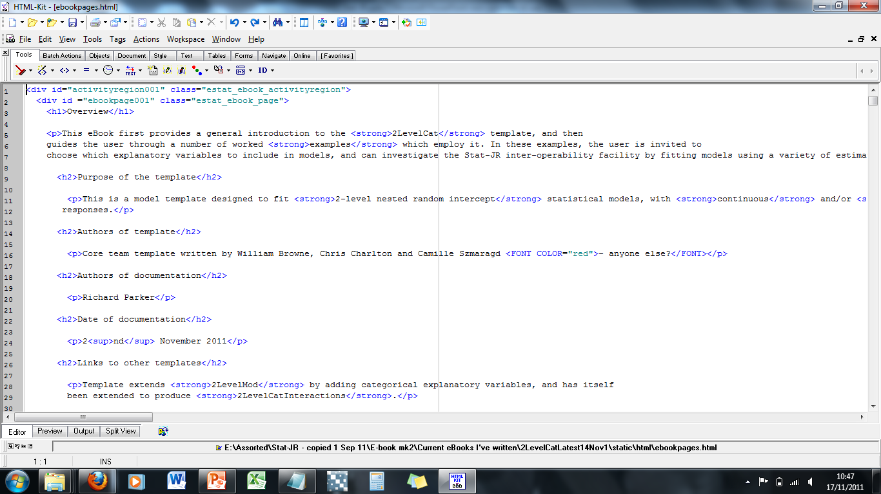
Opening tag indicating which activity region we’re in (and also which page, if want >1)…
…heading levels dictate what appears in navigation tree , and how it’s organised (see next slide)…
…note, can use the usual html mark-up language, although the eBook infrastructure also does a lot of the formatting for you…

Slide 10
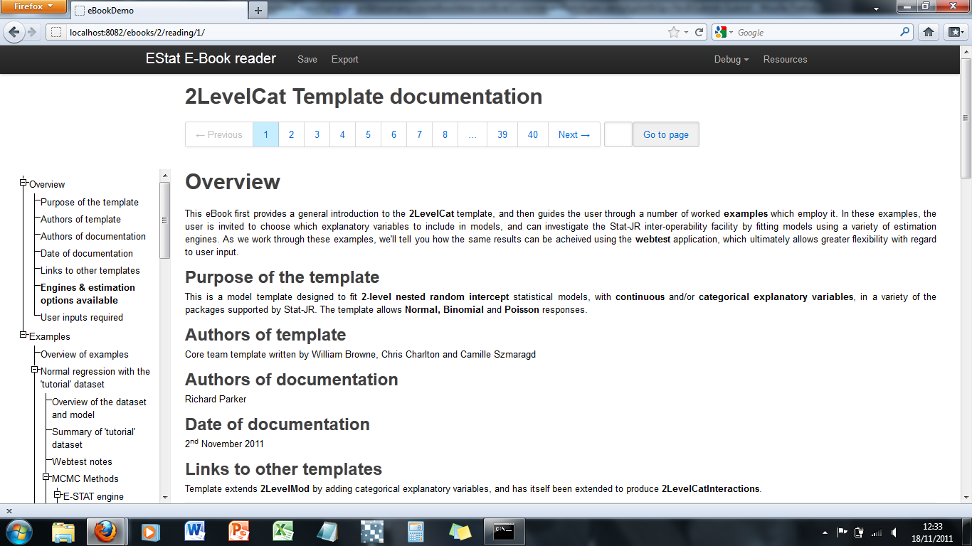
…so, when viewing the eBook, which titles appear in the navigation tree, and how they’re organised, is dictated by the heading levels (<h1>, <h2>, etc)

Slide 11
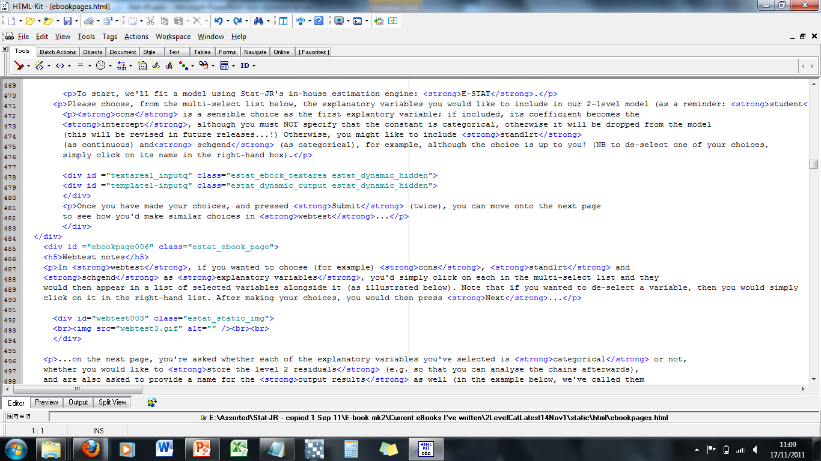
…back to the html file: a little further down we’re indicating that we want the user to have the opportunity to assign values to the template inputs we haven’t pre-specified in the .n3 file here…

Slide 12
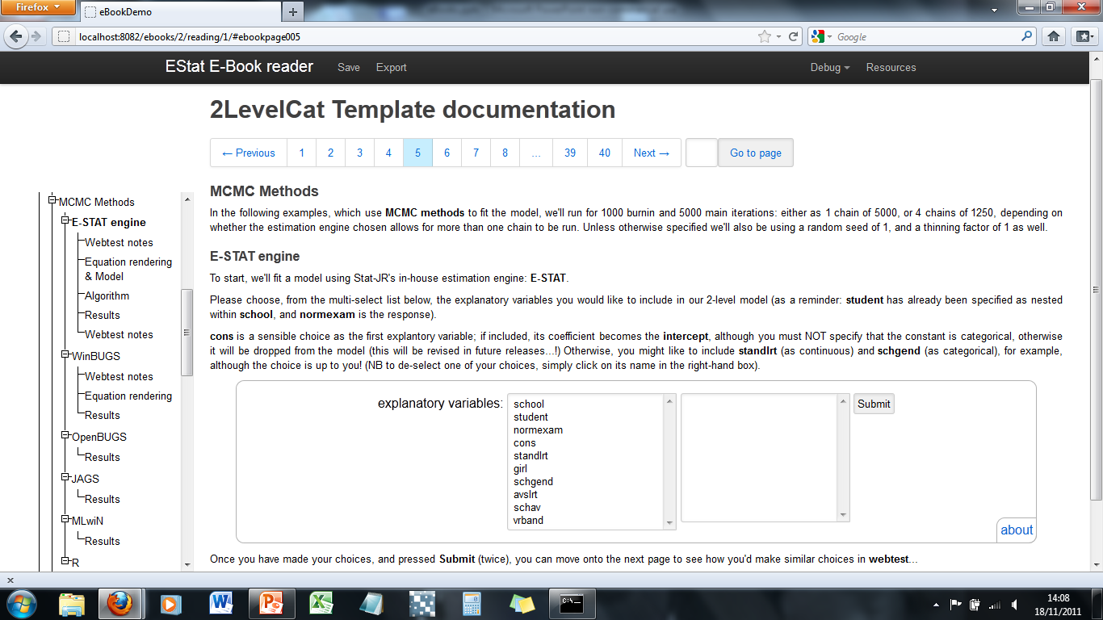
…and this is how it looks in the eBook; if there’s >1 input for the user to specify, then the relevant questions appear sequentially…

Slide 13
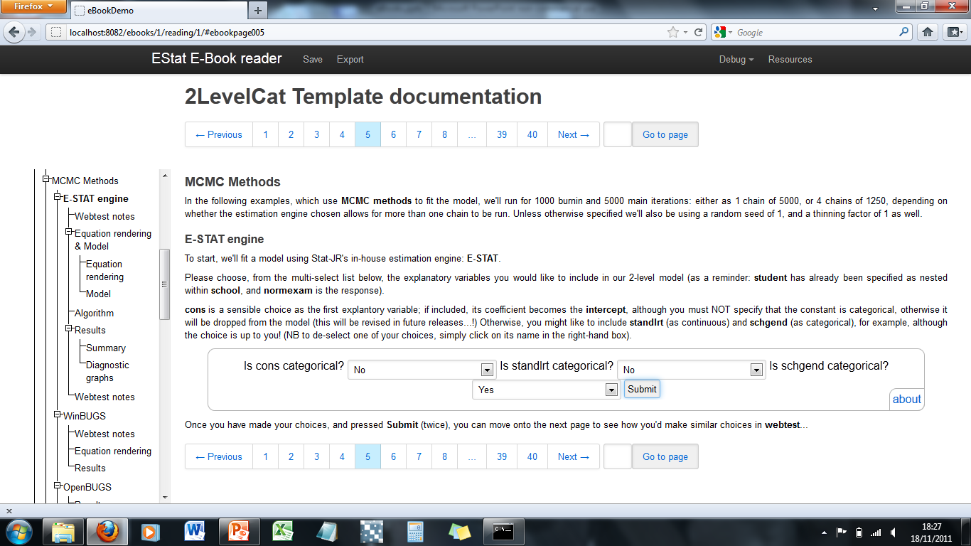
…after the inputs have been completed, the model will run, and as the resulting output becomes available to view in the eBook, the navigation tree changes to reflect this…

Slide 14
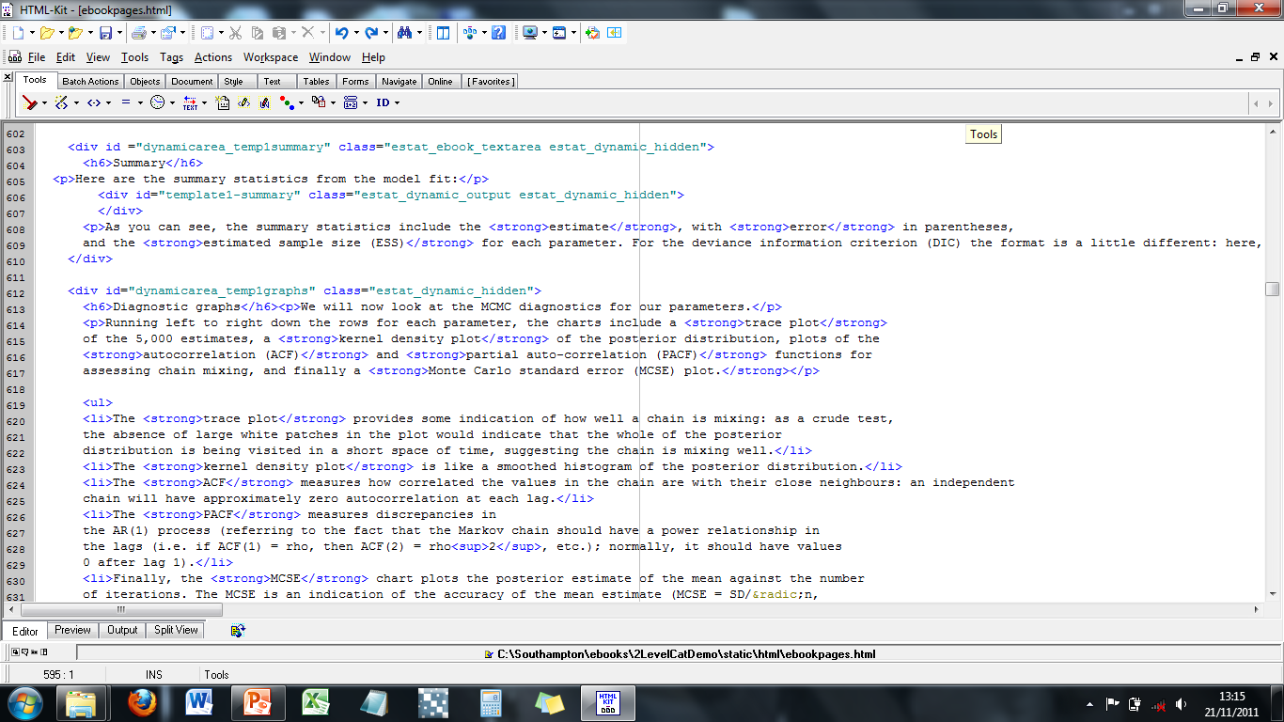
…back to the html file: further down we’re indicating where we want the output of the template execution (in this case results summary) to appear…
…whilst also indicating we want the text enclosed between these tags to appear with the results when they become available…

Slide 15
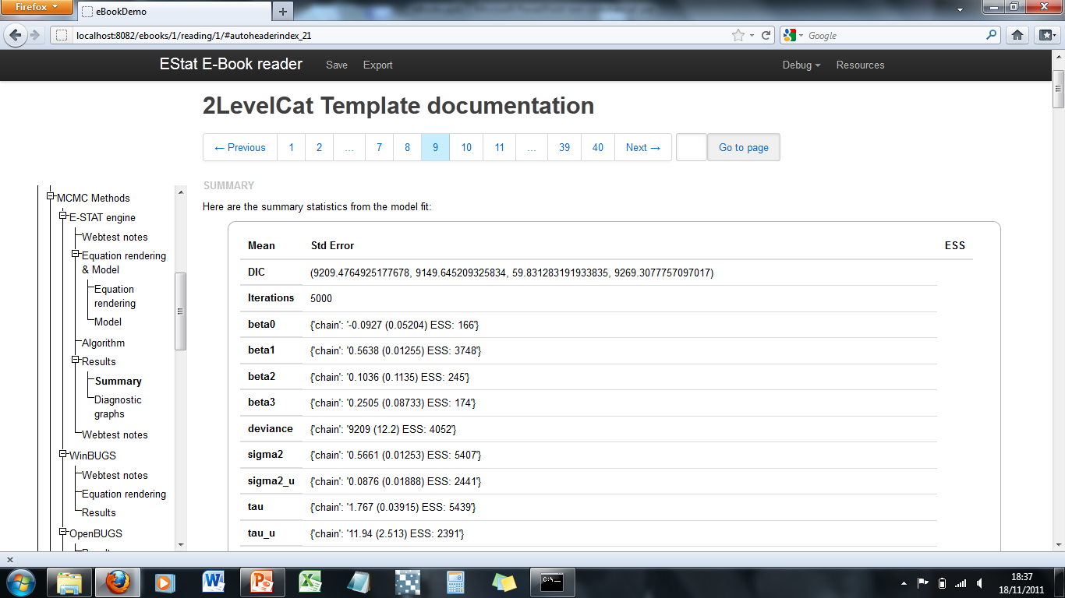
…and if you press the Resources button (or the about button at the bottom of the results summary (dynamic output) box)…
…with some of the text we asked to appear with it too…
…here they are in the eBook…

Slide 16
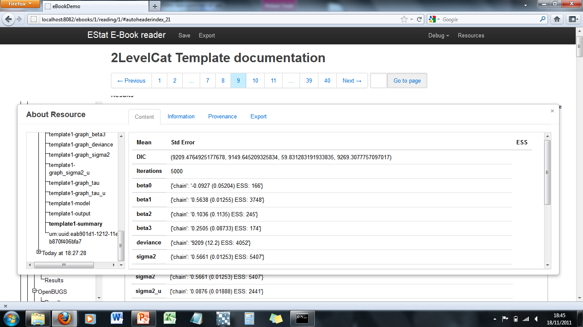
…you can also view all the dynamic output, behind the scenes, organised into a log of template executions (e.g. model runs)

Slide 17
Quick overview: eBook structure 3 main parts…
Other objects such as (non-Stat-JR-derived) pictures, etc.

Slide 18
e.g. this is specifying where we want a picture to appear…
(…and here we’re ending an activity region (and page) and starting the next one…)

Slide 19
Ongoing work…
Sequential / cascading steps: e.g. taking the output from one template execution and using it as the input in second template execution in the same eBook
Conditional text: the text that appears depends on your earlier choices (e.g. engine chosen)
…lots of other tweaks!

Slide 20
eBooks: What might they be used for? (non-exhaustive list!) Data analysis & reporting tools
Record of template executions
E.g. for users fitting a number of models: v useful log of each model’s inputs, and outputs; user could add other textual notes too;
Ebook format: emphasis on record description, organisation and accessibility;
eBook could be shared between users – e.g. to record their additional analyses.
Report-writing
report on data analysis for dissemination;
could remain interactive and/or perhaps rendered in a static format.

Slide 21
eBooks: What might they be used for? Data analysis & reporting tools
Tailored analytical techniques
pre-specifications allow user to ‘cut to the chase’ and/or circumvent software-specific learning curve;
contextual information guides user through (perhaps unfamiliar) models.
Automatic comparison of related models, or same model fitted via different engines
E.g. automatically return results from number of nested models to guide model choice (e.g. random slopes vs not; inclusion of particular explanatory variable vs not)
E.g. fit via different engines: which mixes better? Which takes less time?

Slide 22
eBooks: What might they be used for? Educational tools
Training tools re: statistical concepts / methods;
Introduction to using webtest / various templates;
Introduction to writing eBooks and templates;
Instructive comparison of engines: e.g. taking user through which engine / estimation method might be better under what circumstances; compare pros & cons.
…obviously more ‘static’ (traditional) training tools can do many of these things too, so would really need to exploit eBooks’ capabilities to offer something above & beyond.

Slide 23
eBooks: What might they be used for? Educational tools
An introduction to some of the engines supported by Stat-JR: e.g. R (via script-generation).

