Slide 1

Practical Sensitivity Analysis for Environmental Modeling
Thorsten Wagener
thorsten.wagener@bristol.ac.uk
With Francesca Pianosi
Francesca.pianosi@bristol.ac.uk

Slide 2

My background
Civil engineering with focus on hydrology
  University of Siegen, TU Delft, Imperial College London
  University of Arizona, Penn State, University of Bristol
Interest in system’s methods to characterize and simulate environmental systems
Was asked to leave my first high school informatics course after I scored -1 point in an exam
Don’t give up!

Slide 3




The morning session will have four parts
[1] Introduction to S.A. (Terminology, Use, etc.)
[2] Sensitivity to what?
[3] Visual, Screening and Variance-based Methods
[4] Validation and Robustness of Results

Slide 4

A simulated environment!

Slide 5

The objective is to look inside your model!
Would you trust a doctor who does not use x-ray?
http://www.bytelove.com/images/uploads/Gadgets/linuxgear/x-ray-tux-sticker.jpg

Slide 6
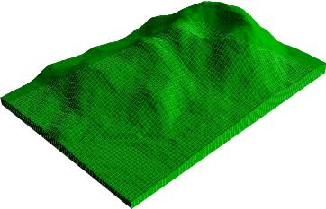

Francesca Pianosi will lead the (applied) afternoon session
We will then focus on applying the theory of the morning to a relatively simple hydrologic model.

Slide 7

[1] Introduction to sensitivity analysis

Slide 8
I will use the following terminology
Factor 1
Model
Output 1
Factor 2
Output 2
…
…
Factor N
Output M
Sensitivity Analysis
The study of how uncertainty in the output of a model can be apportioned to different sources of uncertainty in the model input (factors) (Saltelli et al., 2004).

Slide 9
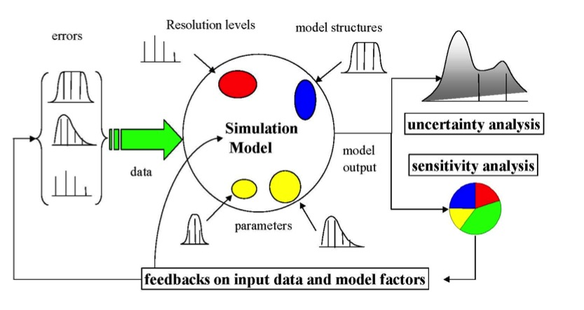
What is the relationship to the material of the previous days?
Output Variance
Output Variance
Decomposition
So what kind of questions might we ask with SA?
Saltelli 2009 http://sensitivity-analysis.jrc.ec.europa.eu

Slide 10
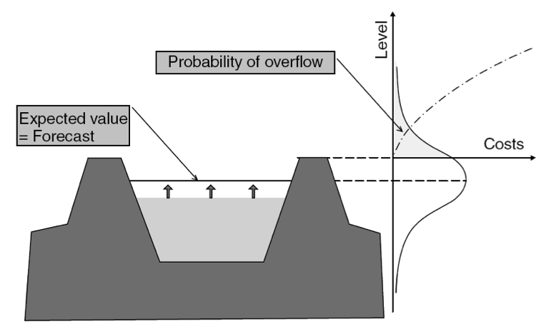
Question 1: What factor contributes most to the output uncertainty?
Example:
Flood forecasting
Todini 2004 Hydrological Processes

Slide 11

Question 2: Which factors do not impact my output?
Example:
Model calibration
“After much whittling down, this is my most parsimonious model structure…”

Slide 12
Sampling needs increase exponentially
No. parameters
Number of samples for consistent grid sampling
1
2
3
4
5
6
100
10,000
1,000,000
100,000,000
10,000,000,000
1,000,000,000,000
Many environmental models, of course, have many more uncertain parameters and inputs and will be subject to the problem of making enough runs to characterize the whole model space.

Slide 13

Question 3: What value does a factor have to take to achieve the desired model output?
For example: Under what conditions do we not reach a global temperature increase of 2°C?

Slide 14
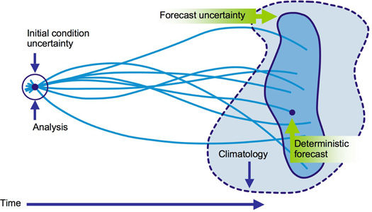
Question 4: How can we reduce the output variance below a chosen threshold?
We might try to fix or reduce the uncertainty in the smallest number of factors to achieve this objective
Notes:
Figure source: http://www.easterbrook.ca/steve/2010/07/tracking-down-the-uncertainties-in-weather-and-climate-prediction/

Slide 15
The 4 possible questions (objectives) in summary:
Factors prioritization (FP) Assume that, in principle, the uncertain input factors can be ‘discovered’, i.e. determined or measured, so as to find their true value. One legitimate question is then “which factor should one try to determine first in order to have the largest expected reduction in the variance of the model output”? This defines the ‘factors prioritization’ setting. Saltelli and Tarantola (2002) have shown that the variance-based main effect provides the answer to the Factor Prioritization setting.
Factors fixing (FF) Another aim of sensitivity analysis is to simplify models. If a model is used systematically in a Monte Carlo framework, so that input uncertainties are systematically propagated into the output, it might be useful to ascertain which input factors can be fixed, anywhere in their range of variation, without sensibly affecting a specific output of interest. This may be useful for simplifying a model in a larger sense, because we may be able then to condense entire sections of our models if all factors entering in a section are non-influential. Saltelli and Tarantola (2002) also showed that the variance-based total effect provides the answer to the Factor Fixing setting. A null total effect is a sufficient condition for an input factor to be irrelevant, and therefore to be fixed.
Factors Mapping (FM) In this case, the analyst is interested to as many information as possible, either global and local, i.e. which values of an input factor (or of group of factors) are responsible for driving the model output in a given region? Which conditions are able to drive a specified model behaviour? In this case, a full array of methods, from local ones, to Monte Carlo Filtering, to model emulators, to variance-based and entropy-based methods can provide useful insights about model properties.
Variance Cutting (VC) In other cases the objective of SA can be the reduction of the output variance to a lower threshold (variance cutting setting) by simultaneously fixing the smallest number of input factors. This setting could be of use when SA is part of a risk assessment study and e.g. when a regulatory authority was to find the width of the impact estimate distribution too wide. Note that the variance cutting and factor prioritization settings may appear to be very similar, as they both aim at reducing the output variance. However, in the case of factor prioritization the scope is to identify the most influent factors one by one, while in the variance cutting setting the objective is to reduce the output variance down to a pre-established level by fixing the smallest subset of factors at once.

Slide 16
In general, there are just a few basic steps in any sensitivity analysis
Sensitivity Analysis is the study of how uncertainty in the output of a model can be apportioned to different sources of uncertainty in the model input (factors) (Saltelli et al., 2004).
How do I sample the factor space?
What output or output-based error metric should I calculate?
What sensitivity metric should I calculate? How do I visualize the result?

Slide 17

[2] sensitivity to what?

Slide 18

There are two major distinctions in how we approach this question. [1]
[1] Analyze the model output directly
In many cases we will not have observations of the variable of interest, especially in relation to extremes
e.g. flash flooding in Africa

Slide 19

We can directly estimate the sensitivity to the simulated output
This approach means that we put all our stock into our model!
Works only if we are rather confident in the realism of our model.
For example, integrated assessment models

Slide 20
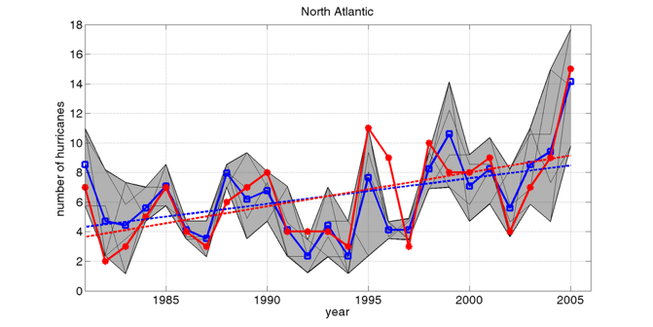
Or [2]. We can do sensitivity analysis in either case, but with different objectives
[2] Analyze some error metric (objective function, likelihood etc.)
If we do have observations, then we can test the model in relation to the data, rather than just in itself
e.g. hurricane occurrence

Slide 21
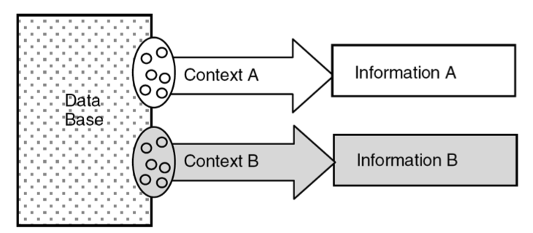
Here we can create a ‘context’ if we have observations of the output of interest
Gupta et al. 2008 Hydrological Processes

Slide 22
In this case we typically estimate some type of (statistical) error metric
y
y_{t}^{sim}(θ) ~ y_{t}^{true} for all t = 1, T
y_{t}^{obs}
e_{t} = y^{obs}_{t} – y_{t}(θ)
e_{t}
y_{t}^{true}
y_{t}^{sim}(θ)
time
E(θ) = { e₁(θ), e₂(θ), e₃(θ), … ,e_{n}(θ) }
0

Slide 23
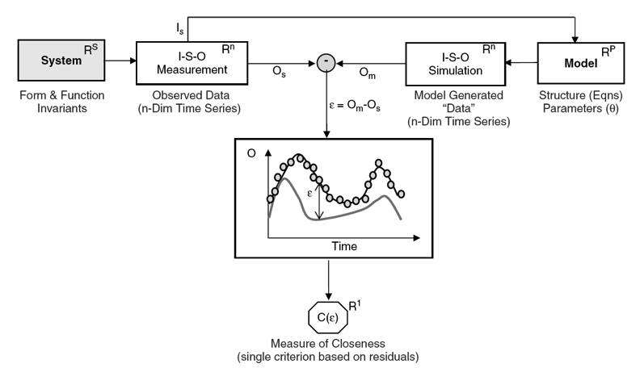
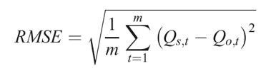
A typical error metric (objective or cost or likelihood function) is the Root Mean Squared Error
e.g.
Gupta et al. 2008 Hydrological Processes

Slide 24
The sensitivity analysis result is very dependent on the metric chosen, e.g.
Mass balance (e.g. bias)
Dynamics (e.g. RMSE)
Peaks over threshold
Periods below threshold
...

Slide 25
Keep in mind that part of the sensitivity analysis has to be a performance analysis
The model sensitivities are more likely to be meaningful if the model shows a good performance!
Performance of your model (i.e. how well it reproduces the data) is a large part of the justification for trusting your model in the first place.
TIP: Assess the performance for all the samples you estimate during your sensitivity analysis (check the histogram).

Slide 26

[3] Visual, screening and variance-based methods

Slide 27
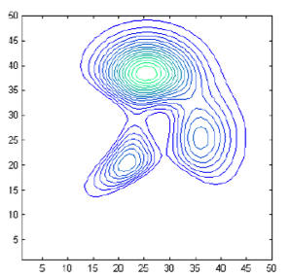


We can distinguish between local and global approaches to sensitivity analysis
[1] Local methods analyze sensitivity around some (often optimal) point in the factor space
[2] Global methods attempt to analyze variability across the full factor space

Slide 28

Local methods require a good ‘baseline’ or ‘nominal point’
Local derivative of output Y with respect to factor X_{i} at fixed point x⁰
A priori or optimized estimate
We will later discuss how looking at multiple starting points can help considerably in making the SA more robust

Slide 29
The simplest strategy (and most widely used) is the One-at-A-Time SA
OAT is a local strategy. The term ‘local’ refers to the fact that all derivatives are taken at a single point, known as ‘baseline’ or ‘nominal value’ point, in the hyperspace of the input factors.
Why modellers like OAT:
  the baseline vector is a safe starting point where the model properties are well known;
  all OAT sensitivities are referred to the same starting point;
  moving one factor at a time means that whatever effect is observed on the output, this is due solely to that factor;
  conversely, a non-zero effect implies influence, i.e. it never detects uninfluential factors as relevant;
  the chances of the model crashing or otherwise giving unacceptable results is minimized, as these are likely to increase with the distance from the baseline. The model has more chances to crash when all its k factors are changed than when just one is. A global SA is by definition a stress testing practice.

Slide 30

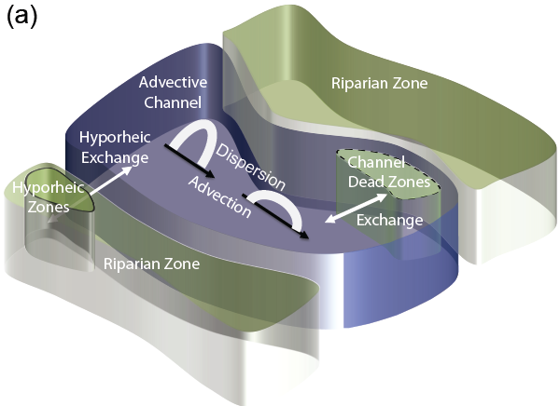
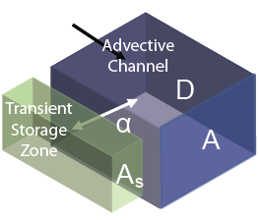
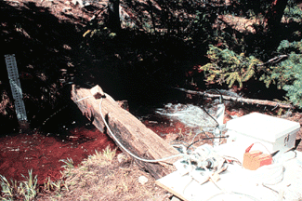
Global methods require a good definition of the space you are going to sample
Stream processes
Transient storage model
Concentration
[mg/L]
t
Concentration
[mg/L]
t
A problem can occur when certain combinations of parameters are infeasible or produce infeasible results (difficult to know before running the model)

Slide 31
What is the impact of your choice of priors?
A good way to test the sensitivity of your result to the choice of prior(s), is to show how the posterior probabilities change under a reasonable variation of assumed priors.
You should also check for the impact of the assumptions made with specific priors, e.g. the boundaries chosen for uniform priors. The best simulations are often located close to the boundaries, which are often rather arbitrary.
[Cowan, 2007, Physics Today]

Slide 32
Further reading regarding priors
Andrew Gelman, John B. Carlin, Hal S. Stern, and Donald B. Rubin. Bayesian Data Analysis, 2nd edition. CRC Press, 2003. ISBN 1-58488-388-X
Cowan, G. 2007. Data analysis: Frequently Bayesian. Physics Today, April.
Edwin T. Jaynes, "Prior Probabilities," IEEE Transactions on Systems Science and Cybernetics, SSC-4, 227-241, Sept. 1968. Reprinted in Roger D. Rosenkrantz, Compiler, E. T. Jaynes: Papers on Probability, Statistics and Statistical Physics. Dordrecht, Holland: Reidel Publishing Company, pp. 116-130, 1983. ISBN 90-277-1448-7

Slide 33
[3.1] GRAPHICAL methods
Output Plots
Scatter Plots
Regional Sensitivity Analysis Plots

Slide 34
A pitch for looking at your results!
Graphical methods provide representations of sensitivity in the form of graphs, charts, or surfaces
Graphical methods are typically not the full solution, but rather in support of a more detailed analysis
Often the results produced for another (not visual) method can easily be visualized as well (hence little extra work)

Slide 35
Example model: Nash Cascade
P
Parameters:
N – Number of linear reservoirs
K – Time constant of reservoirs
K
X₁
Q₁
K
X₂
Q₂
K
X₃
Q₃
and so forth…

Slide 36
Nash Cascade – Effect of perturbation of N from 1 to 9
N=1
K=0.25
N=2
N=9

Slide 37
Nash Cascade – Effect of perturbation of K from 0.1 to 0.9
N=2
K=0.25
K=0.20
K=0.05

Slide 38
Scatter plots (factor vs output-metric)

Slide 39
Scatter plots (factor vs factor)
RMSE = 13.1
RMSE = 3.37

Slide 40

Why should we use simple graphs when we can compute stuff so easily?

Slide 41
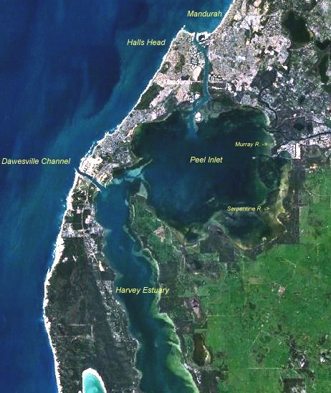
Under what conditions will algae grow in an Australian lake?
REGIONAL SENITIVITY ANALYSIS was first used by George Hornberger, Bob Spear and Peter Young (HSY) in the late 1970s in assessing a model of eutrophication and algal growth in the Peel Inlet near to Perth in Western Australia (Hornberger and Spear, 1980) and rivers in the UK (Whitehead and Young, 1979).

Slide 42



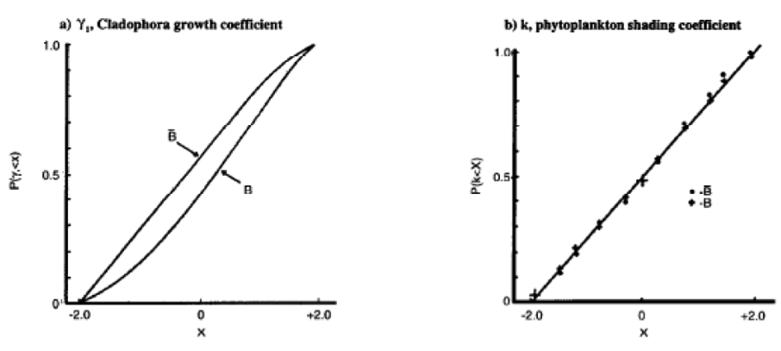

Regional Sensitivity
Analysis (RSA)

Slide 43
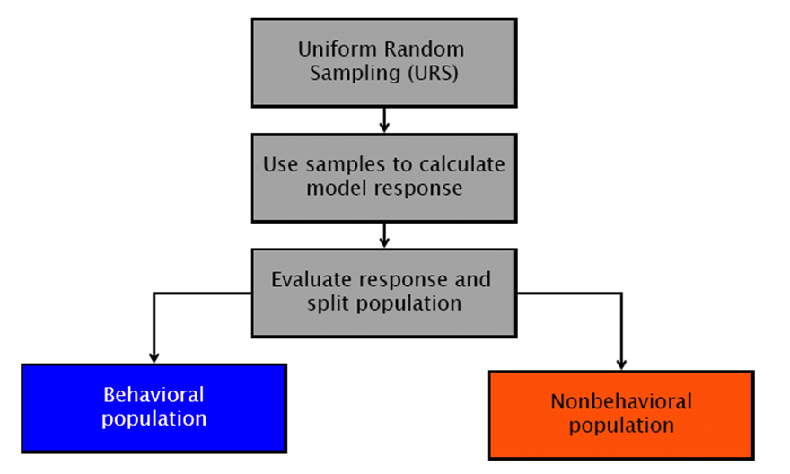
The main idea is to break up the population into behavioral and non-behavioral parameters
θ2
θ2
θ1
θ1

Slide 44
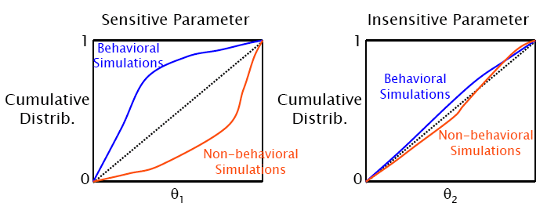
The cumulative distributions then tell us about possible preferential parameter values
The approach is surprisingly robust even for small sample sizes

Slide 45
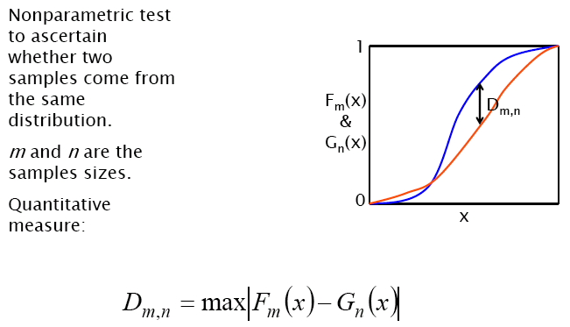
We can use a Kolmogorov-Smirnov test to assess the statistical significance of the difference

Slide 46
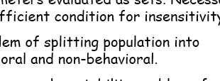
The approach has some significant drawbacks though
A
B
C
It is most useful in combination with other strategies to assess sensitivity

Slide 47
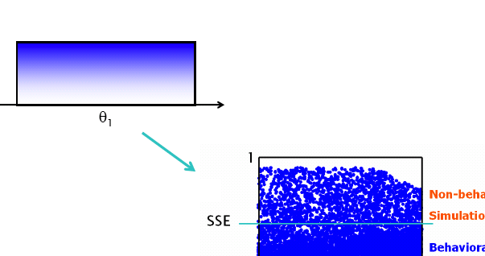
One problem is the need to distinguish behavioral and non-behavioral sets
B

Slide 48
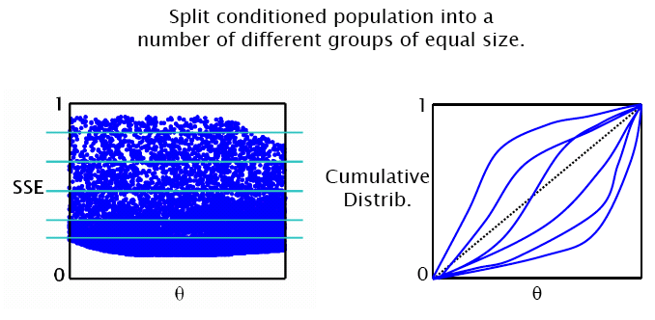
We can eliminate this choice, but turn it into a purely visual approach
B
[Freer et al. 1996, Water Resources Research]
[Wagener et al. 2001, Hydrology and Earth System Sciences]

Slide 49
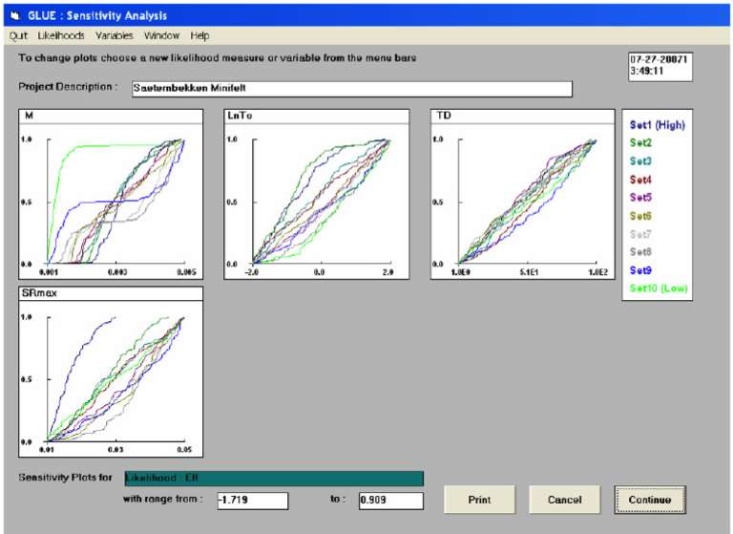
This is an example application from the GLUE package by Beven

Slide 50
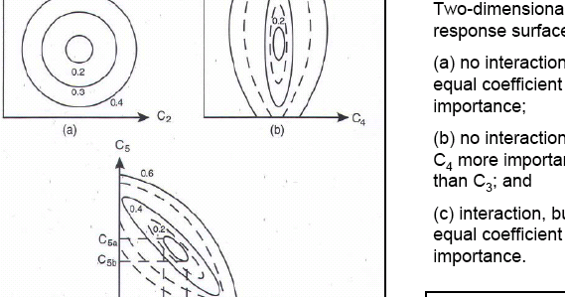
Interactions might lead to straight lines in RSA
A

Slide 51
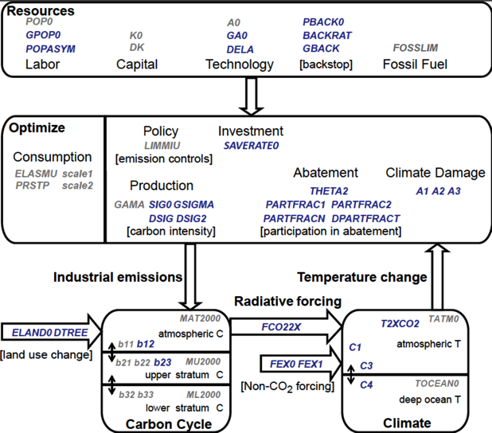
Example: Integrated assessment model of global climate change impacts (DICE)

Slide 52
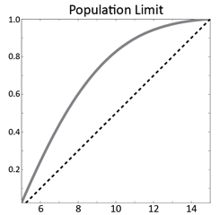
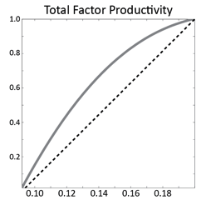
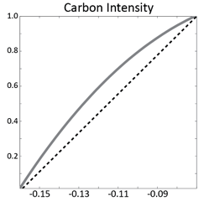
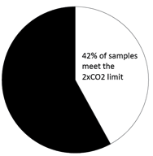
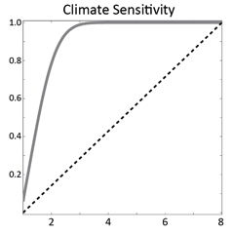
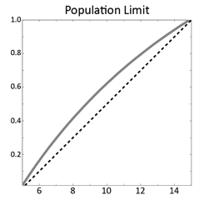
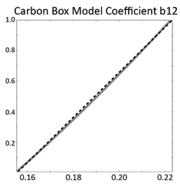
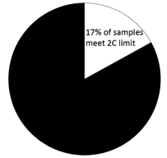
Example: Regional Sensitivity Analysis (RSA) of model ensemble predictions
2xCO2
2C

Slide 53

[3.2] Screening methods
Method of Morris

Slide 54

What if we have a very large number of parameters?
e.g. large scale groundwater pollution model
We’d like to reduce the number of parameters in a first step, so that we can then assess the key parameters more thoroughly

Slide 55
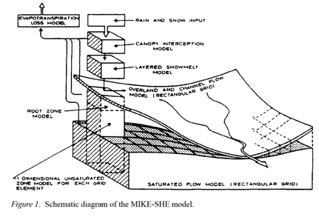
In such cases we can applied what is called a ‘screening method’
Screening methods are preliminary numerical experiments whose purpose is to isolate the most important factors from amongst a large number that may affect a particular model response. By using screening methods, factors can be ranked in order of their importance. However, the percentage of the output variation that each factor is accounting for cannot be quantified.
[Pappenberger and Vandenberghe, 2007. Sensitivity analysis, guidance manual. EU Harmoni-CA Project.]
Notes:
Picture source: http://www.springerlink.com/content/q172m320456w5484/fulltext.pdf

Slide 56
We have earlier discussed OAT, which can easily be improved
A good OAT would be one where, after having moved of one step in one direction, say along X₁, one would straightway move of another step along X₂ and so on till all factors up to X_{k} have been moved of one step each.
This is the basis for elementary effects methods, a popular method of this type is the Method of Morris

Slide 57
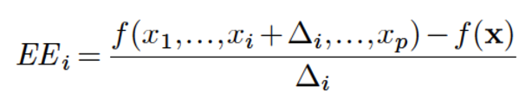
A popular strategy to implement this is the Method of Morris
Derives measures of global sensitivity from a set of local derivatives, or elementary effects (EE)
Each factor x_{i} is perturbed along a grid of size Δ_{i} to create a trajectory through the factor space, where f(x) is the baseline
Each trajectory yields one estimate of the elementary effect for each factor, i.e. , the ratio of the change in model output to the change in that parameter

Slide 58
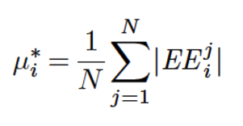
The computational cost is r(k+1) model runs, where k is the no. of parameters and r=4 to 10
We repeat this for N trajectories in the parameter space to avoid the dependence on a baseline
We can then estimate the mean elementary effects μ (first order effects) and their standard deviation σ (interactions)
Campalongo et al. (2007, EM&S) suggested calculating the absolute values of the mean
[Herman et al. 2013, HESS]

Slide 59
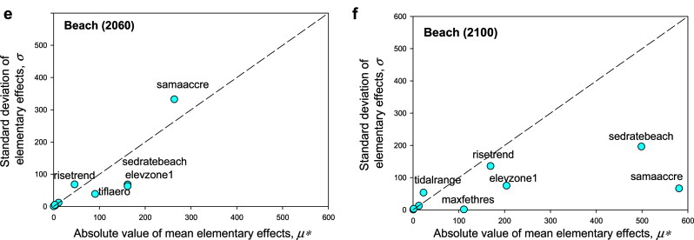
The result provides and indication of factor importance and interactions
[Chu-Agor et al. 2011, EM&S]
Notes:
Figure Source: http://www.sciencedirect.com/science/article/pii/S136481521000321X

Slide 60
Advantages and Disadvantages
Screening procedures do not give any quantitative information about the sensitivity, so they are very useful as a first screening when the number of parameters is too high to perform a quantitative analysis. The low computational cost is one of the main advantages of the screening methods.
Key References
Saltelli, A., Ratto, M., Andres, T., Campolongo, F., Cariboni, J., Gatelli, D., Saisana, M., and Tarantola, S., 2007. Global sensitivity analysis. Gauging the worth of scientific models. John Wiley & Sons. In press.
Morris, M. D., 1991 Factorial sampling plans for preliminary computational experiments, Technometrics, 33, 161–174
Campolongo, F., Cariboni, J. and Saltelli, A., 2007. An effective screening design for sensitivity analysis of large models. Environmental Modelling and Software 22: 1509-1518.

Slide 61
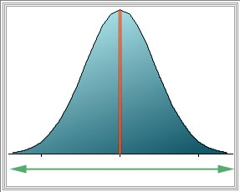
[3.3] Variance-based methods
Sobol’s Method

Slide 62
Variance-based methods quantify sensitivity by decomposing the variance of model outputs into factors related components
In particular, the variance is decomposed into main effects (or first-order effects) and interaction effects. The main effect of a parameter quantifies the portion of the variance of the model output which is explained by that parameter, by allowing all other parameters to be varied at the same time.
The total effect of a parameter measures the residual variance of the model output that remains by removing the portion explained by all other parameters, i.e. quantifies the variance (i.e. the uncertainty) in the model output that would be left by fixing any other factor to its ‘true’, albeit unknown, value.
[Pappenberger and Vandenberghe, 2007]

Slide 63

The steps in this type of approach are:
Sampling
of parameter space
Model evaluation
against sampled parameter sets
Compute sensitivity indices
Latin-hypercube sampling
Sobol’s sequences
...
main effects
interaction effects
total effect

Slide 64
A variance-based approach is called FAST (and extended versions of it)
FAST (Fourier Amplitude Sensitivity Test) is a methodology which allows to estimate the entire set of main effect sensitivities by Fourier transformation (Koda et al., 1979; McRae et al., 1982), using a single sample of size N.
Extensions of the FAST method are described in Saltelli et al. (1999) and Tarantola et al. (2006). In classic FAST only the main effect terms are computed. Extended FAST allows the computation of higher order terms, in particular it allows to compute the entire set of main and total effects, at the cost of kN model runs.
FAST decomposes the output variance V(Y) by means of spectral analysis: Where Vi is the amount of variance explained by factor X_{i} and K is the residual.
[Pappenberger and Vandenberghe, 2007]

Slide 65
Sobol’ is becoming a very popular strategy in environmental modeling
The Sobol’ method is a Monte Carlo procedure that allows to compute any term of the variance decomposition, each at the cost of N model runs (Sobol’, 1993).
Following Saltelli (2002), the cost of estimating the entire set of main and total effects is of (2+k)N model evaluations, which roughly halves the computational cost with respect to the original Sobol’ algorithm.
[Pappenberger and Vandenberghe, 2007]

Slide 66
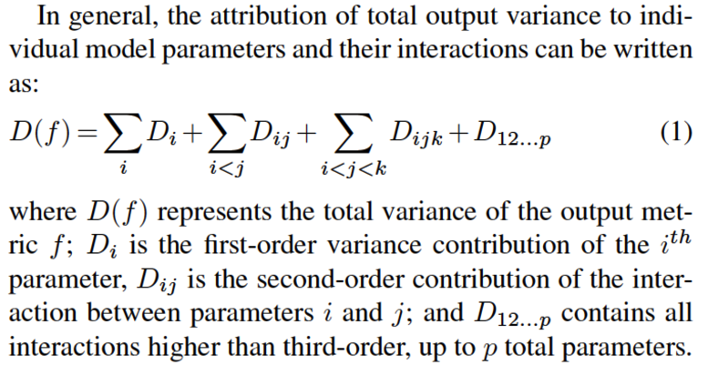
Sobol’ attributes the the variance in the model output as follows …

Slide 67
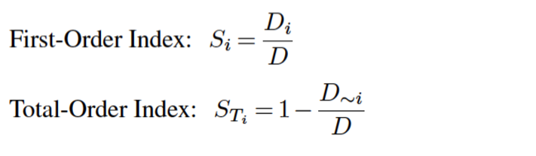
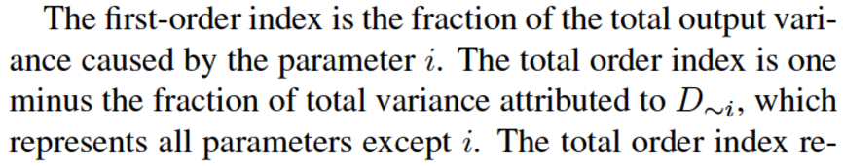
The first-order and total sensitivity indices are defines as …

Slide 68
Interpretation of the sensitivity indices
The main (or first-order) effect (S_{i}) measures the contribution to the output variance from varying the i-the factor alone (but averaged over variations in other factors)
(i) the higher the value of Si, the higher the influence of the i-th factor on the output
(i) if S_{i} = 0, then the i-th parameter has no direct influence on the output (but it might still have some in interaction with other parameters!)
(iii) the sum of all S_{i} is always lower or equal to 1. If it is equal to 1, then there are no interactions between the parameters (“additive” model)
The total effect (S_{Ti}) measures the total contribution to the output variance of the i-th factor, including its direct effect and interactions with other factors
(i) S_{Ti} must be higher or equal to S_{i}. If it is equal, then the parameter has no interactions with the other parameters
(ii) if S_{Ti} = 0, the i-th parameter has no influence (neither direct or indirect) on the model output
(ii) the sum of all S_{Ti} is always higher or equal to 1. If it is equal to 1, then there are no interactions between the parameters
[Pappenberger and Vandenberghe, 2007]

Slide 69
+ & -
Advantages
Extremely robust, they work with any type of discontinuous (even randomised) mapping between input factors and the output. Sobol’ estimator is unbiased. They do not rely on any hypothesis about the smoothness of the mapping. The only key assumption is that variance (i.e. the second moment) is an adequate measure for quantifying the uncertainty of the model output.
Computing main effects and total effects for each factor, while still being far from a full factors mapping, gives a fairly instructive description of the system. Moreover, they provide unambiguous and clear answers to well specified sensitivity settings (prioritisation and fixing).
Disadvantages
The computational cost is relatively high, which implies that these methods cannot be applied to computationally expensive models. They do not provide any mapping, i.e. they decompose the output uncertainty but they do not provide information about, e.g., the input factors responsible for producing Y values in specified regions, such as extreme high/low or any behavioural classification.
[Pappenberger and Vandenberghe, 2007]

Slide 70
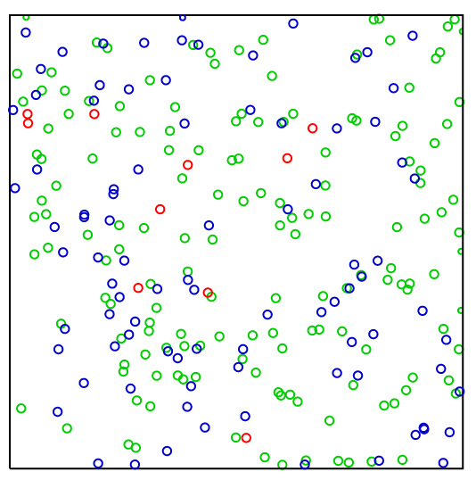
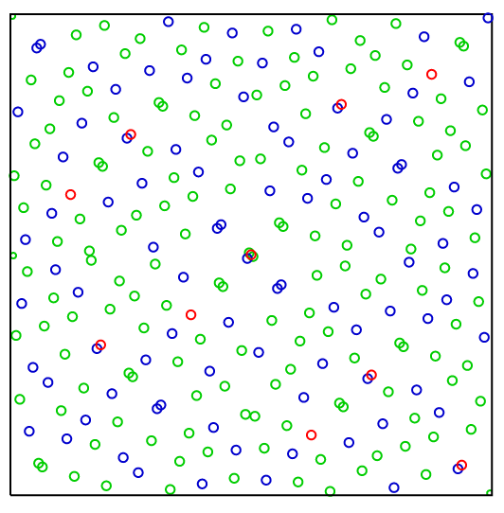
Sobol’ sequences of quasi-random points sample spaces very evenly
256 points from a pseudorandom number source (left); compared with the first 256 points from the 2,3 Sobol sequence (right). The Sobol sequence covers the space more evenly (red=1,..,10, blue=11,..,100, green=101,..,256)
Notes:
Picture Source: Wikipedia

Slide 71

[3.4] Which method should I select?
Notes:
Figure Source: http://therawness.com/why-we-have-more-opportunity-than-our-parents-yet-are-less-happy/too-many-choices-question-marks/

Slide 72
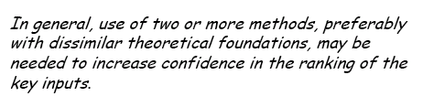
There is not single best strategy for all problems!
[Frey and Patil 2002. Risk Analysis]

Slide 73
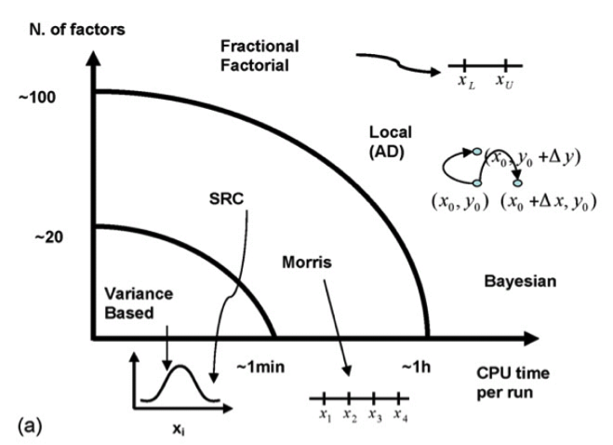
Various techniques available and their use as a function of computational cost of the model and dimensionality of the input space
AD means “automated differentiation”.
[Cariboni et al., 2007. Ecological Modellling]

Slide 74
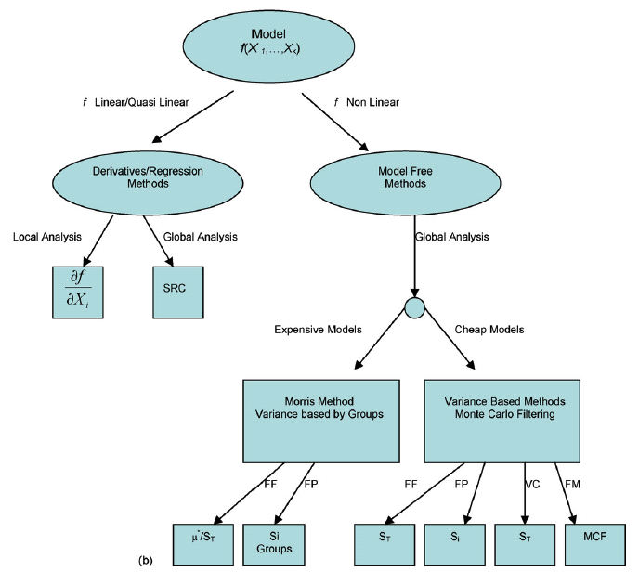
MCF
“Monte Carlo Filtering”
FF
“Factor
Fixing”
FP
“Factor Prioritization”
VC
“Variance Cutting”
FM
“Factor Mapping”
[Cariboni et al., 2007.
Ecological Modellling]
Notes:
Factors prioritization (FP)
Assume that, in principle, the uncertain input factors can be ‘discovered’, i.e. determined or measured, so as to find their true value. One legitimate question is then “which factor should one try to determine first in order to have the largest expected reduction in the variance of the model output”? This defines the ‘factors prioritization’ setting. Saltelli and Tarantola (2002) have shown that the variance-based main effect provides the answer to the Factor Prioritization setting.
Factors fixing (FF)
Another aim of sensitivity analysis is to simplify models. If a model is used systematically in a Monte Carlo framework, so that input uncertainties are systematically propagated into the output, it might be useful to ascertain which input factors can be fixed, anywhere in their range of variation, without sensibly affecting a specific output of interest. This may be useful for simplifying a model in a larger sense, because we may be able then to condense entire sections of our models if all factors entering in a section are non-influential. Saltelli and Tarantola (2002) also showed that the variance-based total effect provides the answer to the Factor Fixing setting. A null total effect is a sufficient condition for an input factor to be irrelevant, and therefore to be fixed.
Factors Mapping (FM)
In this case, the analyst is interested to as many information as possible, either global and local, i.e. which values of an input factor (or of group of factors) are responsible for driving the model output in a given region? Which conditions are able to drive a specified model behaviour? In this case, a full array of methods, from local ones, to Monte Carlo Filtering, to model emulators, to variance-based and entropy-based methods can provide useful insights about model properties.
Variance Cutting (VC)
In other cases the objective of SA can be the reduction of the output variance to a lower threshold (variance cutting setting) by simultaneously fixing the smallest number of input factors. This setting could be of use when SA is part of a risk assessment study and e.g. when a regulatory authority was to find the width of the impact estimate distribution too wide. Note that the variance cutting and factor prioritization settings may appear to be very similar, as they both aim at reducing the output variance. However, in the case of factor prioritization the scope is to identify the most influent factors one by one, while in the variance cutting setting the objective is to reduce the output variance down to a pre-established level by fixing the smallest subset of factors at once.

Slide 75

[4] Validation and robustness analysis

Slide 76
Andres (1997) suggested a simple strategy to verify that all important factors have been identified
Vary all insensitive factors
Optimal: No correlation
Optimal: Perfect correlation
Vary all sensitive factors
Vary all factors
Vary all factors
Andres 1997 J. Statistical Computing and Simulation

Slide 77
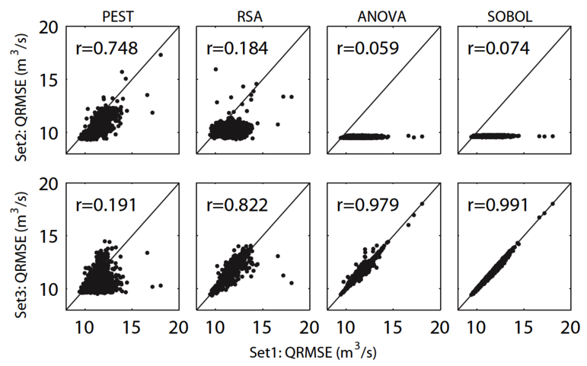
Example: Verification results for 4 different S.A. strategies
Tang et al. 2007 Hydrology and Earth System Sciences
Notes:
Andres, T. H.: Sampling method and sensitivity analysis for large parameter sets, J. Statist. Comput. Simul., 57, 77–110, 1997.
Figure from Tang et al. (2007): Figure 10 illustrates that by plotting Set 2 versus Set 1 as
well as Set 3 versus Set 1 we can test the effectiveness of
the sensitivity analysis methods. As shown for the Sobol’s
method and ANOVA results in Fig. 10a varying parameters
that are correctly classified as “insensitive” in Set 2 should
theoretically yield a zero correlation with the full random
sample of Set 1 (i.e., plot as a horizontal line). If some
parameters are incorrectly classified as insensitive then the
scatter plots show deviations from a horizontal line and increased
correlation coefficients as is the case for the PEST
and RSA results in Fig. 10a. Conversely, if the correct subset
of sensitive parameters is sampled randomly (i.e., Set 3)
than they should be sufficient to capture model output from
the random samples of the full parameter set in Set 1 yielding
a linear trend with an ideal correlation coefficient of 1.
Figure 10b shows that the Sobol’s method yields the highest
correlation between Set 3 and Set 1 followed closely by
ANOVA. PEST yields the worst correlations for the hourly
SPKP1 watershed’s results shown in Fig. 10. More generally,
the plots in Fig. 10 show that this analysis can be quantified
using correlation coefficients.

Slide 78
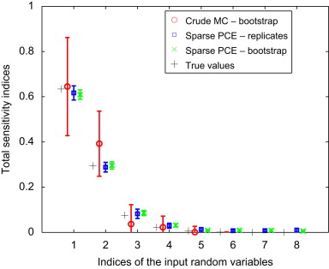
And finally, we can use bootstrapping to assess the robustness of the results
Blatman and Sudret 2010. Reliability Engineering & System Savety
Notes:
Figure Source: http://www.sciencedirect.com/science/article/pii/S0951832010001493

Slide 79
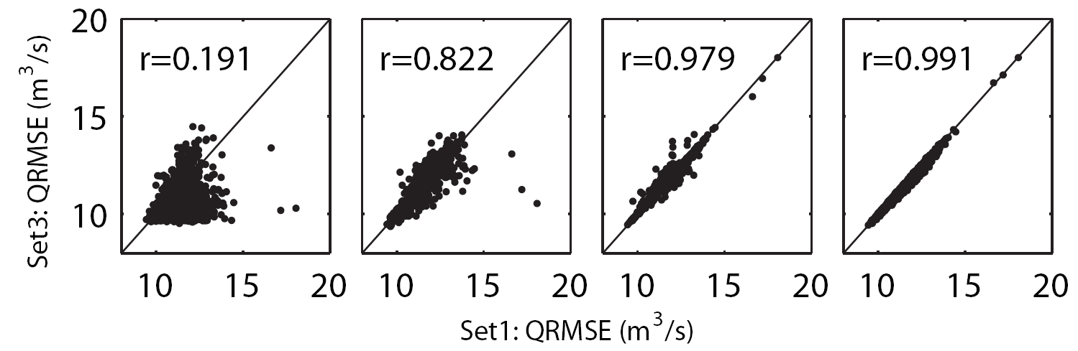
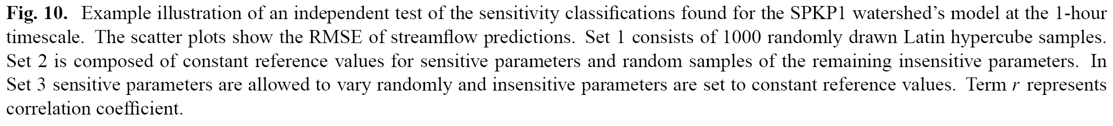
[Tang et al., 2007. HESS]

Slide 80

[5] A brief outlook regarding developments

Slide 81
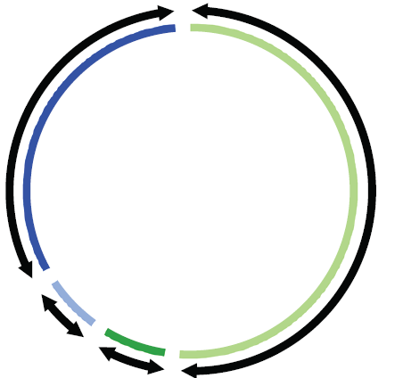
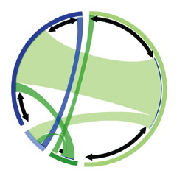

[a] Better visualization of complex spaces and interactions
Total Order
First Order
Interactions
Total effect
=
Identifiability
+
Interactions
A
A_{s}
A
A
A_{s}
A_{s}
A
D
A_{s}
D
α
α
Outside
Inside, white space
Inside, connection
Color corresponds to parameters:
D
A
A_{s}
α
Kelleher et al. In Press. Water Resources Research

Slide 82

[b] Analyzing increasingly complex models (incl. emulation)
Notes:
Figure Source: http://serc.carleton.edu/images/eet/envisioningclimatechange/gcm_grid_graphic.jpg

Slide 83

[c] Understanding space-time variability of controls in environmental systems
Van Werkhoven et al. 2008. Geophysical Research Letters

Slide 84

Having the capability of being wrong gracefully should be a convincing argument for practicing … modelers’ routinely to estimate the uncertainty associated with their predictions!
(Beven, 2000, Wiley)

